Slide 1



Slide 2

Further investment in community
infrastructure by way of
Groundwater Treatment,
Advanced Water Metering,
& Pipe Replacement
are considered to sustain progress, increase
efficiencies and ensure reliability of
service as Norman leads toward tomorrow.

Slide 3
Striking a
Balance:
Revenue Stability/
Resiliency
Economic Development
Conservation/
Water Supply
Affordability

Slide 4
Water Utility
Previous Water Rate Request
Need for Rate Adjustment
Designing Rates
  Residential
  Commercial

Slide 5
Voters approved the last water rate increase in
January 2015.
  Passed with 67% vote
  $47 million in capital projects
  $1.8 million in operational costs
  (Total Package $5.8 million increase)

Slide 6
2015 Water Rate Capital Projects ($M)
2015 2021
Proposed Actual
$31 WTP Phase II $36.2
$ 2 Blending $0
$ 9 New Wells 2 MGD $11
$ 2 Purchase Land $0
$ 3 Water Line Replacements $15.8
$47 TOTAL CAPITAL $63.0

Slide 7
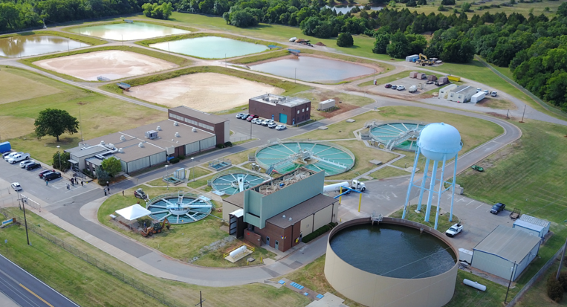
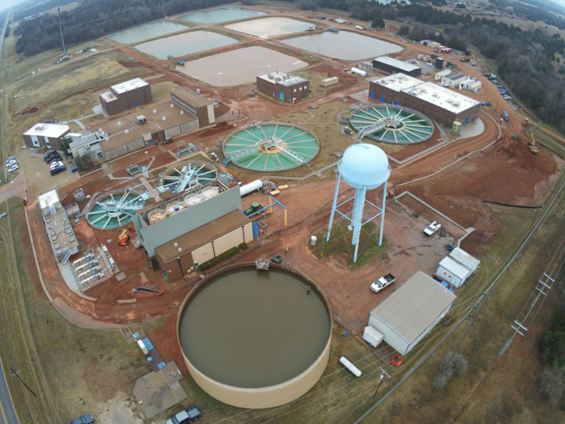
Before Construction (Above)
During Construction (Right)

Slide 8
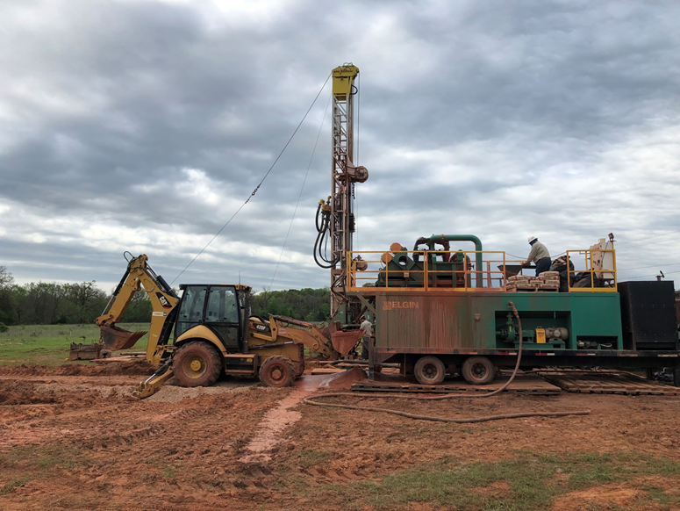
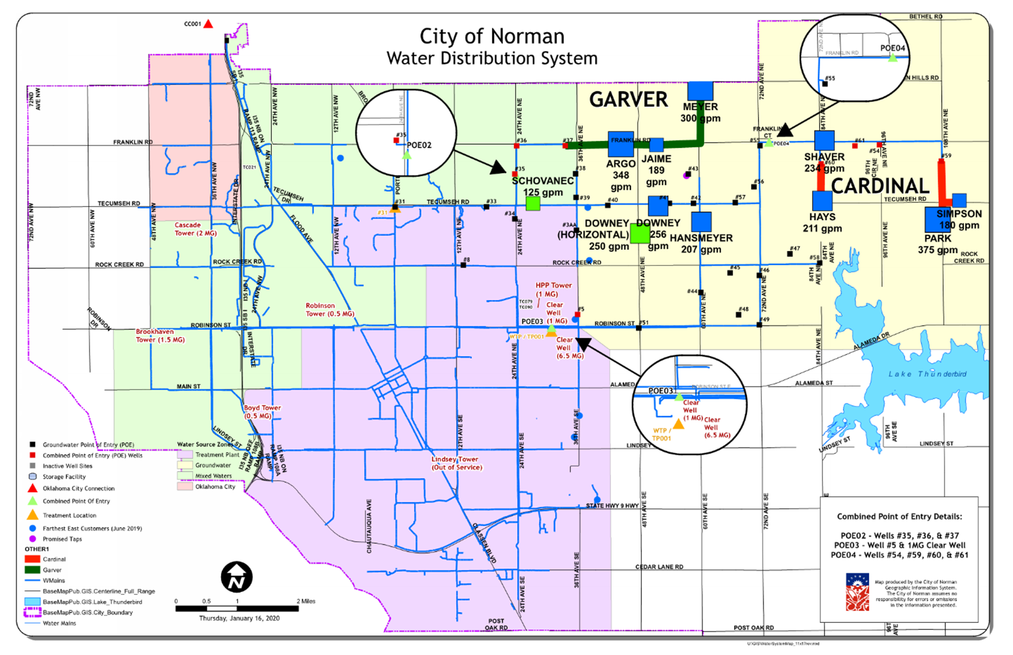
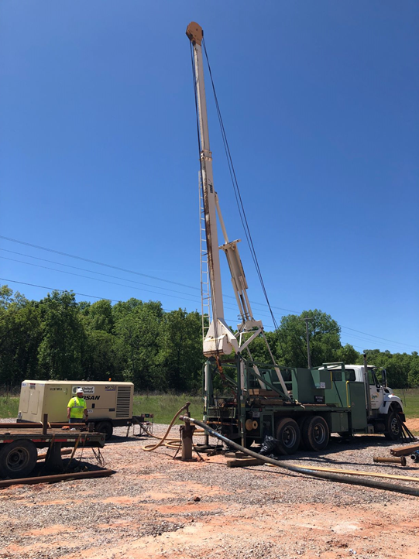
Constructed 9 New Wells
Installed 3.1 Miles of Water Lines to New Wells

Slide 9
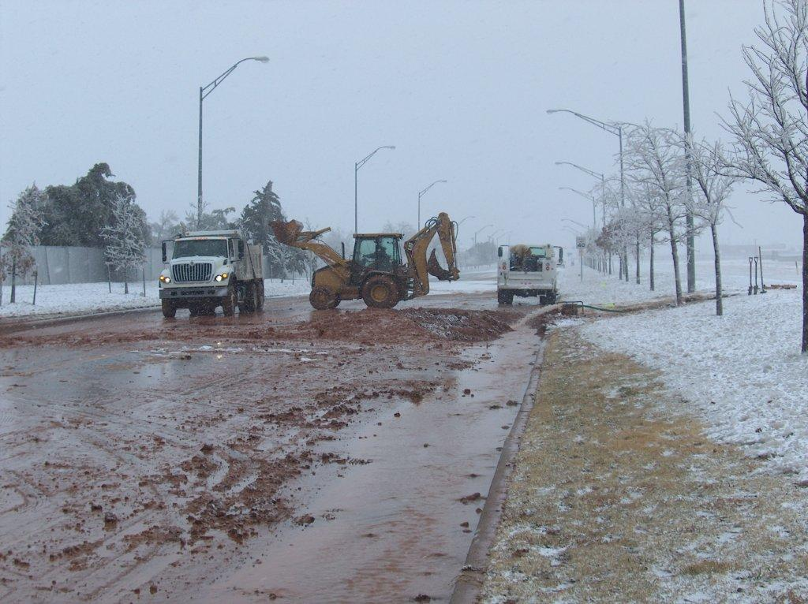
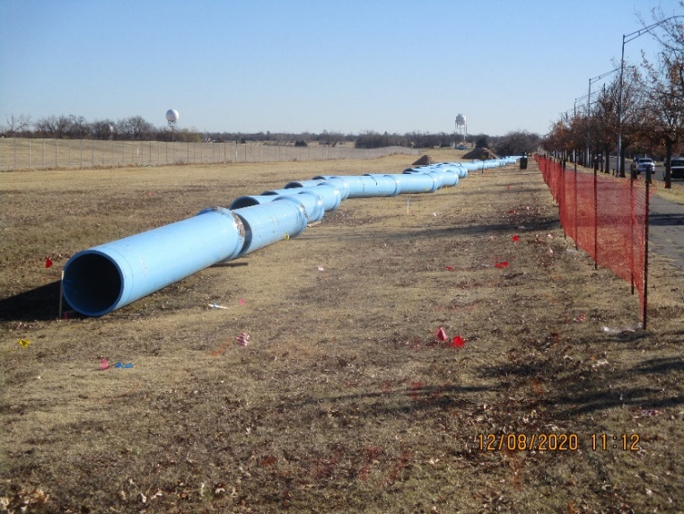
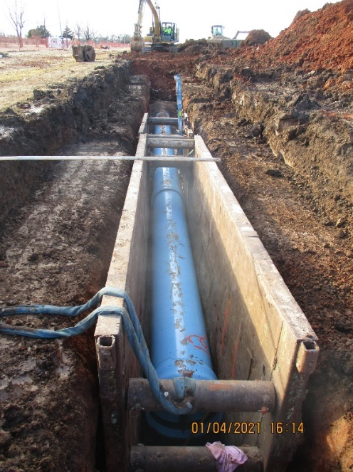
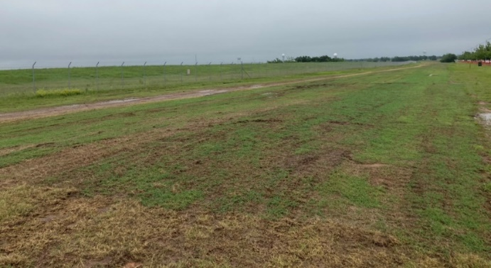
Recent Water Replacements
Robinson Line
30-inch
6.0 miles
$20.6 million
56% complete
Core Norman with Street Projects
$3.2
$5.3
$2.3
$4.5
$3.2
$2.1
$2.0

Slide 10
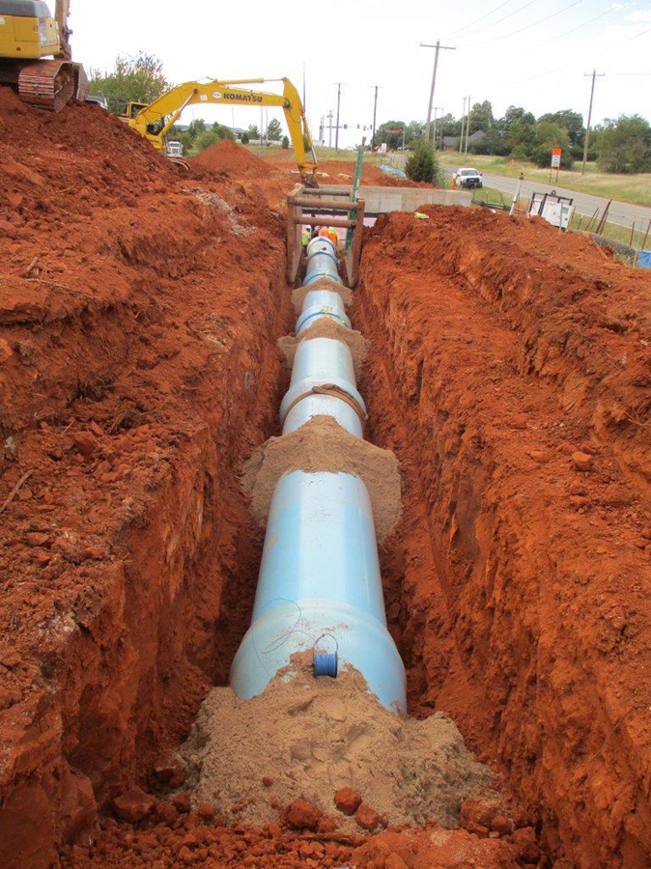
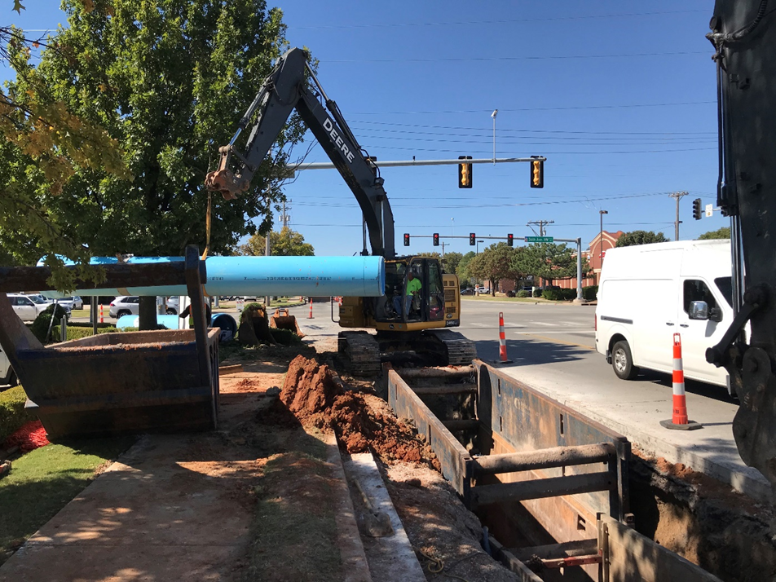
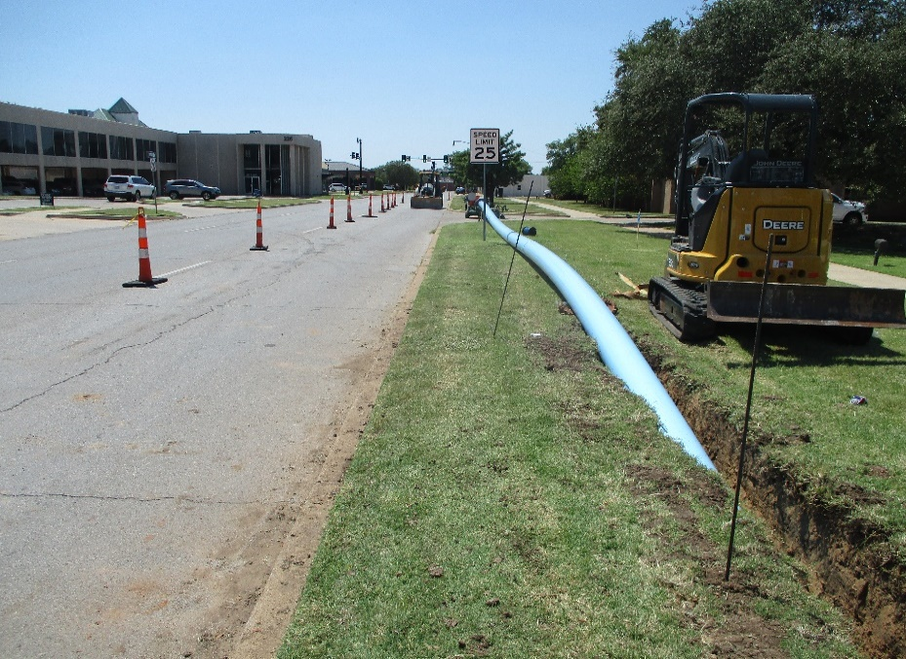
Water Line Replacements

Slide 11
Water Utility
Previous Water Rate Request
Need for Rate Adjustment
Designing Rates
  Residential
  Commercial

Slide 12

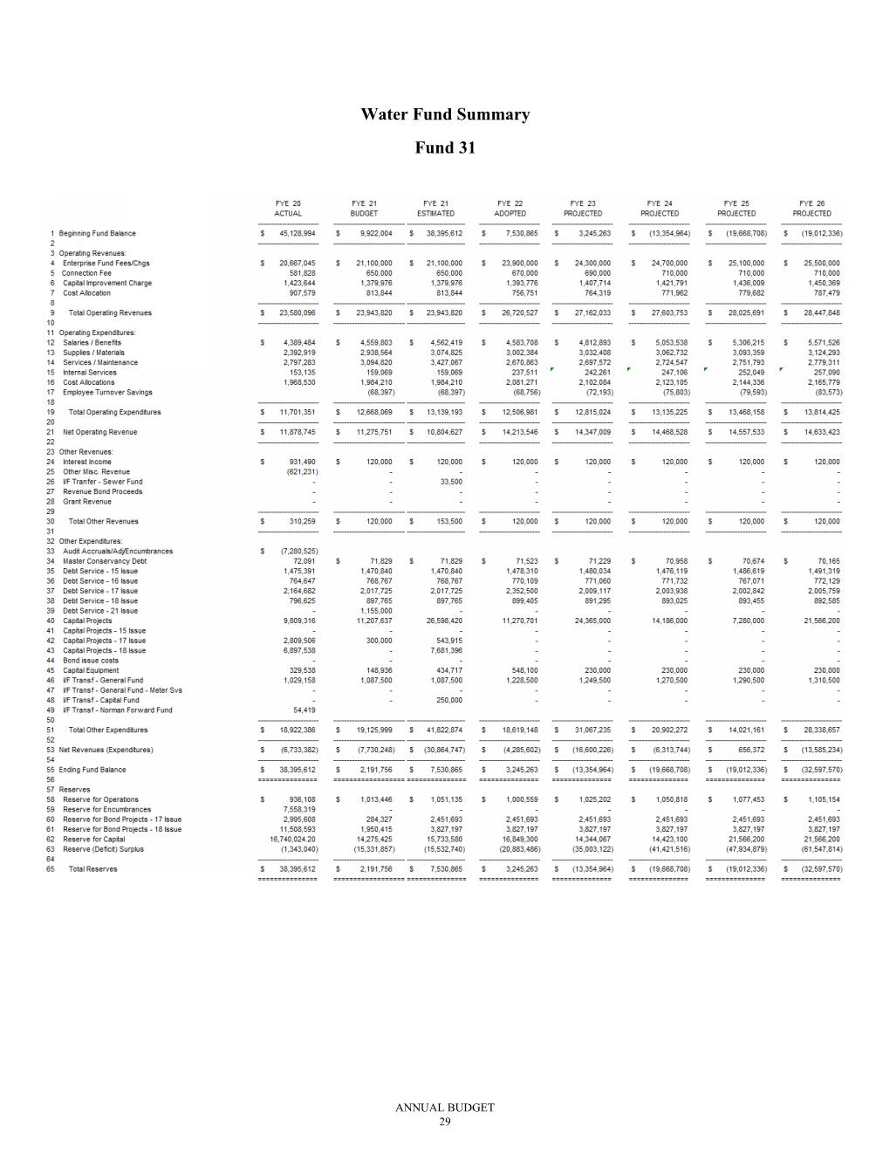

FYE 20 Actual
Total Revenues $23,580,096
Total Op Expenditures -$11,701,351
Loan Payments -$5,273,436
Capital Equip -$ 300,000
Franchise Fee -$1,029,158
Remaining for Capital Projects $5,276,151
Operations Expenses increasing at 3% per year = $300K per year

Slide 13
Operating Cost Increase

Slide 14
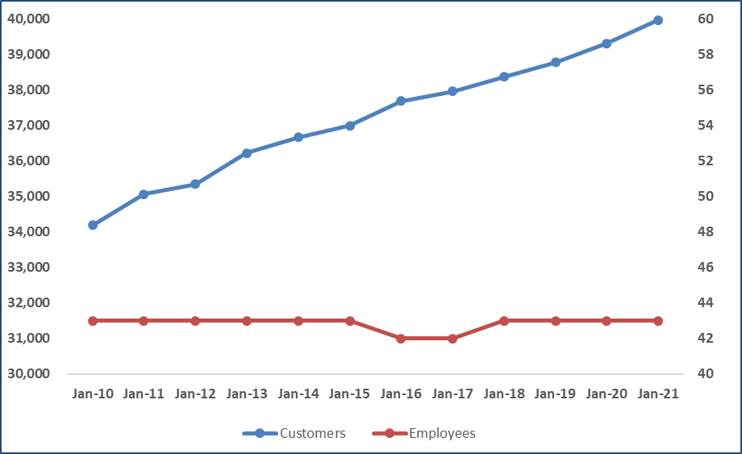
Percent Increase in Number of Customers
18%
Percent Increase in Number of Water Employees
0%

Slide 15
According to water usage data, conservation efforts and education have proven successful.
2020 73.1% used 5K or less
2009 66.4% used 5K or less

Slide 16
Need for Rate Adjustment
Groundwater Disinfection
Advanced Water Metering
Water Line Replacements
Increasing Operating Costs

Slide 17
Groundwater Treatment (disinfection) - $17 million
Centralized location to disinfect to meet ODEQ mandate for chlorine residual
Site will be designed to allow for future treatment
Project includes new facility and new lines in well field to connect to facility

Slide 18
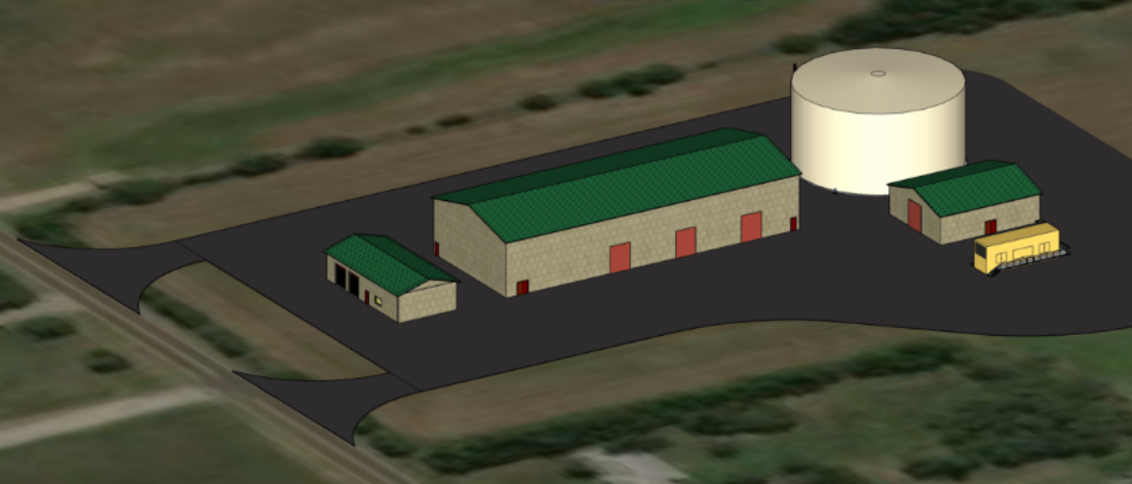
Groundwater Disinfection
Future Area for Treatment as Regulations Reduce Limits

Slide 19
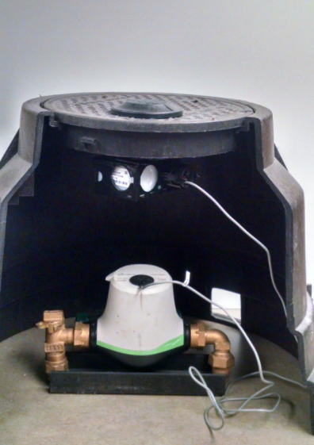
Advanced Water Metering - $15 million
Majority of existing meters warrant replacement
New meters that will be read wirelessly multiple times per day
Project will have numerous benefits:
  Accurate water bills
  Leak detection
  Improved customer service
  Reduced environmental footprint
  Water conservation
  More efficient water system operation
https://www.midwestcityok.org/utility-customer-service

Slide 20
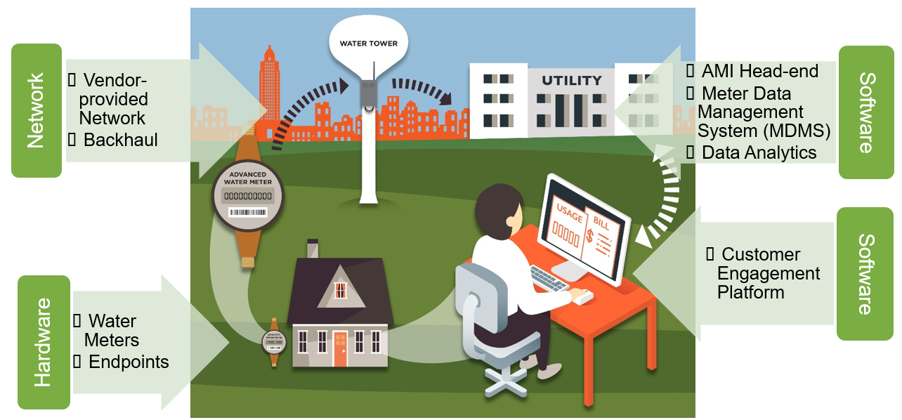
Courtesy of E Source (2021)

Slide 21
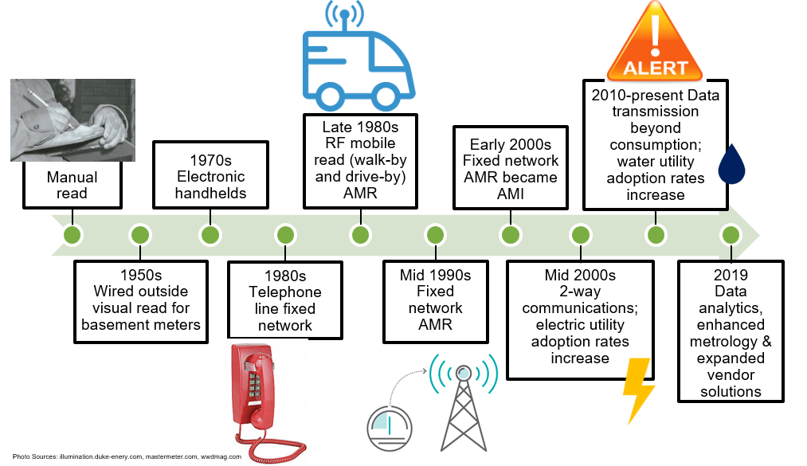
Current Method of Meter Reading
1970s
Advanced Water Metering
2020s
Courtesy of E Source (2021)

Slide 22
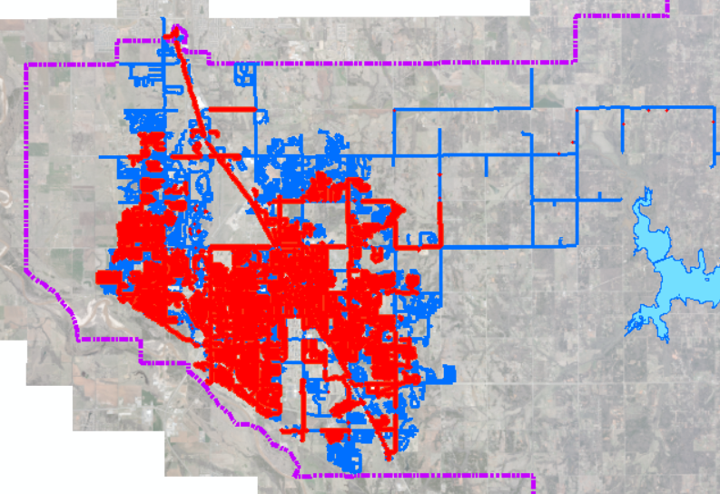
Total Water System
640 miles
Metal Lines
300 miles
Replacement
Cost per Mile
$750,000
Water Line Replacement

Slide 23
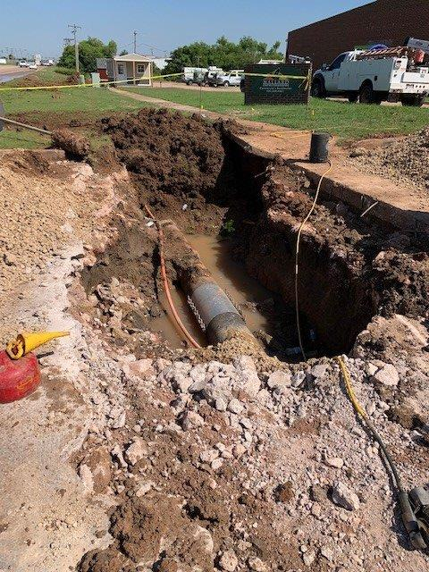
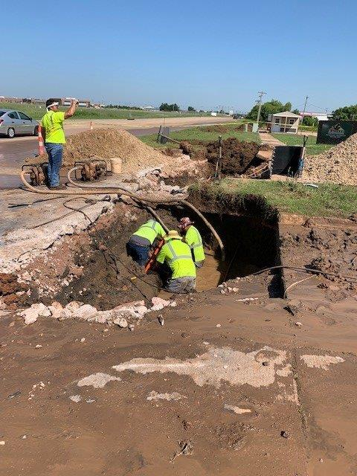
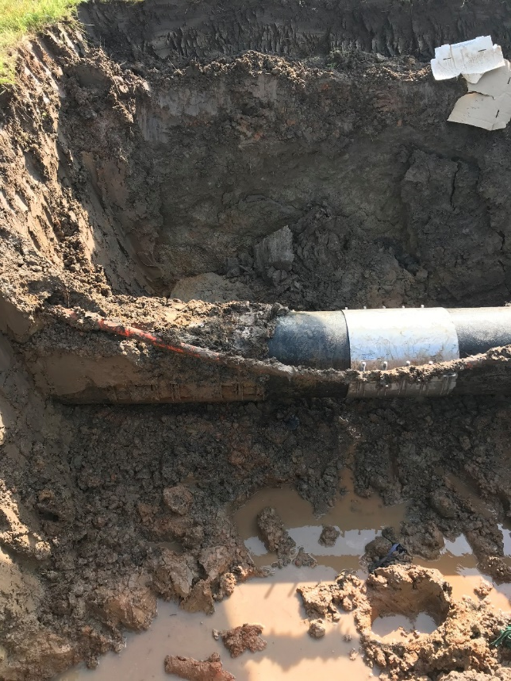
Spent over $30K
Could have replaced 150-200 LF of 12-16 inch line

Slide 24
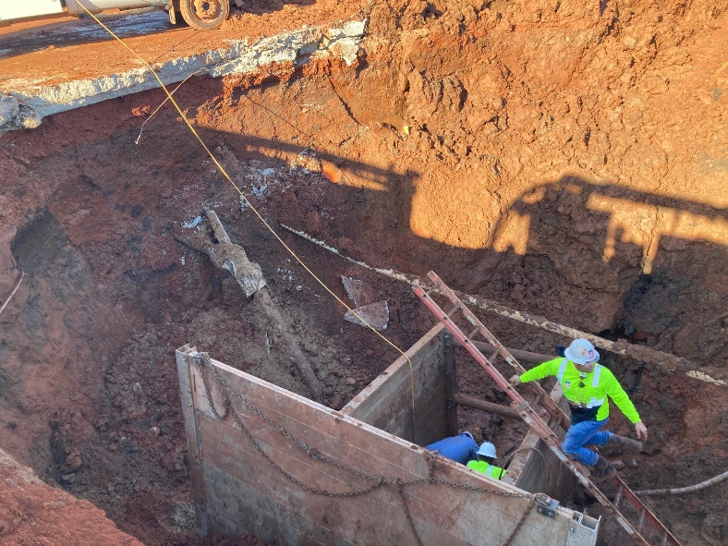
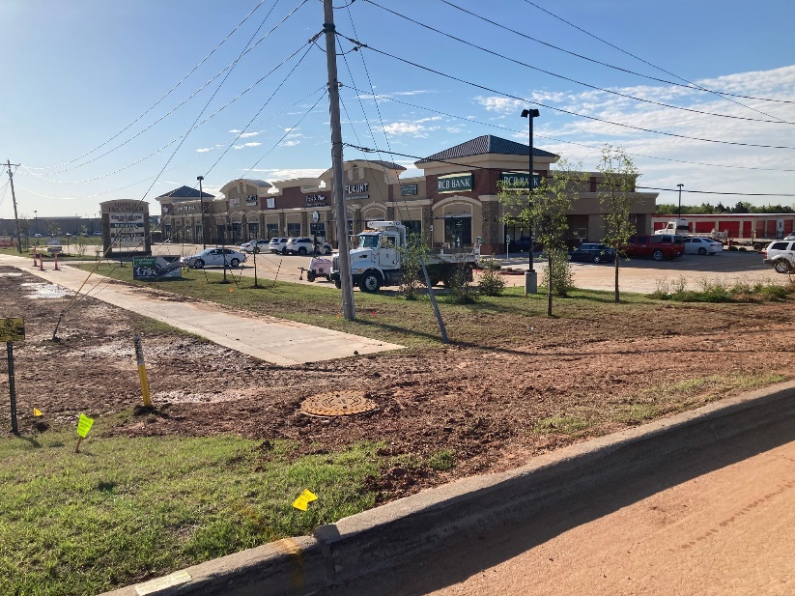
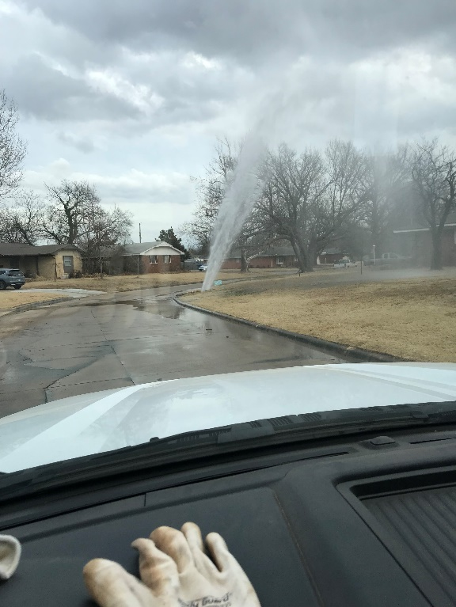
Upcoming Water Replacements
$2.8
$4.0
$5.3
$4.5
$1.0
$1.0

Slide 25
Need for Water Rate Increase
Major Capital Investments
  Groundwater Disinfection (DEQ required) $17M
  AMI (Advanced Metering Infrastructure) $15M
  TOTAL MAJOR CAPITAL PROJECT $32M
Annual Costs for Capital Investments:
  Groundwater Disinfection $17M @3%, 15yrs = $1.4M/year
  AMI $15M @3%, 10yrs $1.8M/year
  TOTAL ANNUAL COSTS $3.2M/year

Slide 26
Need for Water Rate Increase
Water Line Replacements $1.0M
3.5% Increase in Operating Costs $0.5M
ANNUAL COST SUBTOTAL $1.5M
Annual Capital Costs $3.2M
Water Line Replacement Costs $1.0M
3.5% Increase in Operating Costs $0.5M
TOTAL ANNUAL COSTS $4.7M

Slide 27
Water Utility
Previous Water Rate Request
Need for Rate Adjustment
Designing Rates
  Residential
  Commercial

Slide 28
Commercial (FY23)
Residential (FY23)
Description | 2022 Current Rates | Alt. 1 Across the Board | Alt. 2 July Retreat | Alt. 3 Higher Fixed Charge
Monthly Service Charge, $ per bill
All Customers | $7.50 | $9.30 | $9.50 | $11.50
Volume Rates, $ per 1,000 gallons
Block 1 | $3.35 | $4.20 | $4.50 | $4.10
Block 2 | $4.10 | $5.15 | $5.50 | $5.00
Block 3 | $5.20 | $6.50 | $6.50 | $5.90
Block 4 | $6.80 | $8.50 | $8.00 | $7.25
Description | 2022 Current Rates | Alt. 1 Across the Board | Alt. 2 July Retreat | Alt. 3 Higher Fixed Charge
Monthly Service Charge, $ per bill
All Customers | $7.50 | $9.30 | $9.50 | $11.50
Volume Rates, $ per 1,000 gallons
Block 1 | $3.80 | $4.35 | $5.25 | $4.25
Block 2 | $4.20 | $4.80 | $5.75 | $4.70
*The proposed service charges from the residential alternative apply to commercial. The volume rate structure, price ratios, and number of tiers remain the same as the existing rates for all alternatives.

Slide 29
Residential (FY23)
Description | Existing Rates | Proposed Rates
Monthly Service Charge, $ per bill*
All Customers | $7.50 | $9.30
Volume Rates, $ per 1,000 gallons
Block 1 (0-5K) | $3.35 | $4.20
Block 2 (5K-15K) | $4.10 | $5.15
Block 3 (>15K-20K) | $5.20 | $6.50
Block 4 (>20K) | $6.80 | $8.50
*Includes Capital Improvement Charge (CIC) of $1.50

Slide 30
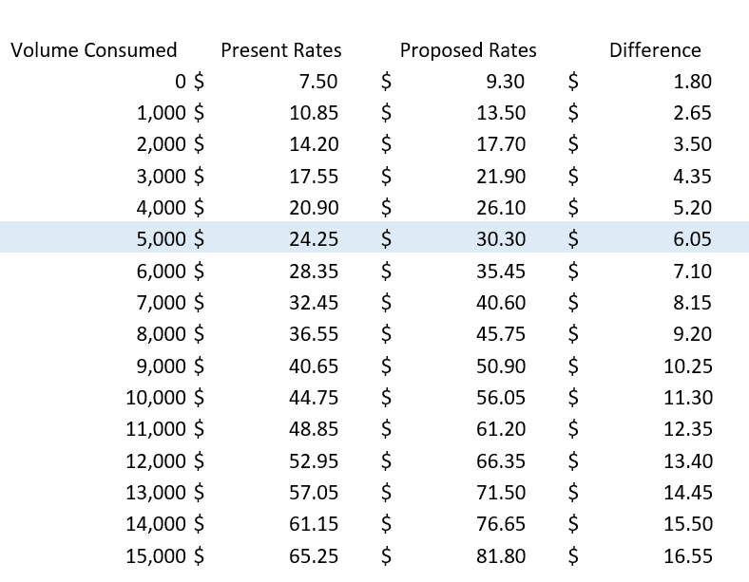
(Residential Proposed Rate Chart)
Base fee
73% of bills show usage of 5,000 gallons per month
or less. The average water bill increase in this bracket is $3.93.

Slide 31
Average = $12.42
Existing = $7.50 (36% below)
Proposed = $9.30 (19% below)
Average = $5.00
Existing = $3.35 (31% below)
Proposed = $4.20 (7% below)

Slide 32
If the proposition were to pass, Norman’s water rates would still be more affordable in comparison to the average rates of peer cities.
Existing Rates
Peer City Average | $ 34.58
Norman | $ 24.25
Extent to which Norman is below average | - 30%
Proposed Rates
Peer City Average | $ 34.58
Norman | $ 30.30
Extent to which Norman is below average | - 12%

Slide 33
Commercial Rates were modified in 2015 to a tiered structure for commercial customers.
AWC = Average winter consumption; billed water usage during December – February.

Slide 34
Commercial (FY23)
Description | Existing Rates | Proposed Rates
Monthly Service Charge, $ per bill*
All Customers | $6.00 | $7.80
Volume Rates, $ per 1,000 gallons
AWC or Less | $3.80 | $4.35
Above AWC | $4.20 | $4.80
*Does not include Capital Improvement Charge (CIC) which is 60% of sewer

Slide 35
(Commercial Proposed Rate Chart)
Base fee
69% of bills show usage of 10,000 gallons per month or less. The average bill increase for these customers would be $4.55 per month.

Slide 36
Average = $18.85
Existing = $12.00 (36% below)
Proposed = $13.80 (27% below)
Average = $5.00
Existing = $3.80 (24% below)
Proposed = $4.35 (13% below)

Slide 37
Average = $40.65
Existing = $37.48 (8% below)
Proposed = $42.03 (3% above)
Average = $65.45
Existing = $62.96 (4% below)
Proposed = $70.26 (7% above)

Slide 39
Voter Information
March 22: Deadline to register to vote
March 31 & April 1: Early voting
April 5: Election Day
Learn more at normanok.gov/toward-tomorrow

