Slide 1

2022 Community Interest and Opinion Survey
Presented by ETC Institute

Slide 2
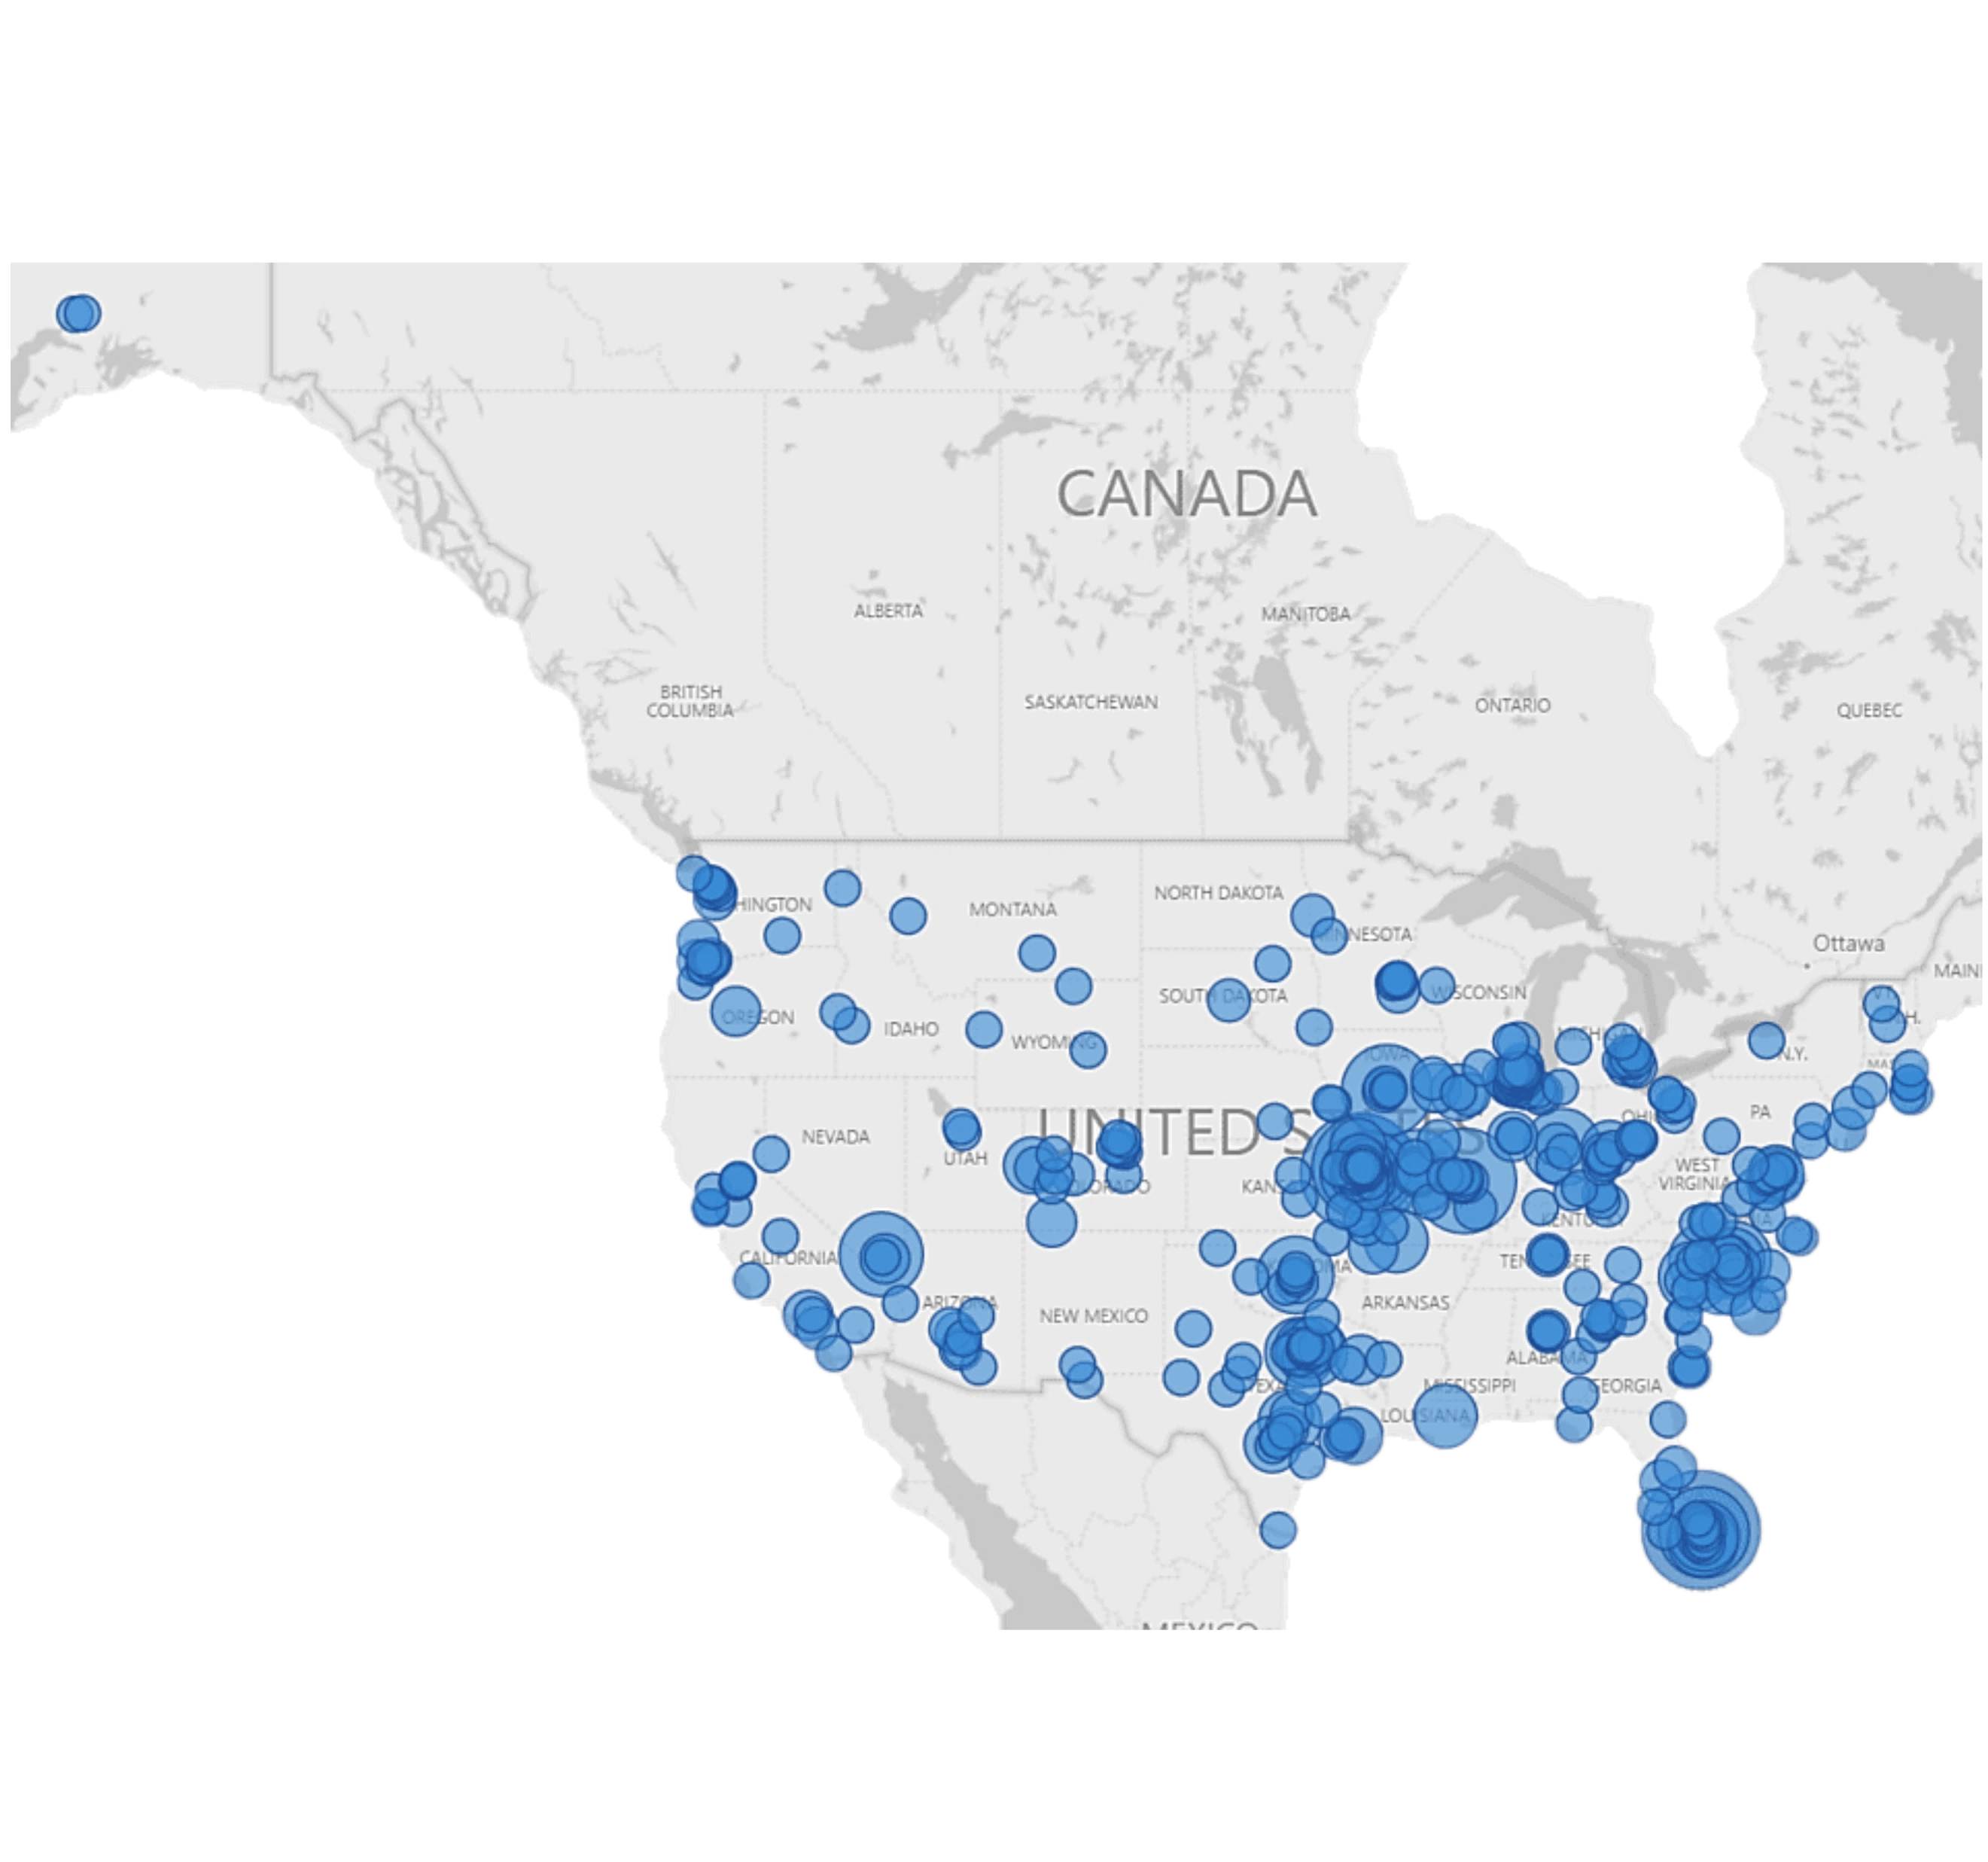
ETC Institute is a National Leader in Market Research for Local Governmental Organizations
Since 2006,
ETC Institute Has,
In More Than 1,000 Cities
&
49 States, Surveyed More Than 3,000,000 Persons.
For more than 35 years, our mission has been to help municipal governments gather and use survey data to enhance organizational performance.

Slide 3
Purpose
To objectively assess usage, satisfaction, and needs for a wide range of park and recreation facilities and programs
To help identify opportunities for the City to better serve the leisure and recreation needs of the community

Slide 4
Methodology
Survey Description
Six-page survey
Method of Administration
By mail and online to a random sample of households in the City
Each survey took approximately 15-20 minutes to complete
Sample Size
417 completed surveys
Margin of Error
+/- 4.8% at the 95% level of confidence
Notes:
STRONG DEMOGRAPHICS COMPARED TO CENSUS NUMBERS (INCOME/RACE/ETHNICITY).

Slide 5
What We Learned
85% of respondents indicated their household used parks or facilities offered by the City during the past year
35% of respondents indicated their household has participated in programs offered by Norman during the past year
Most respondents depend on the City of Norman Parks and Recreation (73%) or the University of Oklahoma (54%) for parks, recreation facilities, or recreation programs
Notes:
FACILITIES: 82% gave excellent (24%) or good (58%) ratings (15% gave fair and 3% gave poor rating)
PROGRAMS: 89% gave excellent (28%) or good (61%) ratings (9% gave fair and 3% gave poor rating)

Slide 6
Top Priorities Based on PIR Analysis
Recreation amenities
Recreation programs
Trails, steps, pathways
Indoor swimming pool
Community gardens
Dedicated social space for active older adults
Park benches to relax, read, enjoy nature
Indoor fitness classes
Dog parks
Adult fitness and wellness programs
Community event programs
Nature/environmental education programs
Fitness/exercise classes
Community garden programs
Outdoor hiking/walking clubs
Adult art/performing arts programs
Notes:
It is easy to draw lines from the amenities that topped the list to the programming respondents want and need – a good breakdown of responses that shows the continuity in responses and the thoughtfulness of respondents.

Slide 7
Usage and System Ratings

Slide 8
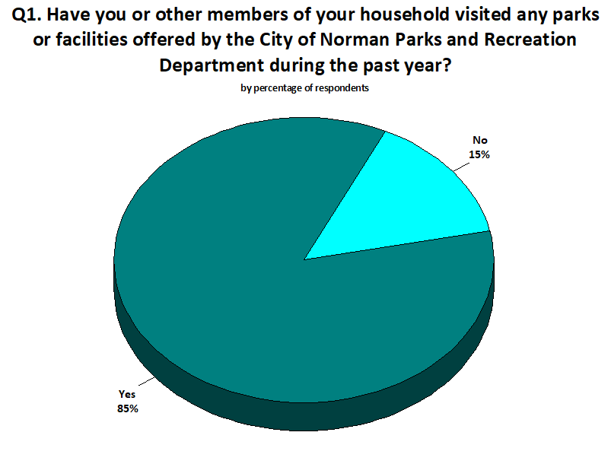
National Average: 76%
Usage/visitation is significantly higher than the National Average

Slide 9
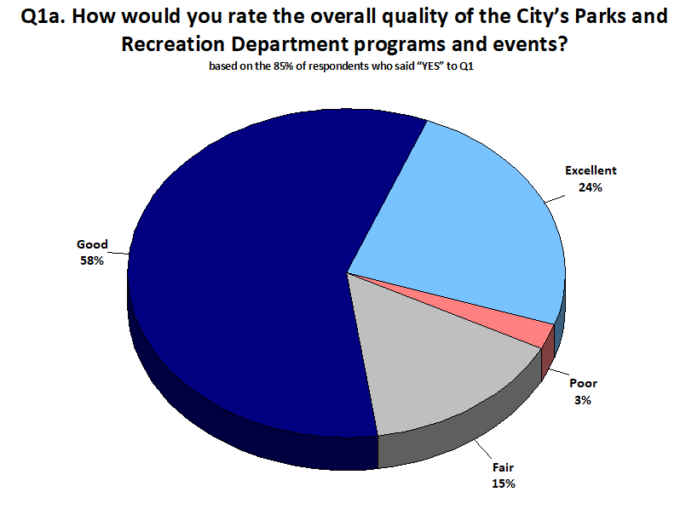
National Average
Excellent: 27%
Good: 52%
City’s “excellent” and “good” ratings are much higher than National Average

Slide 10
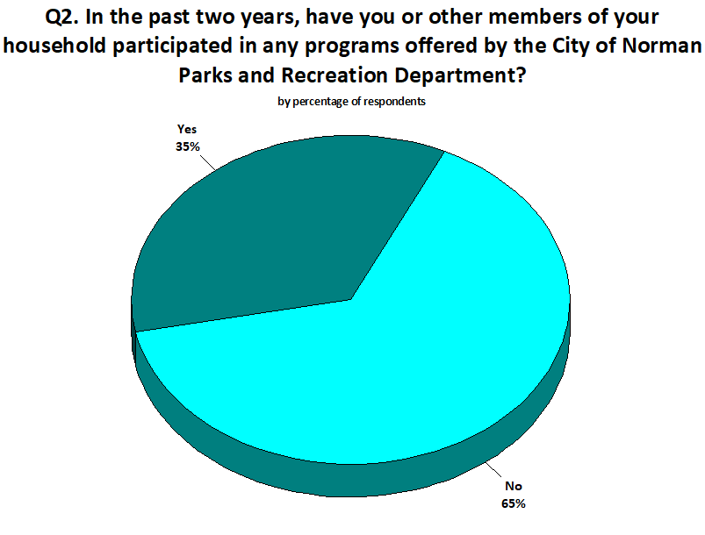
National Average: 32%
Participation programs are aligned with National Average

Slide 11
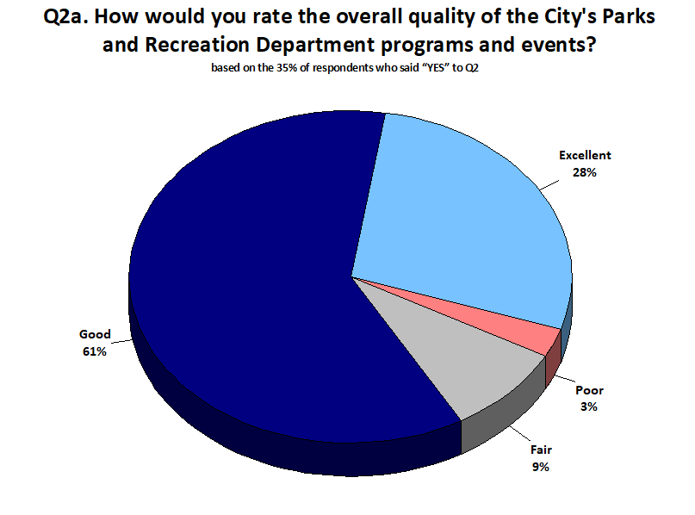
National Average
Excellent: 25%
Good: 44%
Overall ratings are significantly higher than National Average

Slide 12
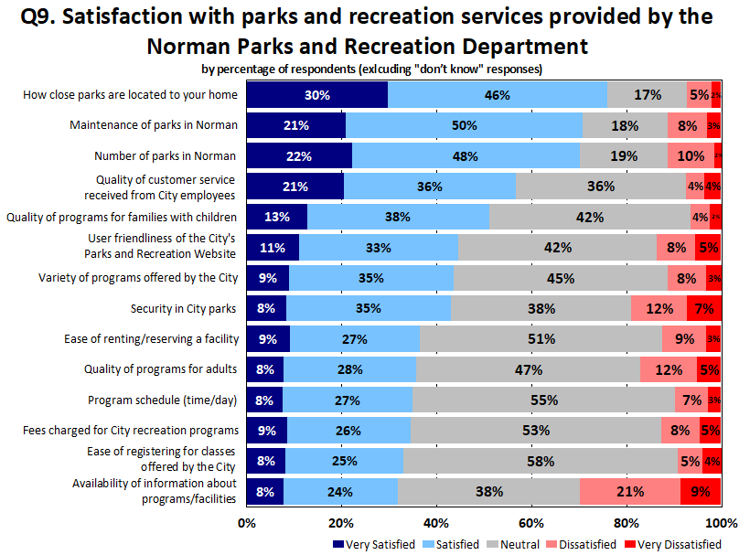
Items highlighted received the highest level of importance ratings

Slide 13
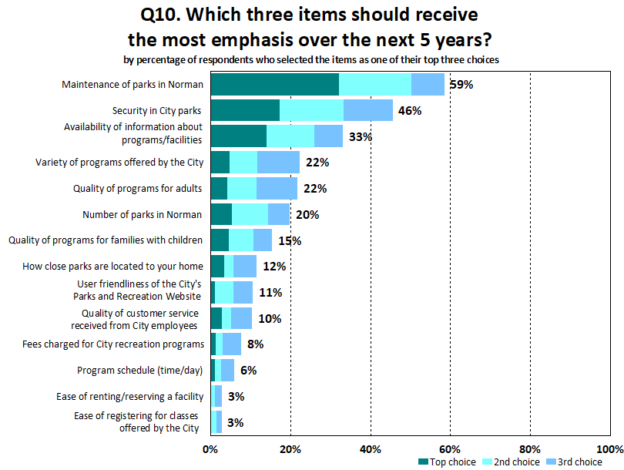
Items with above average importance and below average satisfaction should receive the highest level of investment

Slide 14
IS Ratings above 0.1000 are high priorities for improvement

Slide 15
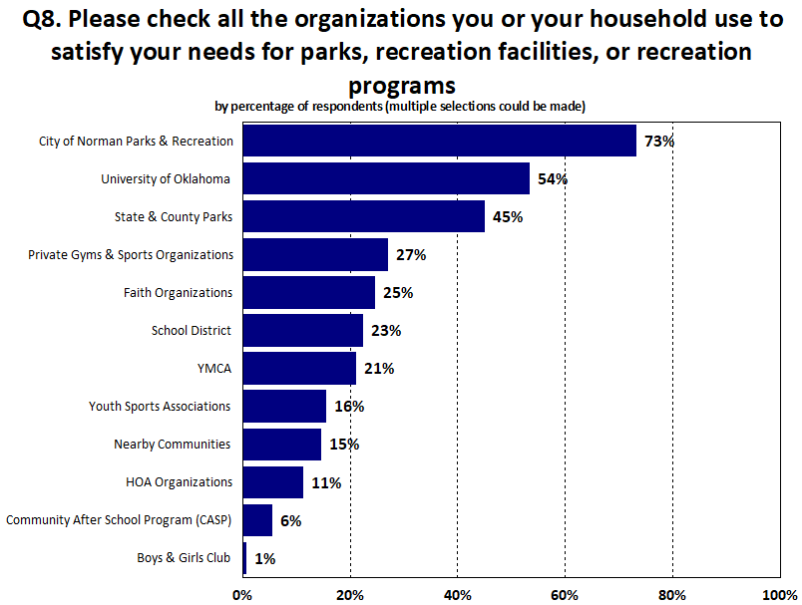
The City and the University of Oklahoma are the primary recreation providers in the area

Slide 16
Program Priorities
Unmet Needs and Priorities for Programs

Slide 17
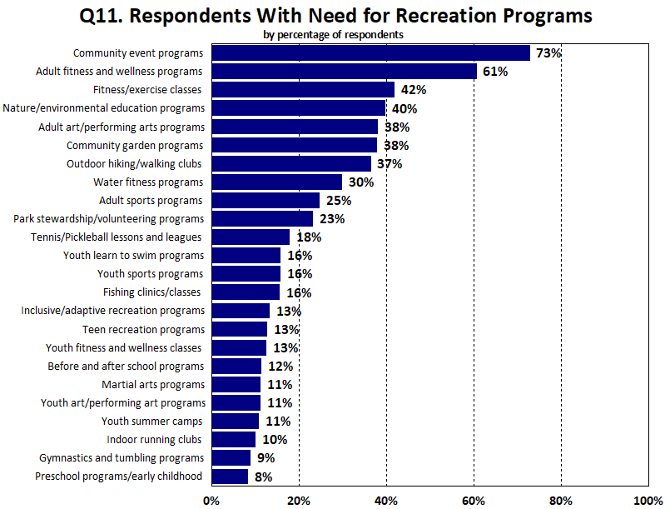

Slide 18
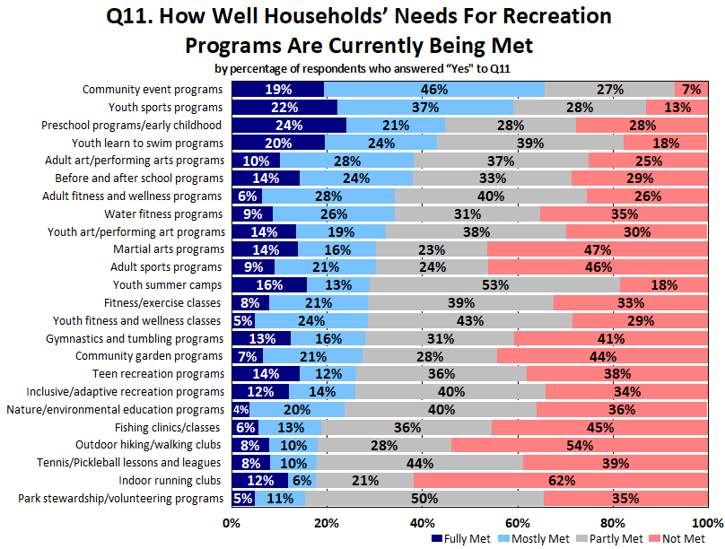

Slide 19
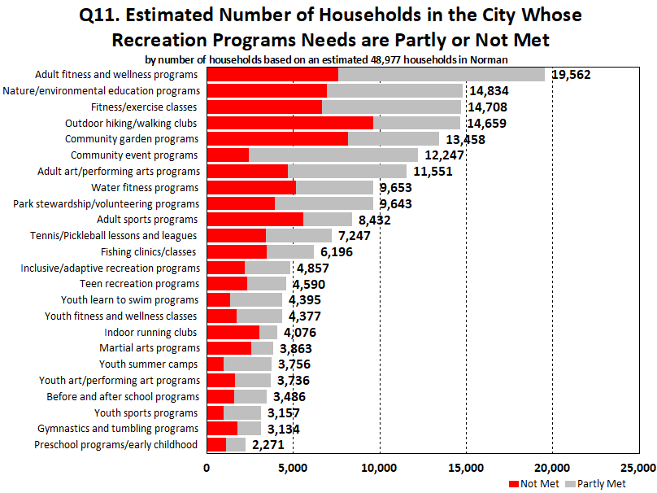
Notes:
Waiting for Senior Wellness Center to open will help reduce that gap between the needs

Slide 20
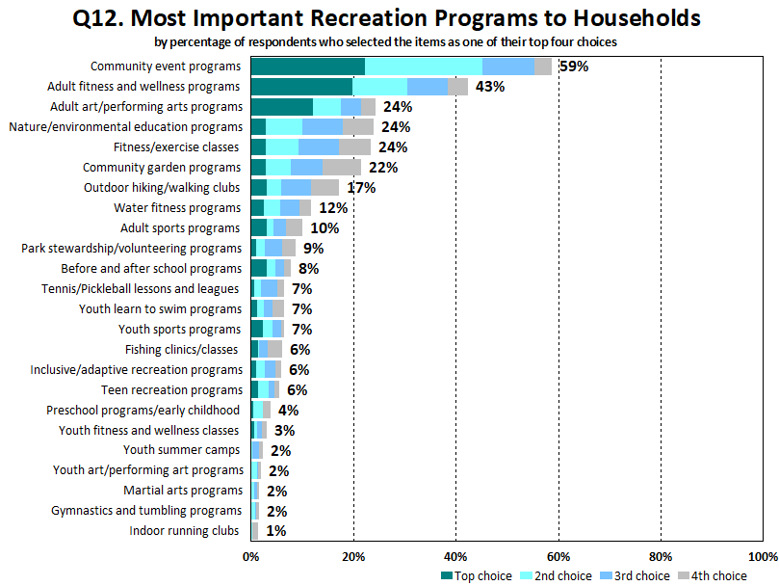

Slide 21
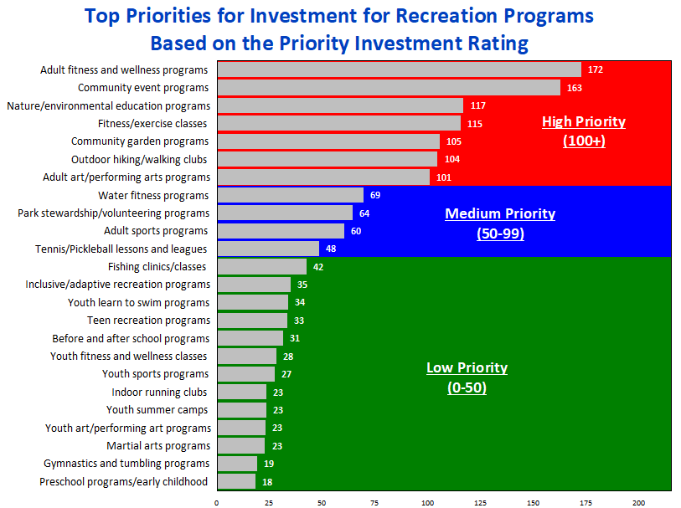
Top Priorities
(high importance/higher unmet need)
Continued
Emphasis
(high importance/lower unmet need)
Lower
Immediate
Need
(lower importance/lower unmet need)

Slide 22
Facility Priorities
Unmet Needs and Priorities for Facilities

Slide 23
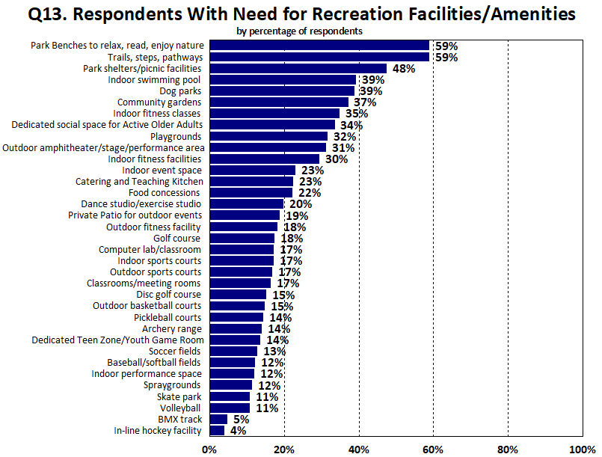
Showing the 20 most selected items – a total of 39 items were included in this list

Slide 24
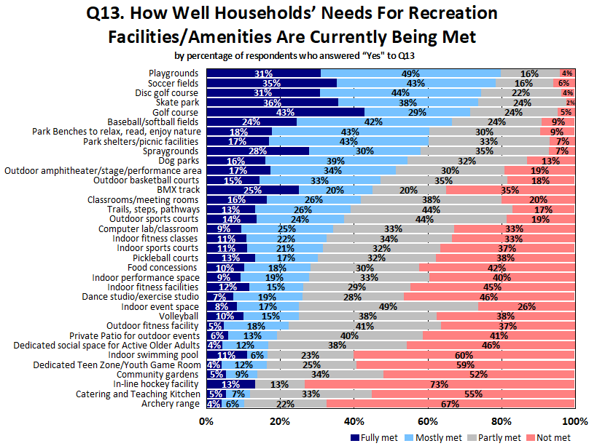

Slide 25
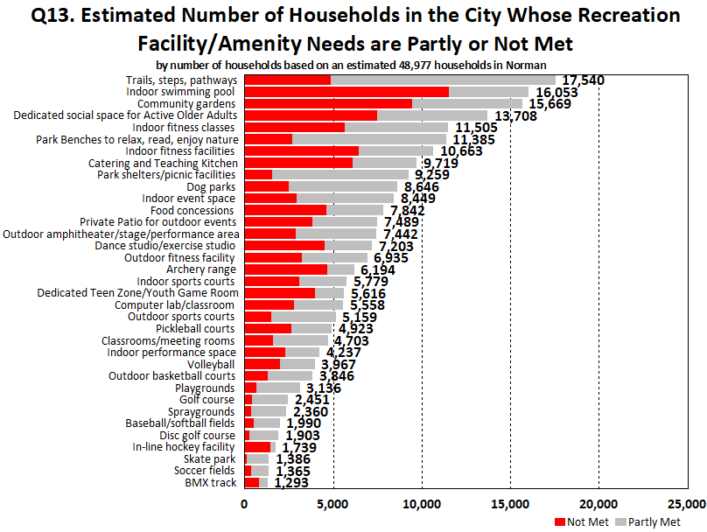

Slide 26
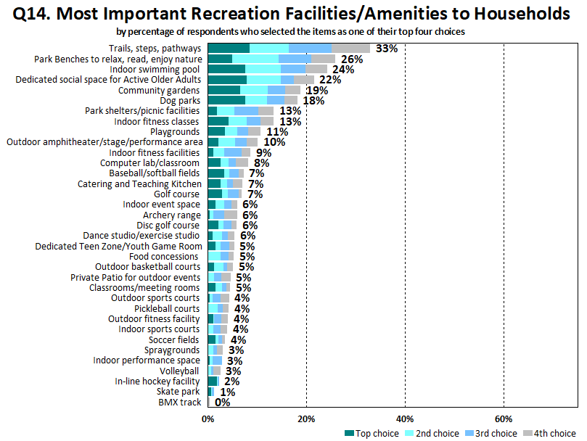

Slide 27
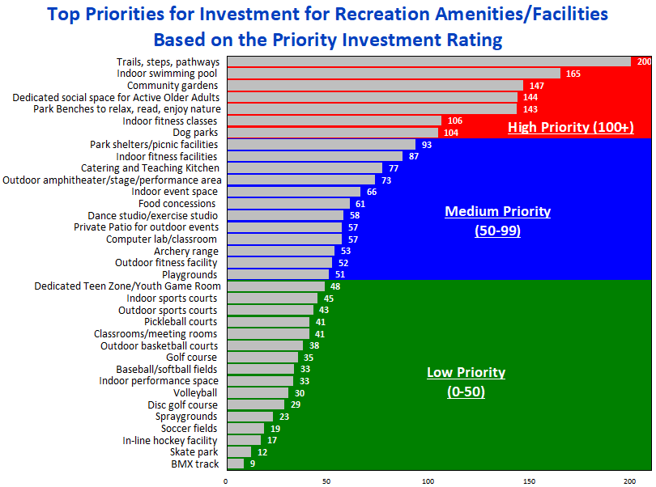
Top Priorities
(high importance/higher unmet need)
Continued
Emphasis
(high importance/lower unmet need)
Lower
Immediate
Need
(lower importance/lower unmet need)

Slide 28
Improvements and Support Mechanisms

Slide 29
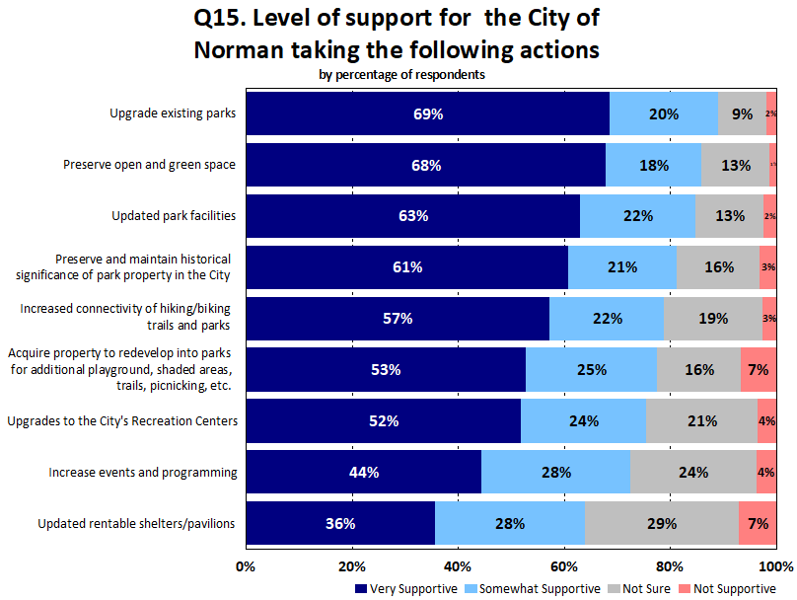

Slide 30
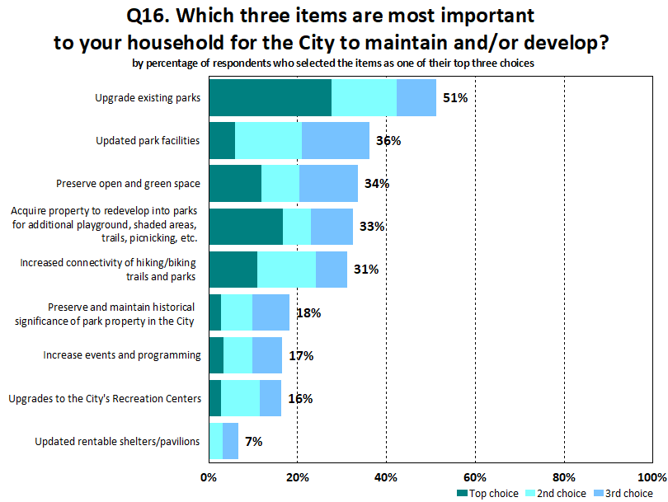
Notes:
The top three choices align with the level of support shown for each of the top 3 items listed

Slide 31
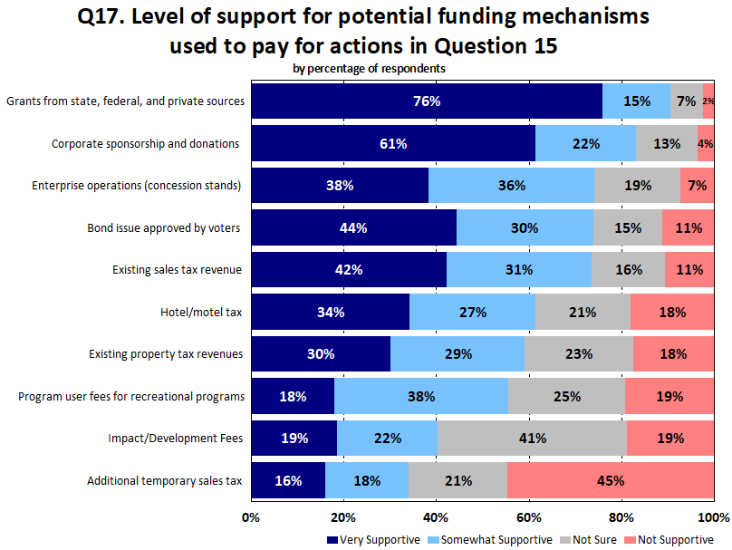

Slide 32
Communication and Barriers

Slide 33
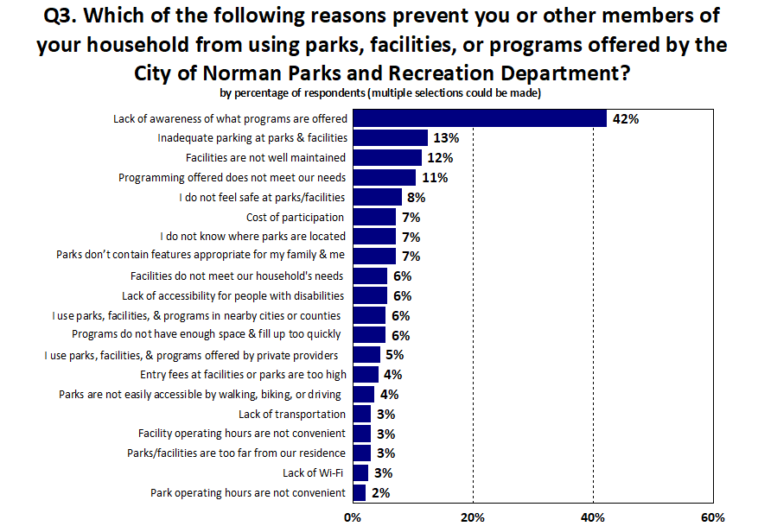

Slide 34
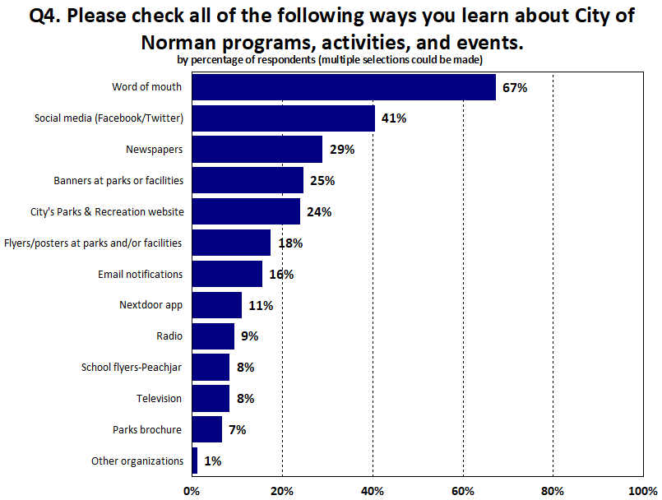

Slide 35
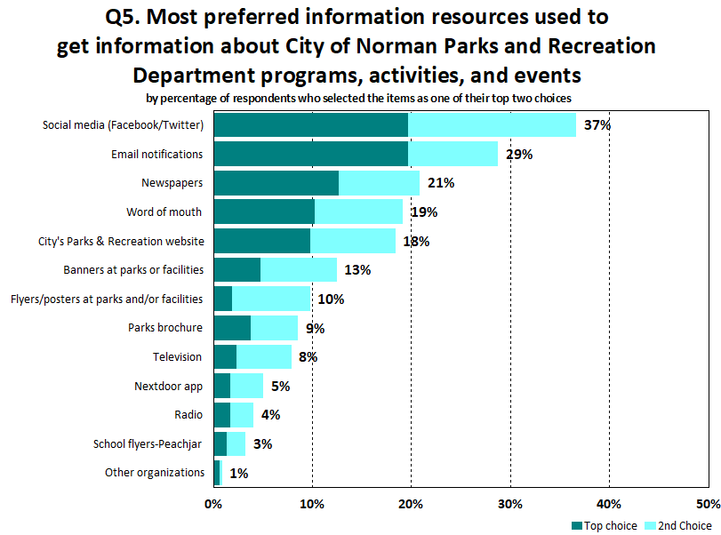

Slide 36
Questions?
Thank you

