Slide 1

City of Norman/Gooden Group/Amber Integrated
Proposed Bridge Maintenance Bond Program
Survey #1 Results
Council Study Session
Tuesday,
July 11, 2023

Slide 2

Program Background
October 27, 2022 – CP&T Committee
January 17, 2023 – Council Study Session
June 20, 2023 – Council Study Session
June 23 – 27, 2023 – Public Survey
July 11, 2023 – Survey Results

Slide 3
Norman Bridge Bond Survey #1
(400 respondents from June 23rd – June 27th, 2023)
Key Findings
Norman voters generally view bridges as safe. Nearly 85% of likely voters in Norman believe the bridges in their community are either “very” or “somewhat” safe.
There is general confusion and/or misunderstanding about how Norman’s bridges are funded. Only a quarter of respondents believed the city was responsible for funding.
A majority of voters (60%) believed the city was responsible for less than the current 80 bridges they are responsible for.
General concern about specific bridges in a voter’s neighborhood or community is low suggesting a lack of awareness about the current bridge concerns.
The Norman Transcript newspaper was referenced the most times (21%) when asking voters how they research local elections in Norman.
The 10-year $50 Million bond program is much more favorable than the 5-year $20 Million bond program.

Slide 4
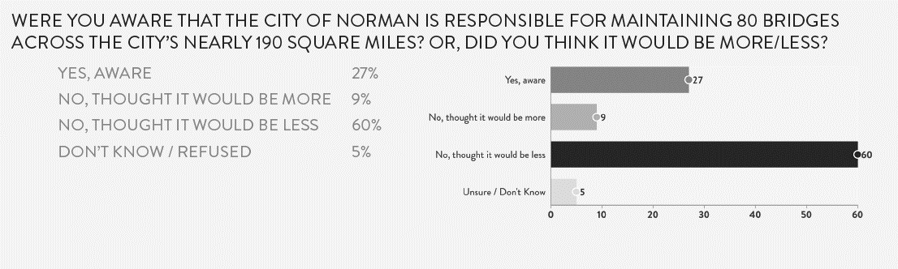


Slide 5
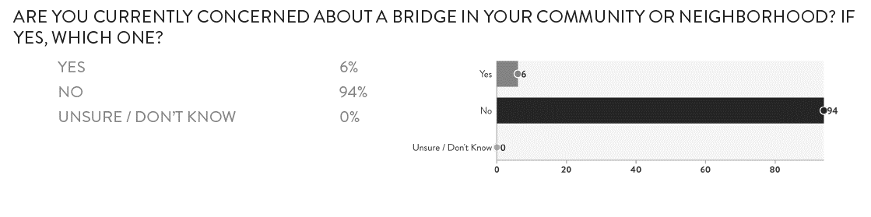

Slide 6
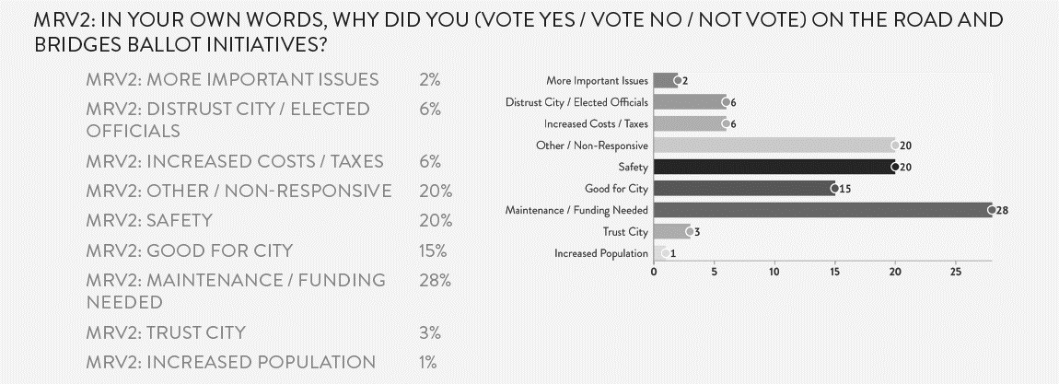

Slide 7
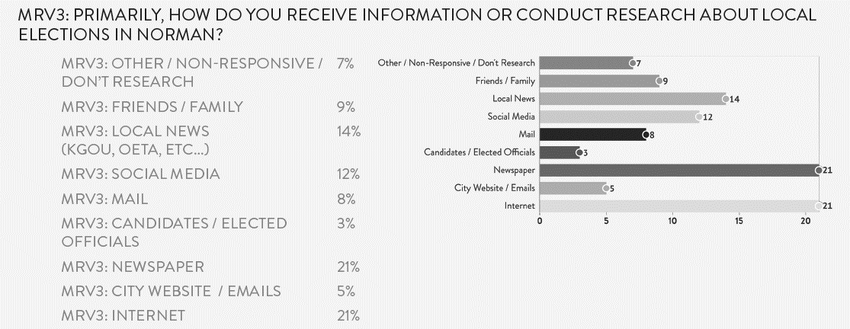

Slide 8
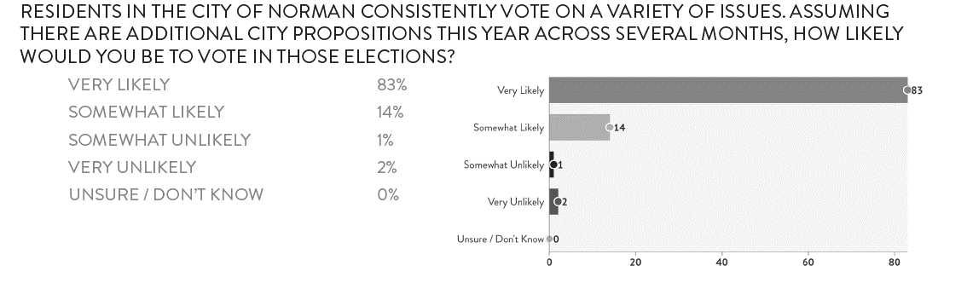

Slide 10
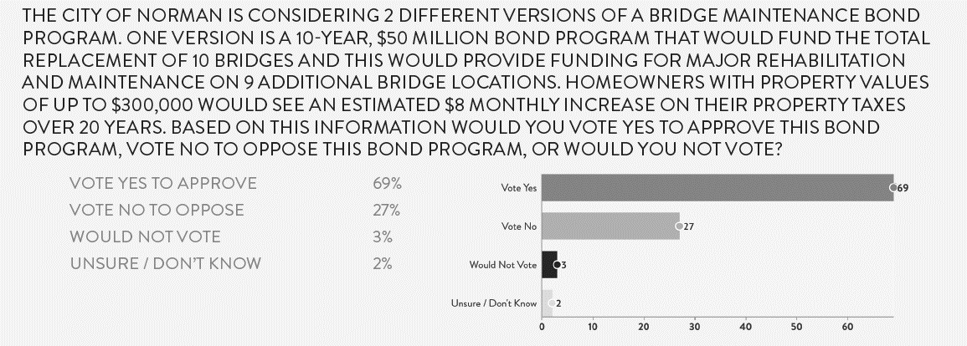

Slide 11
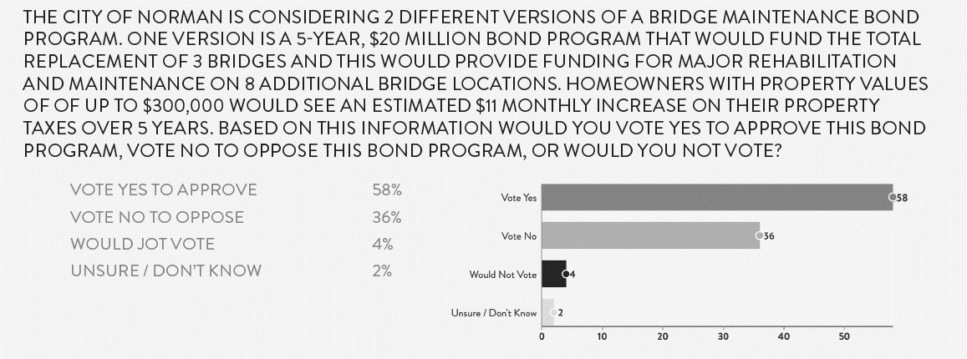

Slide 12
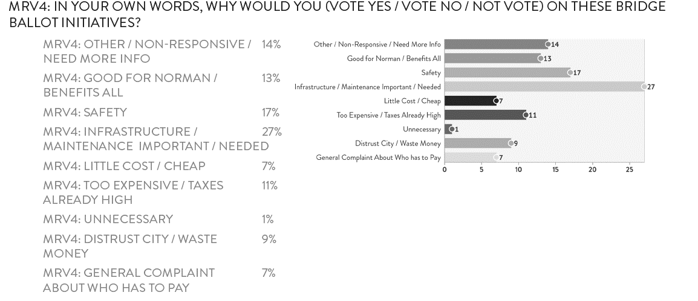

Slide 13
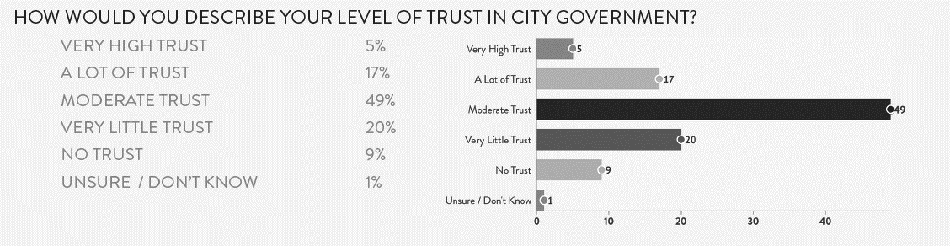

Slide 14


Issues & Options
10 – Year, $50 Million Bond Program
or
5 – Year, $20 Million Bond Program
October 10, 2023 Bond Election
or
Other Election Date (Nov., Feb., Apr.)

Slide 15
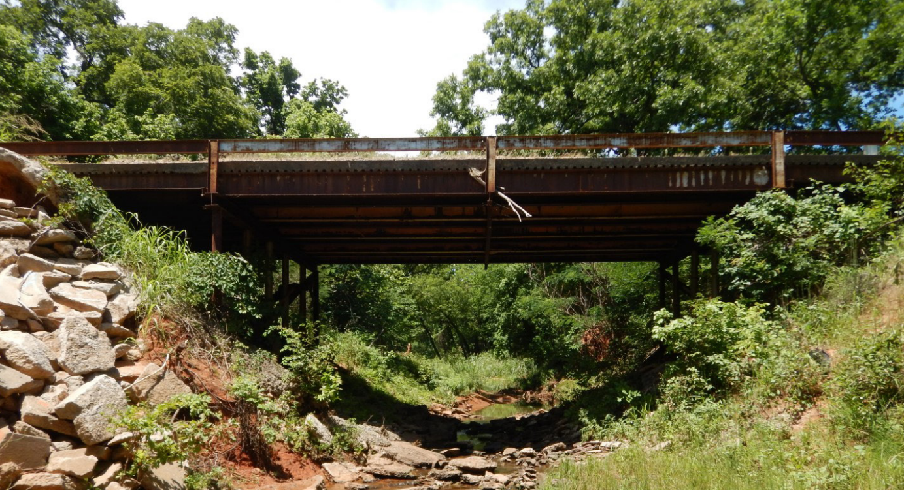
Next Steps
July 25, 2023
  Ballot Ordinance, First Reading
August 8, 2023
  Ballot Ordinance, Second Reading
August 2023
  Develop Campaign Materials
  Send Second Survey
September – October 2023
  Active Information Campaign
October 10, 2023
  Election Day
May, 2024
  Begin Bridge Maintenance Bond Program Construction
60th Ave NE Bridge over Rock Creek (located north of Rock Creek Rd).
Built in 1940.
This Bridge is rated Structurally Deficient and Load Posted for 4 Tons.
This Bridge is currently closed indefinitely due to structural failure.

Slide 16
COUNCIL DIRECTION?
Shawn O’Leary, City Director of Public Works
Joseph Hill, City Streets Program Manager
Jackson Lisle, Amber Integrated
Beth Harrison, Gooden Group

Slide 17
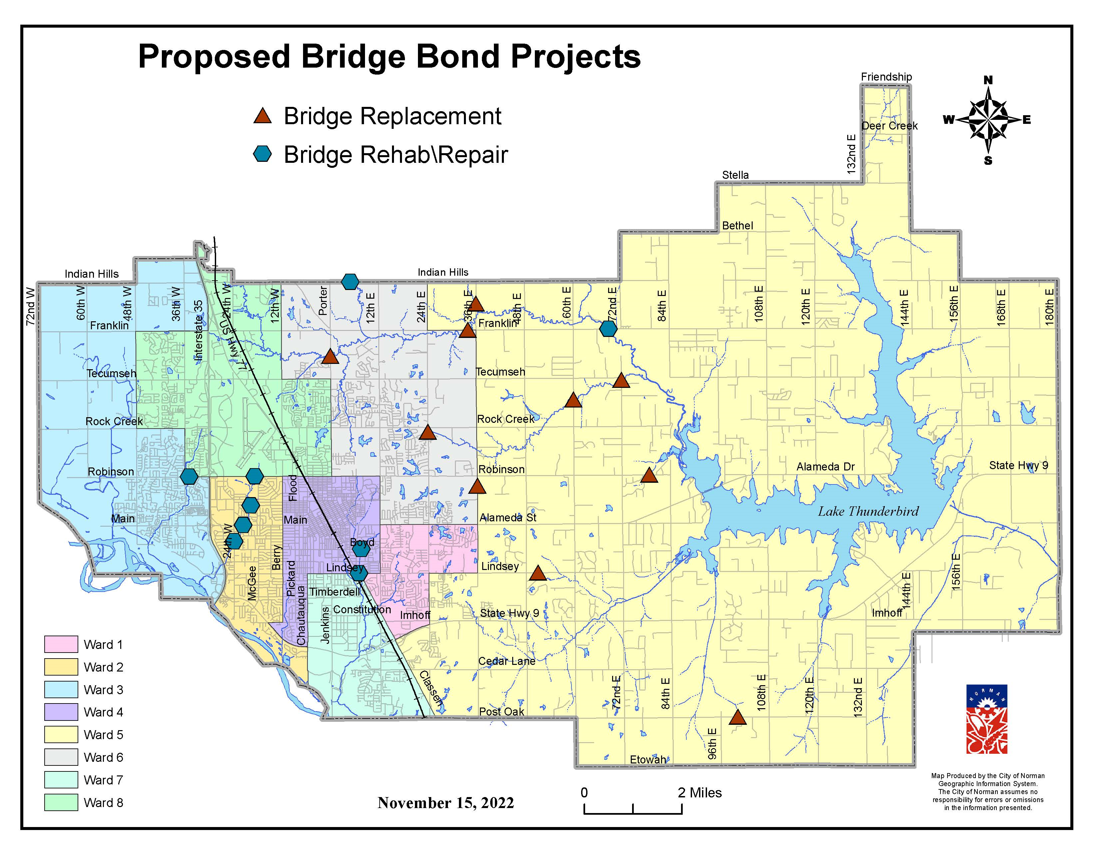
Proposed Bridge Bond Locations
REPLACE [Ward] | MAJOR REPAIR [Ward]
60TH Ave NE [5] | Indian Hills Rd [6]
N. Porter Ave [6] | Franklin Rd [5]
E. Robinson [5] | 24th Ave SW [2]
72nd Ave NE [5] | W. Robinson [3/8]
Lindsey St. [5] | Lindsey St. [1/4/7]
24th Ave NE [6] | Boyd St. [4]
36th Ave NE [5/6] | Iowa St. [2]
E. Post Oak [5] | E. Robinson [8/2]
Franklin Rd [5/6] | Main St. [2]
36th Ave NE [5]
Creekside Dr. [1]

Slide 18
Proposed Cost Breakdown

