Slide 1
University North Park
Tax Increment Finance District (TIF #2)
Citizen’s Oversight Committee
Discussion of Proposed
Rock Creek Entertainment
Tax Increment Finance Districts (TIF #4 and TIF #5)
June 18, 2024

Slide 2
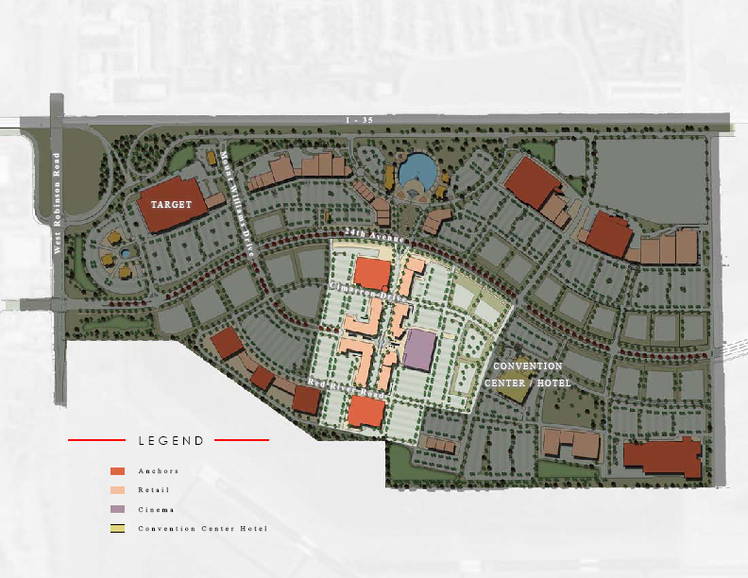
CIRCA 2006-2017 UNTIL NOW: THE “SOUTH HALF”

Slide 3
Subject
Tract
Existing Zoning
Map produced by City of Norman GIS Division

Slide 4
2023 Aerial Photography
Map produced by City of Norman GIS Division

Slide 5

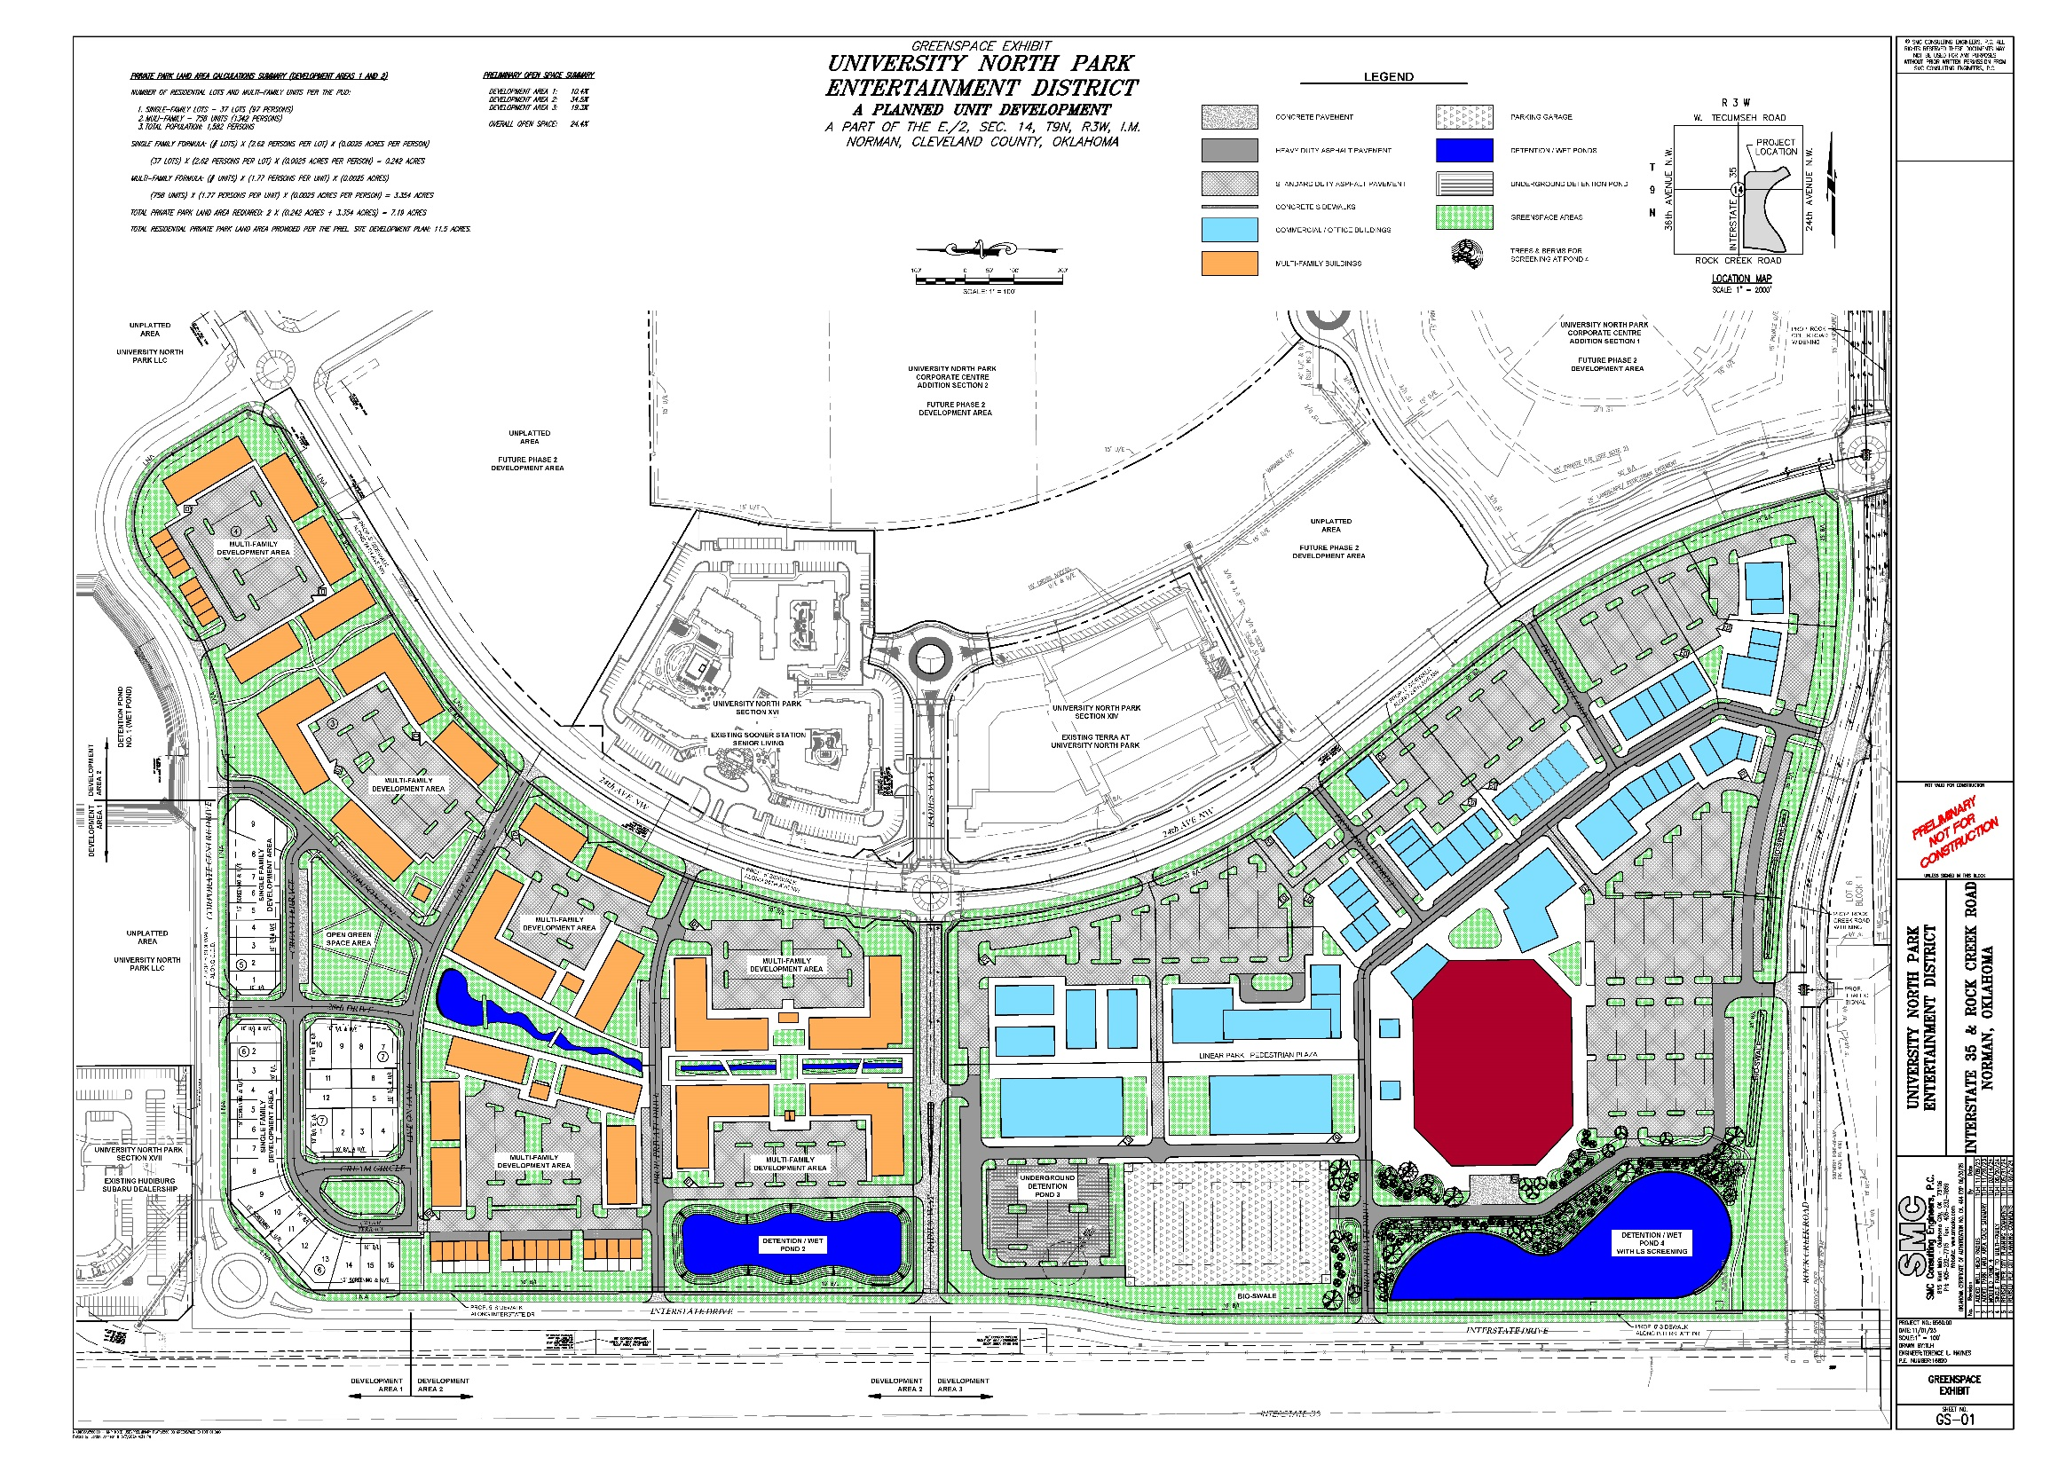

Slide 6
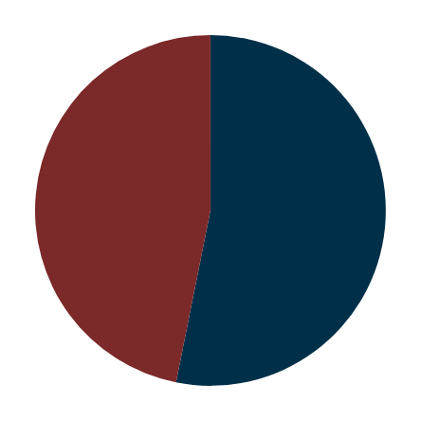
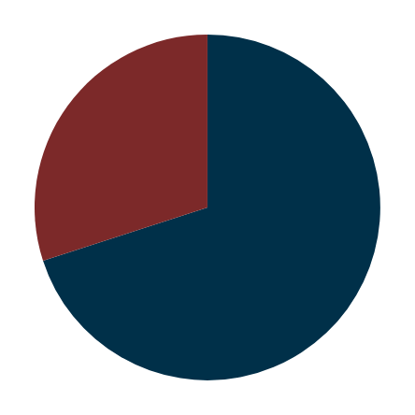
The Numbers
Arena
1
Public Funding Request of $230 Million
Here are the numbers rounded within 3% for description purposes:
$300 million arena and parking garage + $30 million infrastructure cost (roads, utilities, etc.)
  $100 million other capital from OU/Developers
  $230 million from TIF Financing
  $800 million private capital by Developers (retail, medium/high density residential, office, hotel, etc.)
                Ad Valorem – Cleveland County, and other taxing bodies (67%)
                Sales Tax – Norman City (33%)
  Non-Dedicated TIF REVENUES ONLY FOR REPAYMENT
  DEDICATED SALES TAX (public safety, etc.) WILL BE PAID to Norman City throughout life of TIF ($56 million)
Other capital
Debt
33%
67%
                $240 million capital from Developers
  $560 million debt guaranteed by Developers
Private Developers
Other Capital
30%
Debt
70%

Slide 7
Developer
Danny Lovell, CEO of Rainier Companies, a vertically integrated real estate investor and operator.
David Neher, President of Rainier Development Company, and leading expert in retail-driven, mixed-use.
Lincoln Property Company, among the largest diversified real estate firms in the nation and perennial leader in office and multifamily development.
Arcadis (Callison RTKL), a leading mixed-use planner and top 5 Architect in the US.
Legends, global experience company specializing in solutions for sports and entertainment.
Gensler, industry leading architecture design and planning firm specializing in sports facilities.

Slide 8
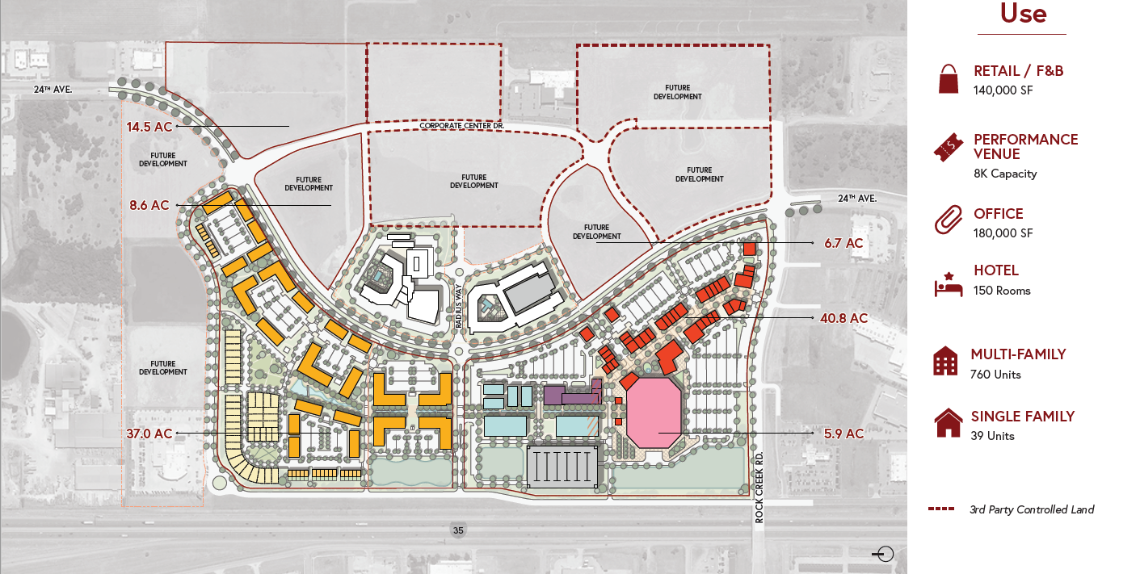
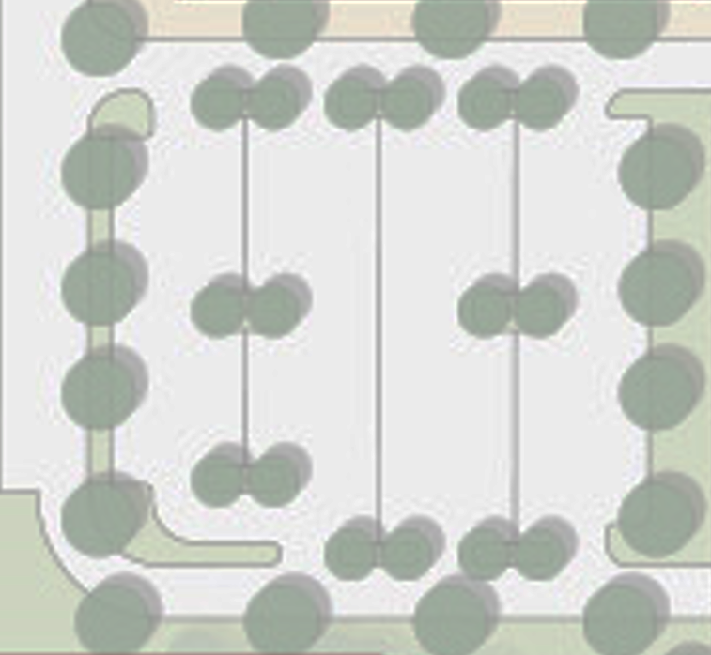
Masterplan
758 Units
24 Townhomes
URBAN RESIDENTIAL
37 Units

Slide 9
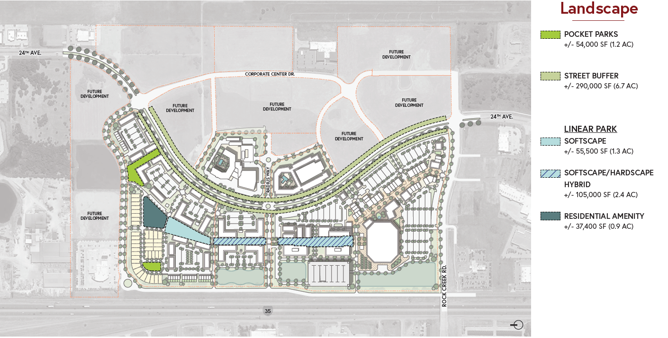
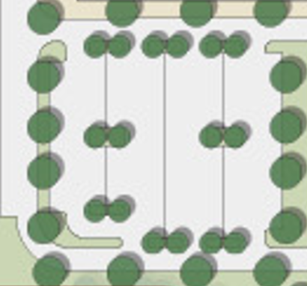




Masterplan

Slide 10
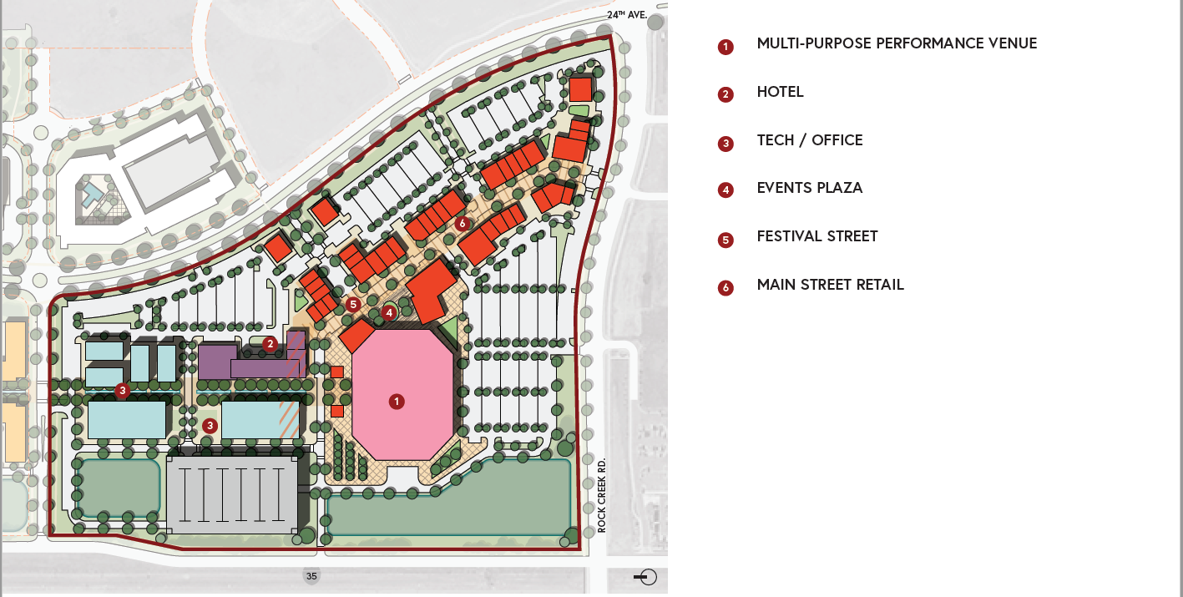
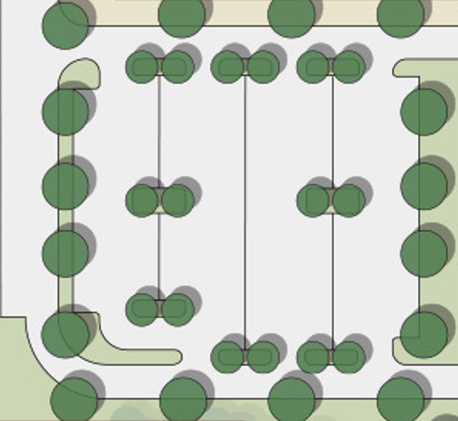
Mixed-Use Entertainment

Slide 11
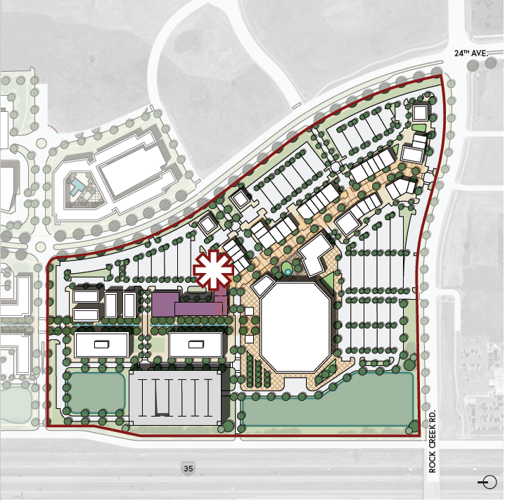
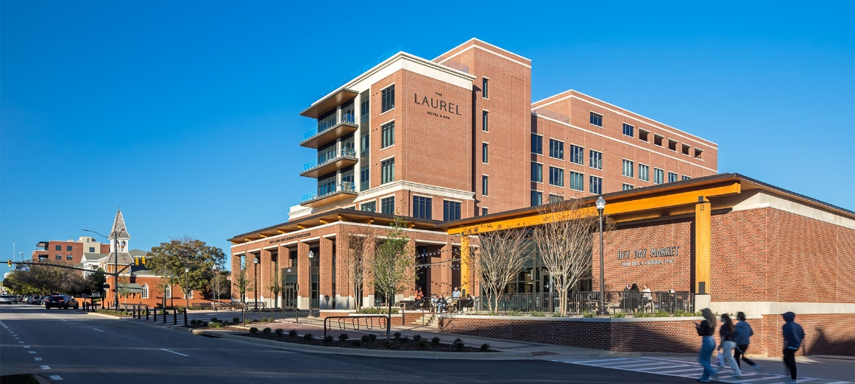
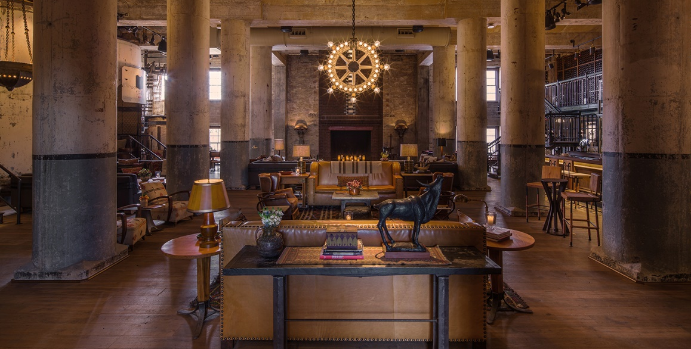

Mixed-Use Entertainment
Hotel
THE LAUREL - AUBURN, AL
HOTEL EMMA – SAN ANTONIO, TX

Slide 12
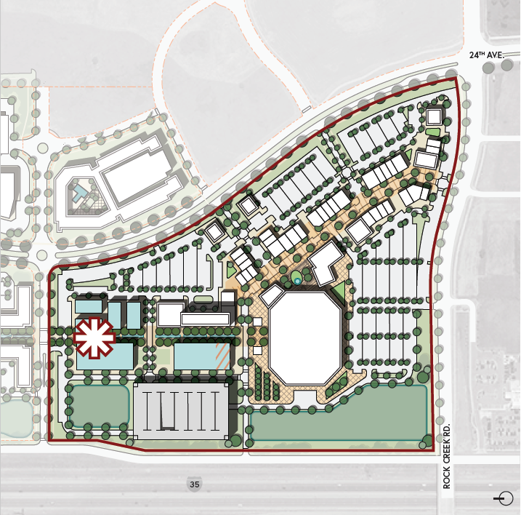
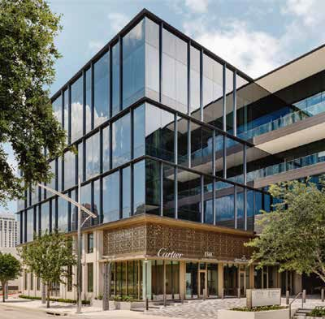
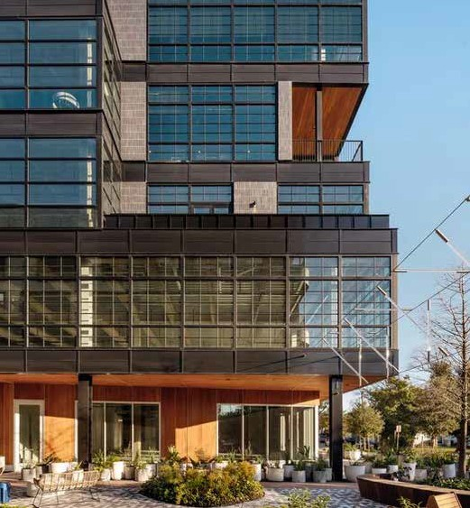
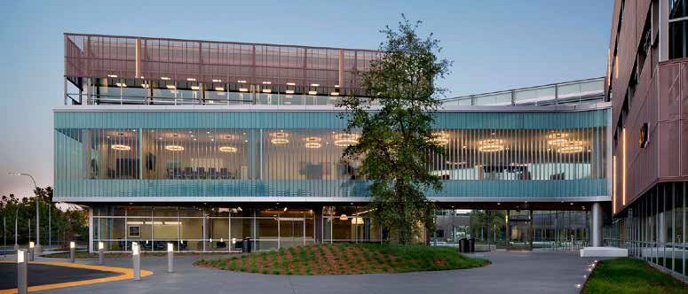
Mixed-Use Entertainment
Office

Slide 13
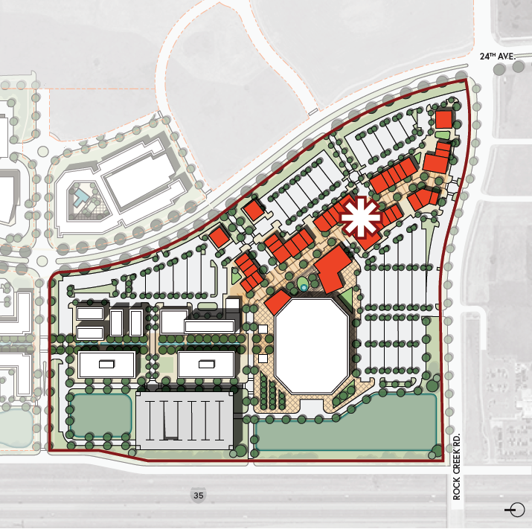
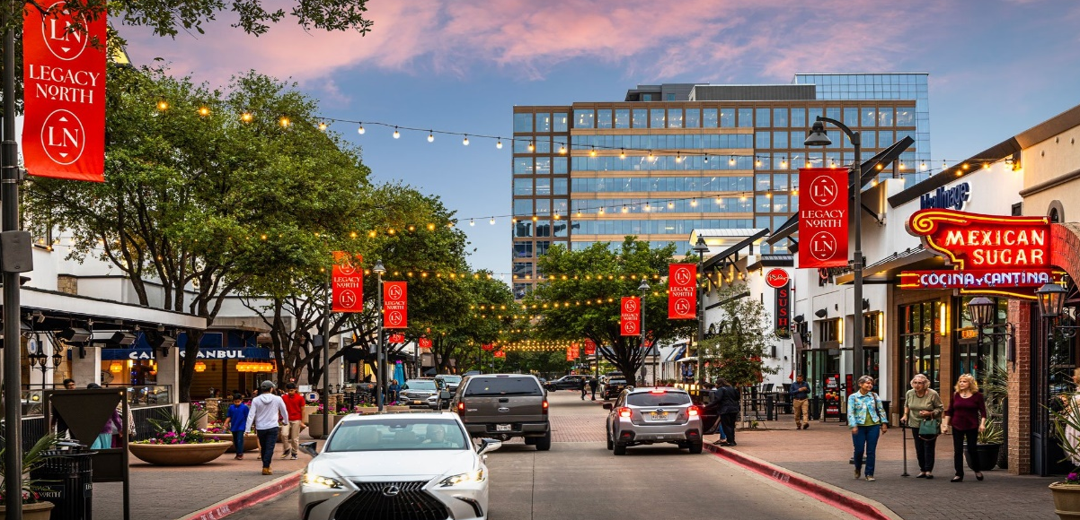
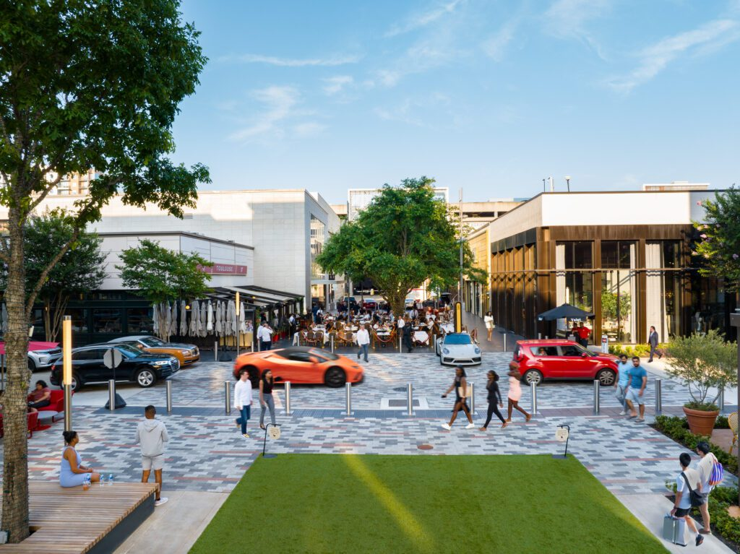
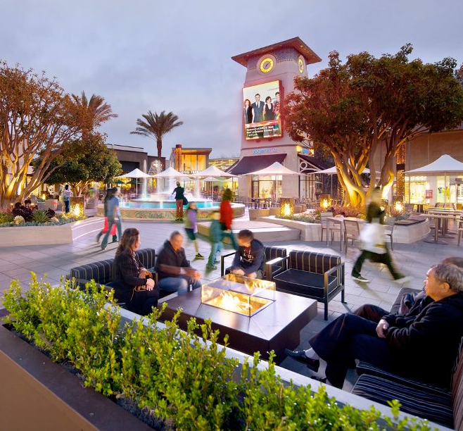
Mixed-Use Entertainment
Festival Street Retail

Slide 14
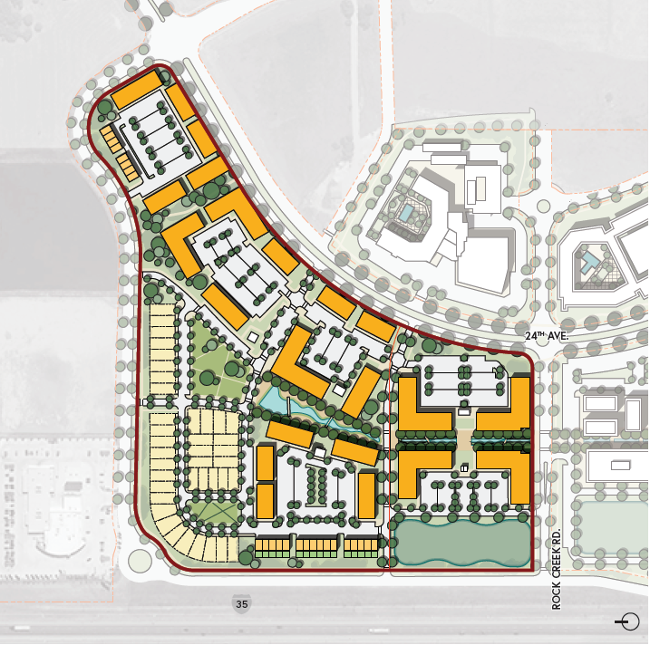
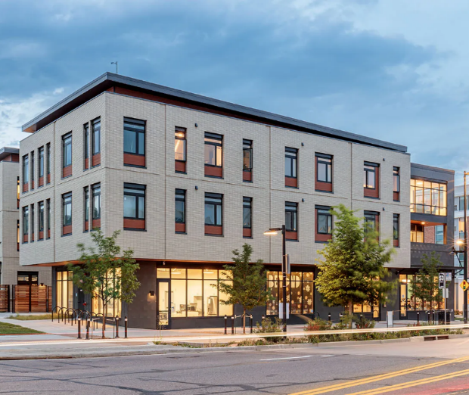
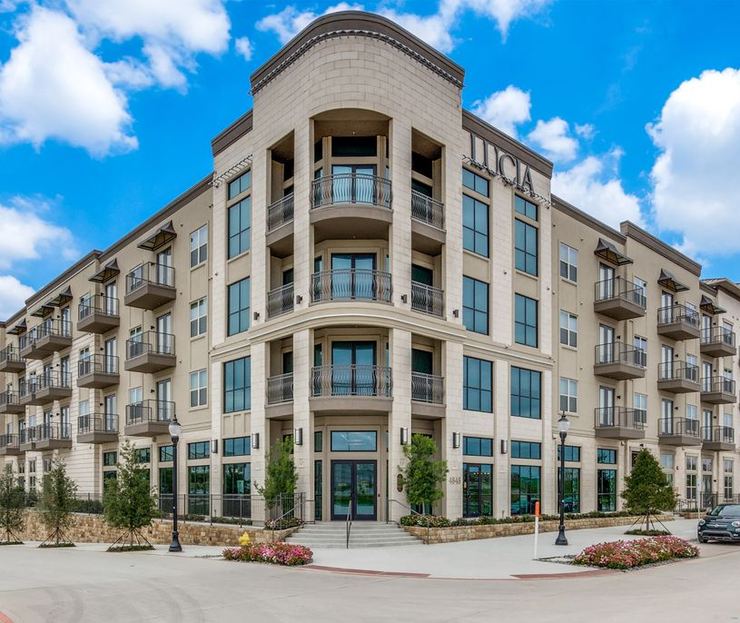
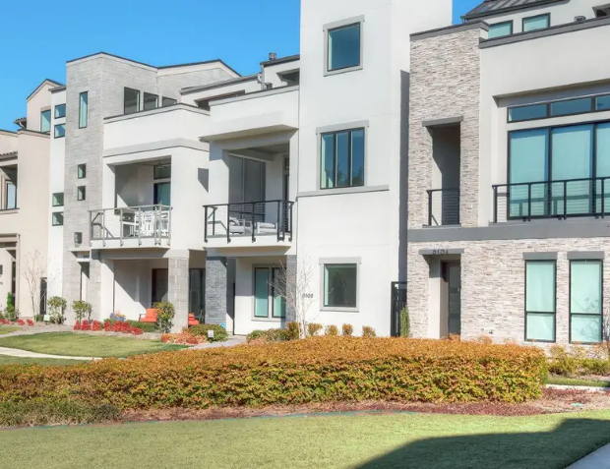
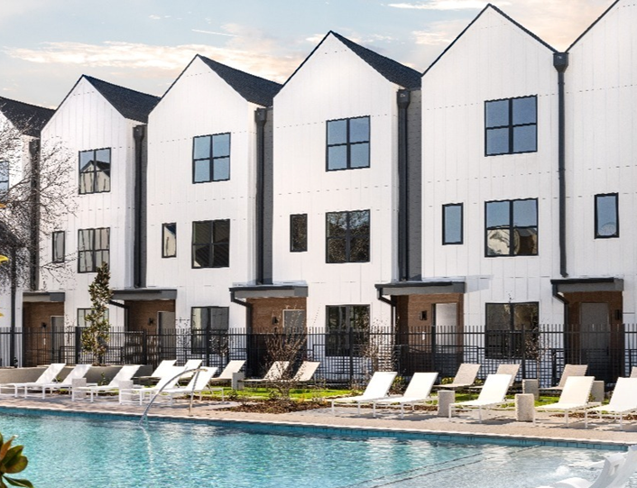
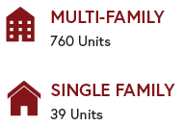
Residential
758 Units
24 Townhomes
URBAN RESIDENTIAL
37 Units

Slide 15
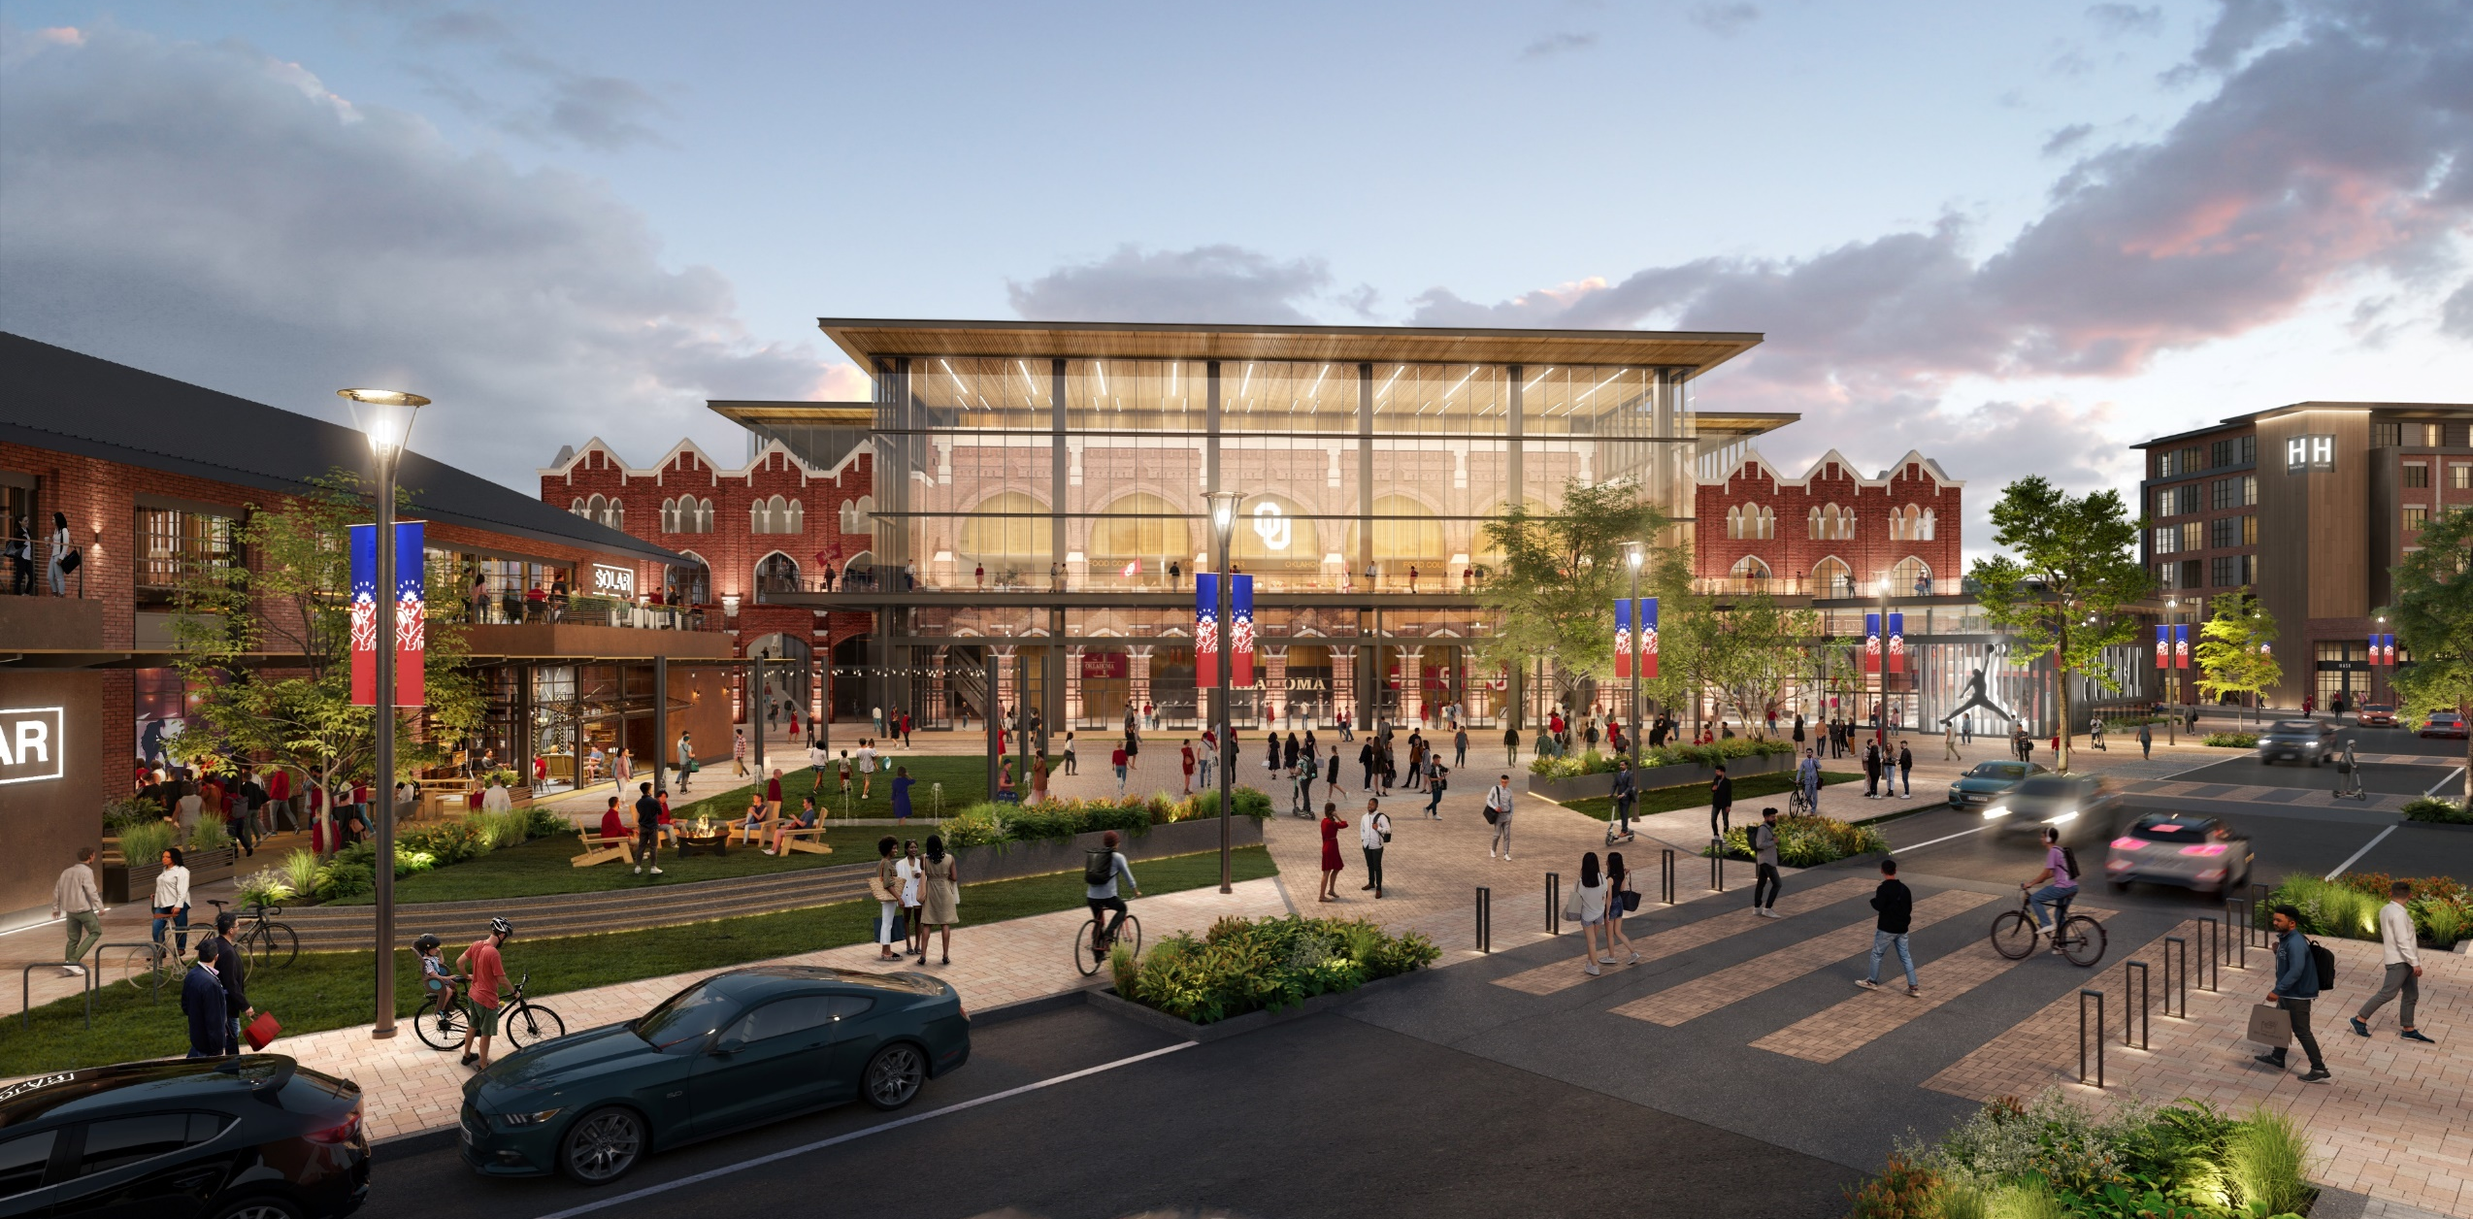
Mixed-Use Entertainment

Slide 16
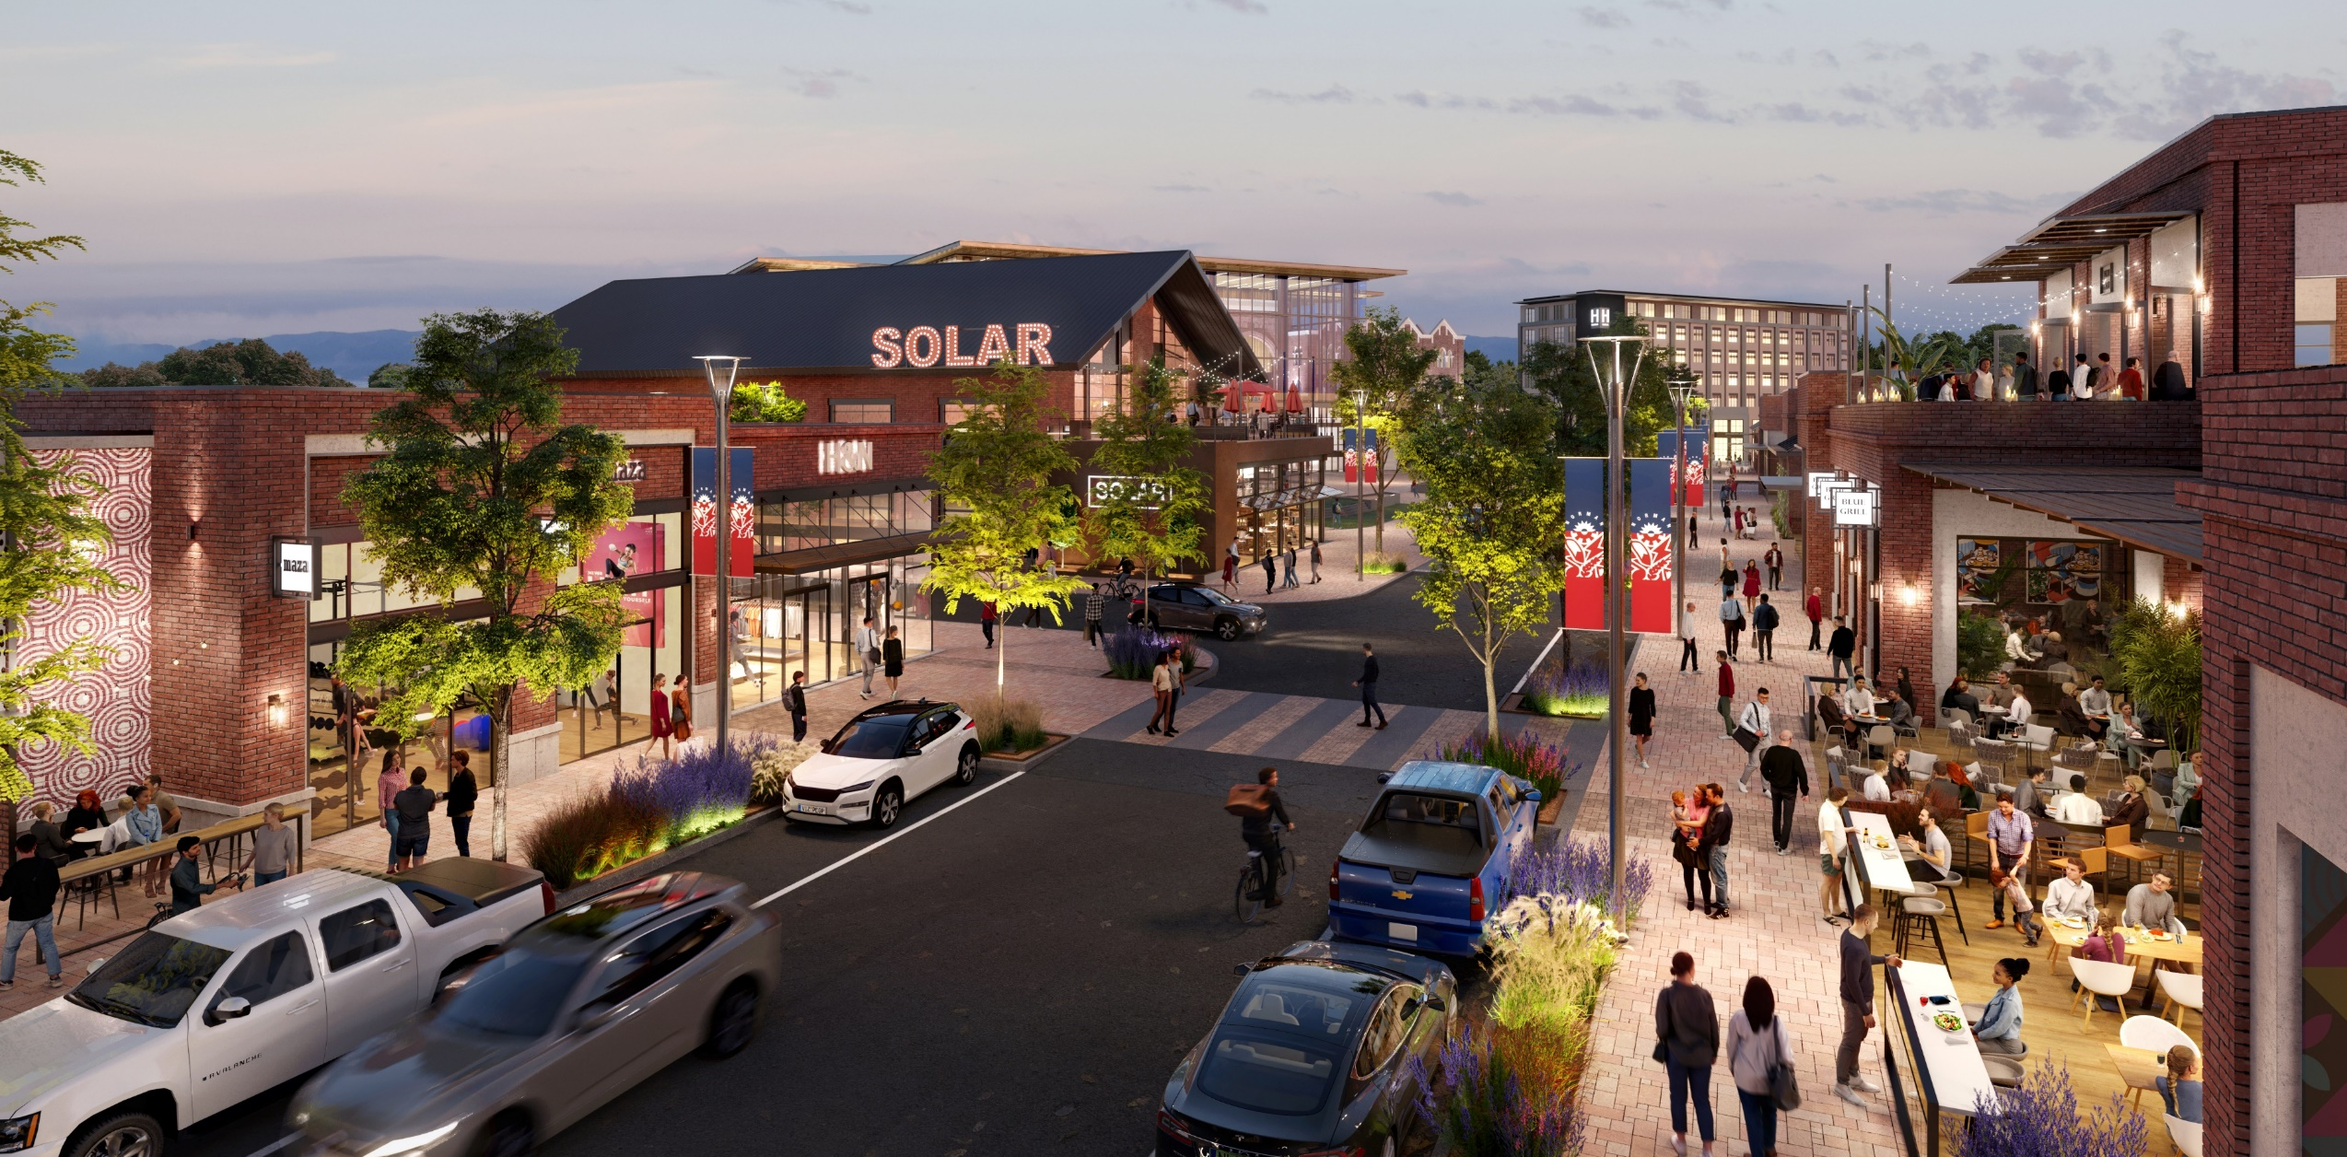
Mixed-Use Entertainment

Slide 17
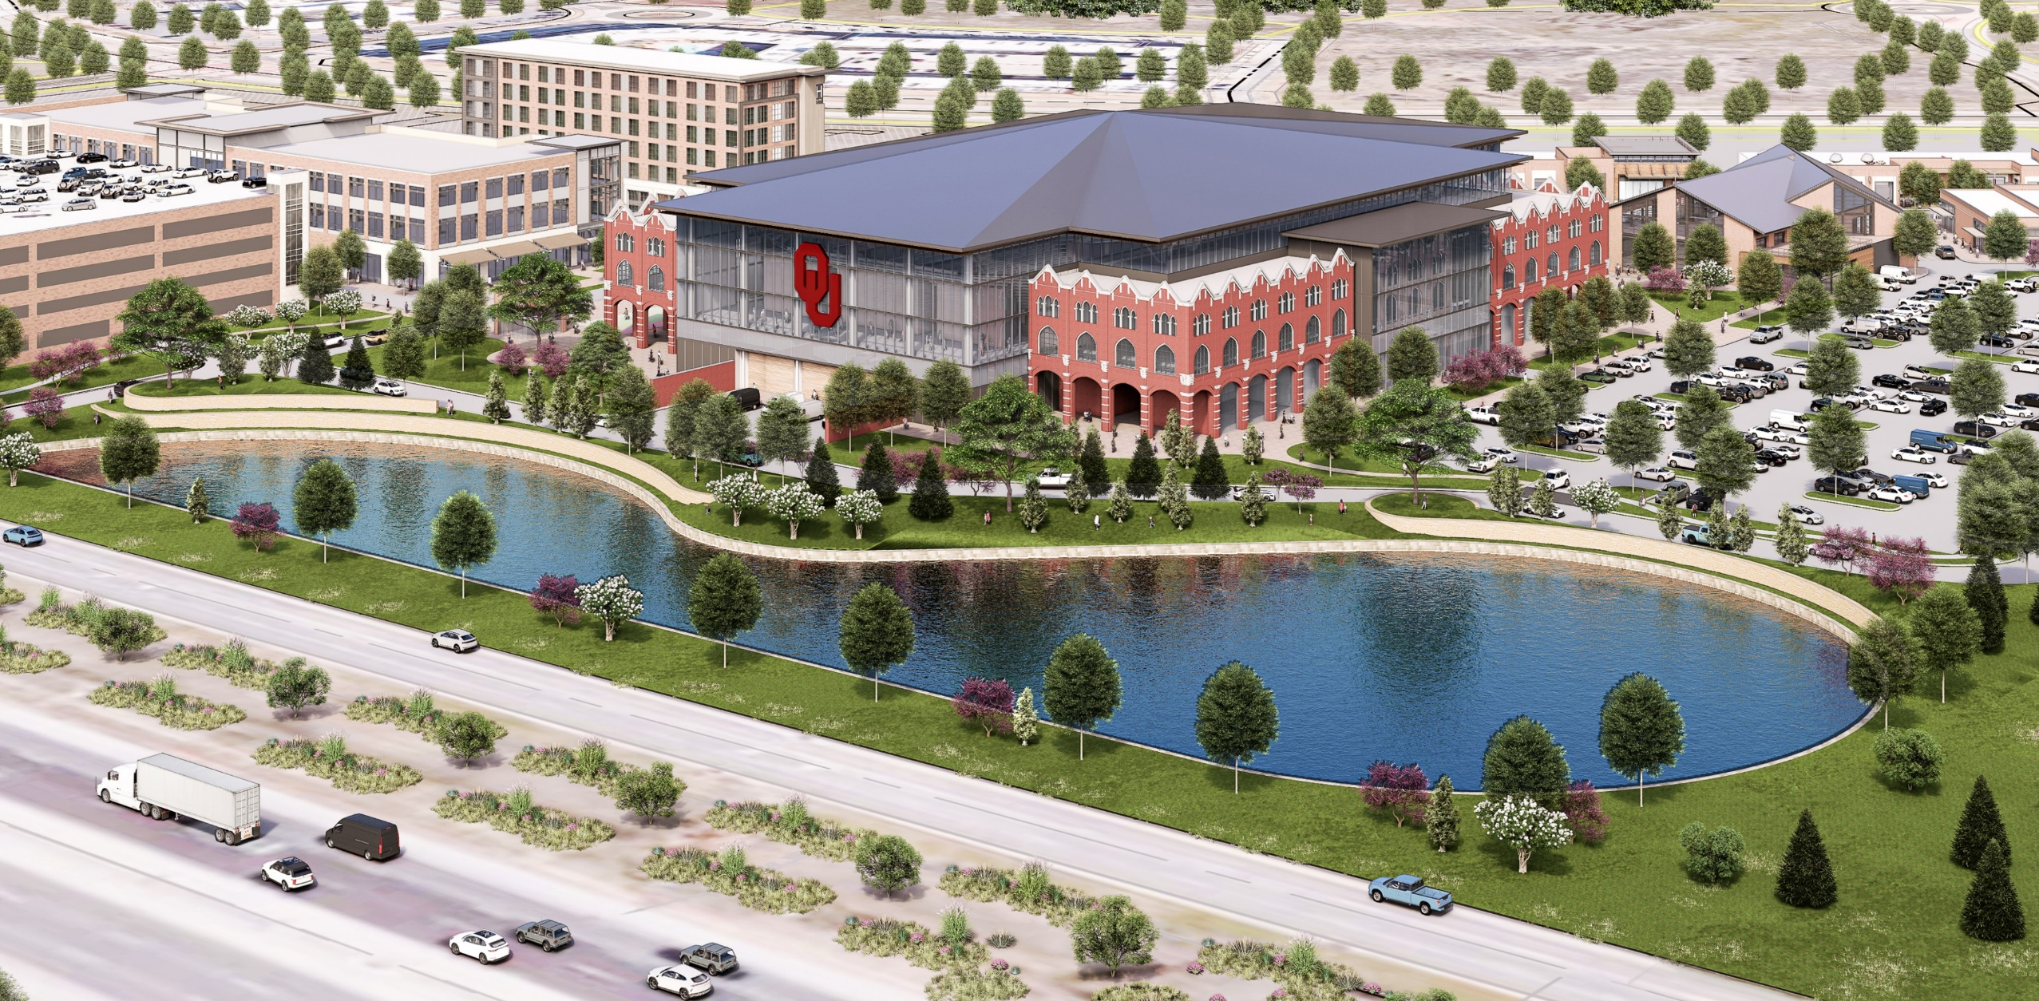
Mixed-Use Entertainment

Slide 18
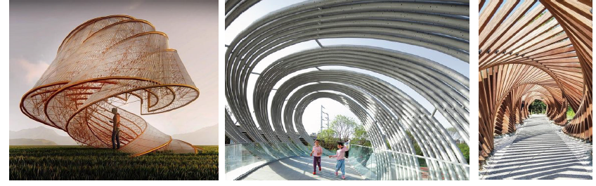

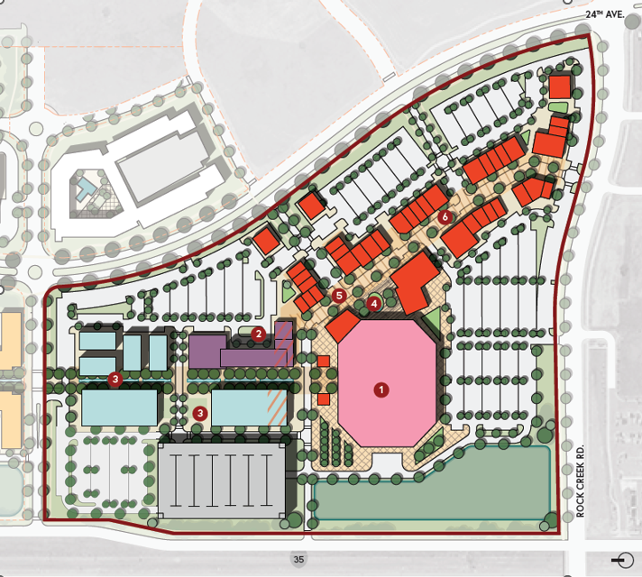

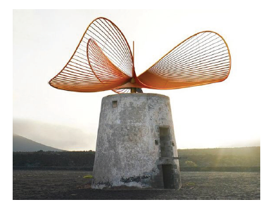

Public Art Concept
Overview:
The objective is to ideate and conceptualize a significant, engaging sculpture at the entrance of the University North Park Entertainment District. This project, seeking collaboration with Norman Arts Council, aims to honor the historical contributions of the Naval Airbase while celebrating the local community. This sculpture honors the WAVES program, which trained female World War II volunteers, including the Naval Air Technical Training Center in Norman, Oklahoma, crucial to aviation training from 1942 until 1959.
Proposed Concept Imagery:
Location:
Concept A Imagery for “WAVE”
Concept B Imagery for “Perpetual Propeller”
in collaboration with 25-100 local artists
Objective:
Historical Landmark
Memoriam to Naval Air Base
Local Artist Involvement
Connection to University of Oklahoma
Concept C Imagery
by Artist Vincent Leroy

Slide 19
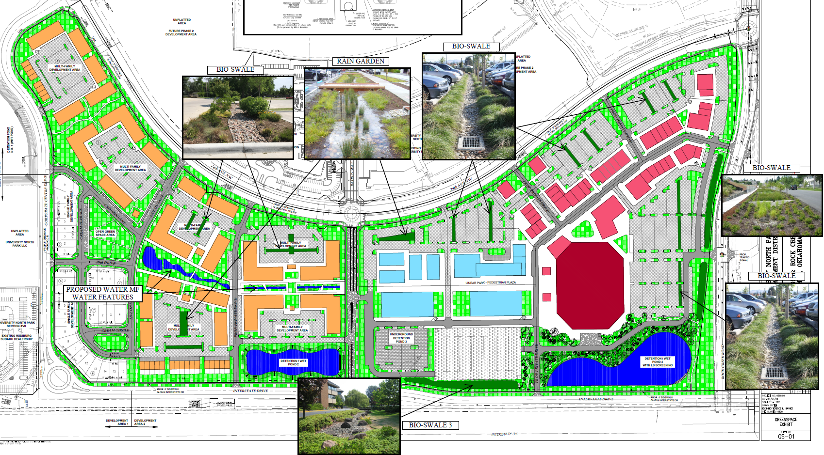
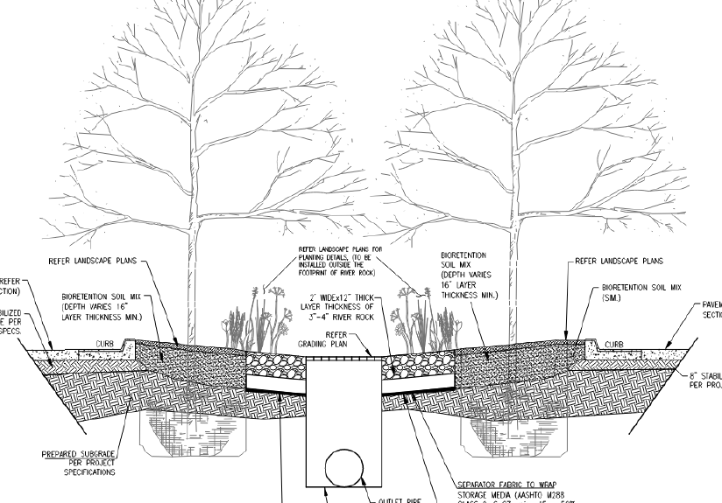
Storm Water Engineering, L.I.D., B.M.P

Slide 20
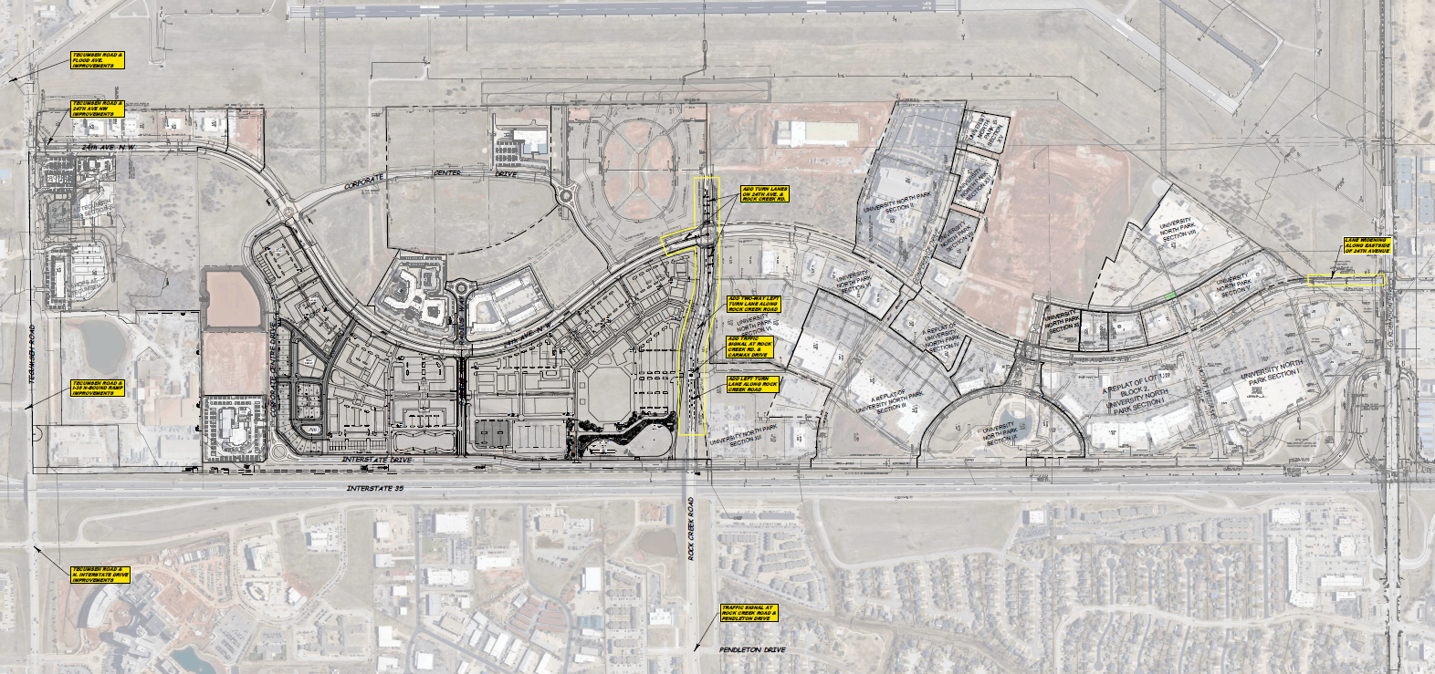


Traffic Engineering
STAFF: “No traffic operational issues are anticipated due to development assuming improvements are in place…”
Turn lanes
Turn lanes
Traffic light
Turn lanes
Traffic light

Slide 21
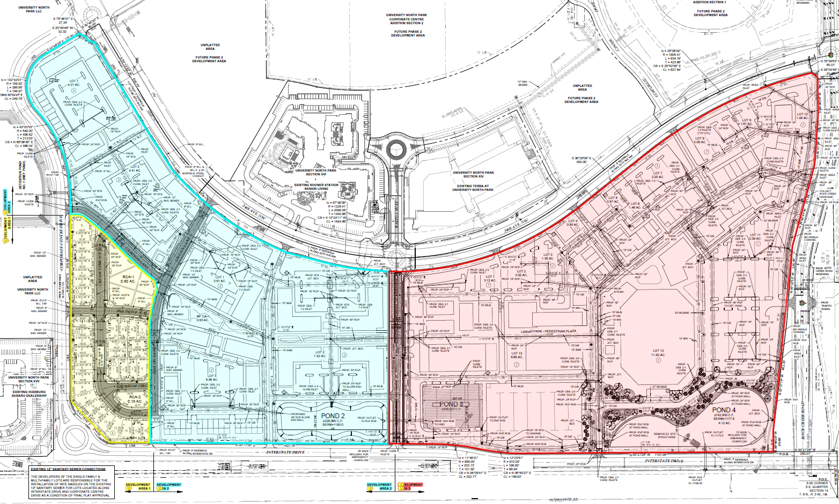
PUD Development Areas - Uses
Dev. Area 1
Urban
Residential
37 Units
ADU’s
Home Businesses
Dev. Area 2
High Density
Residential
758 Units, &
24 Townhomes
Ground floor small Commercial allowed
Dev. Area 3
Commercial

Slide 22
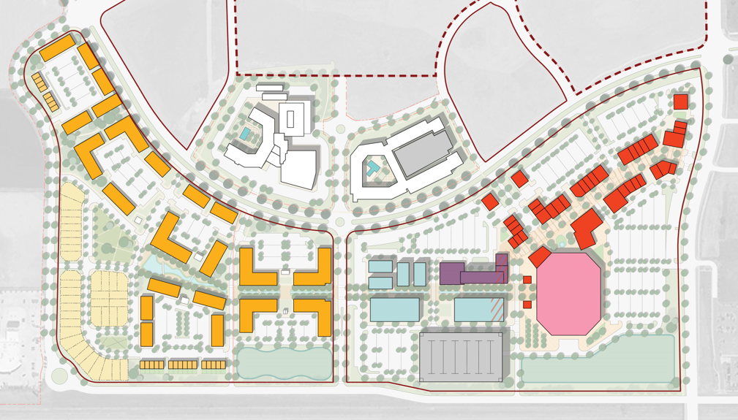
Development Phasing
PHASE 2
PHASE 3
PHASE 1

Slide 23
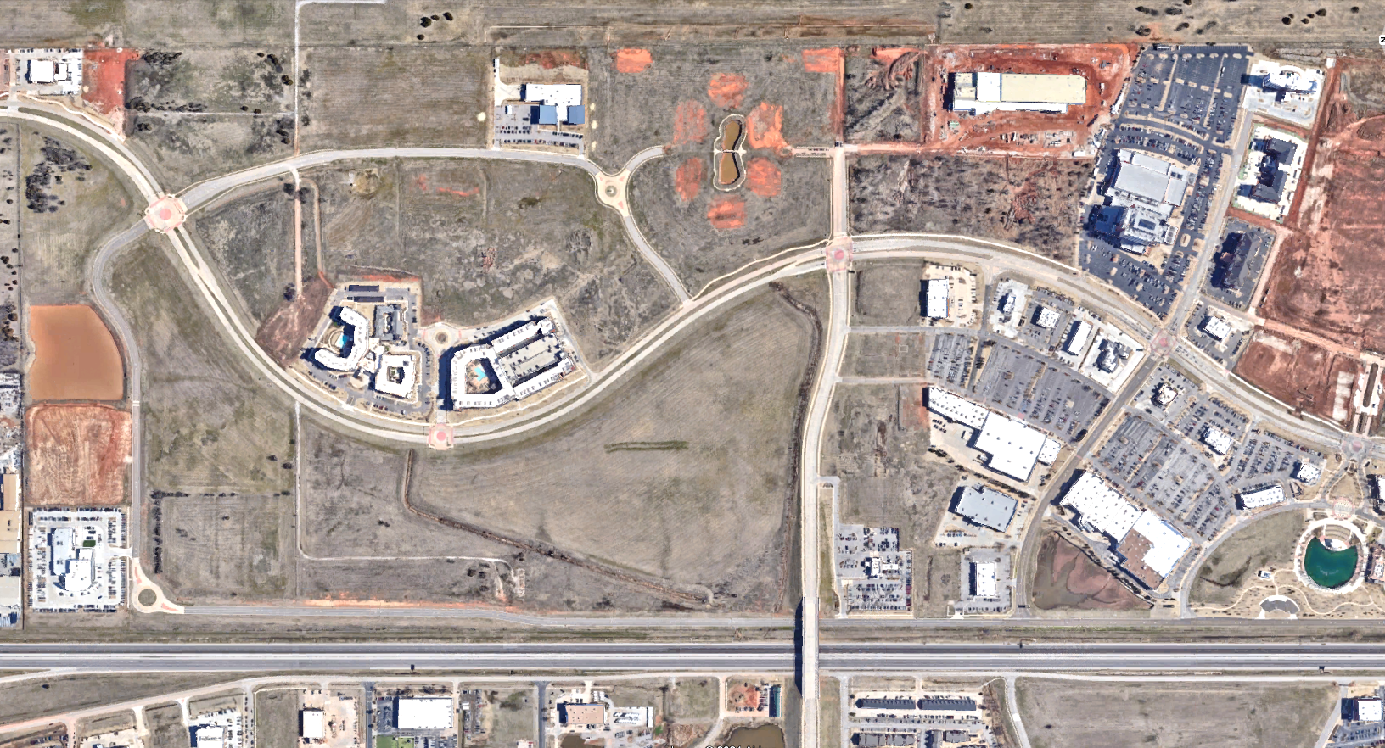


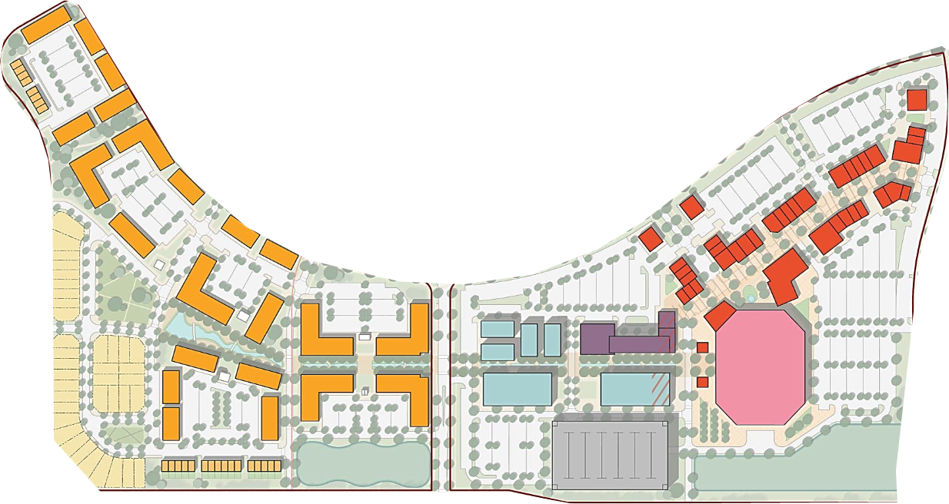




Site Plan in Context
24th Ave NW
24th Ave NW
Corporate Centre Dr
Rock Creek Rd

Slide 24
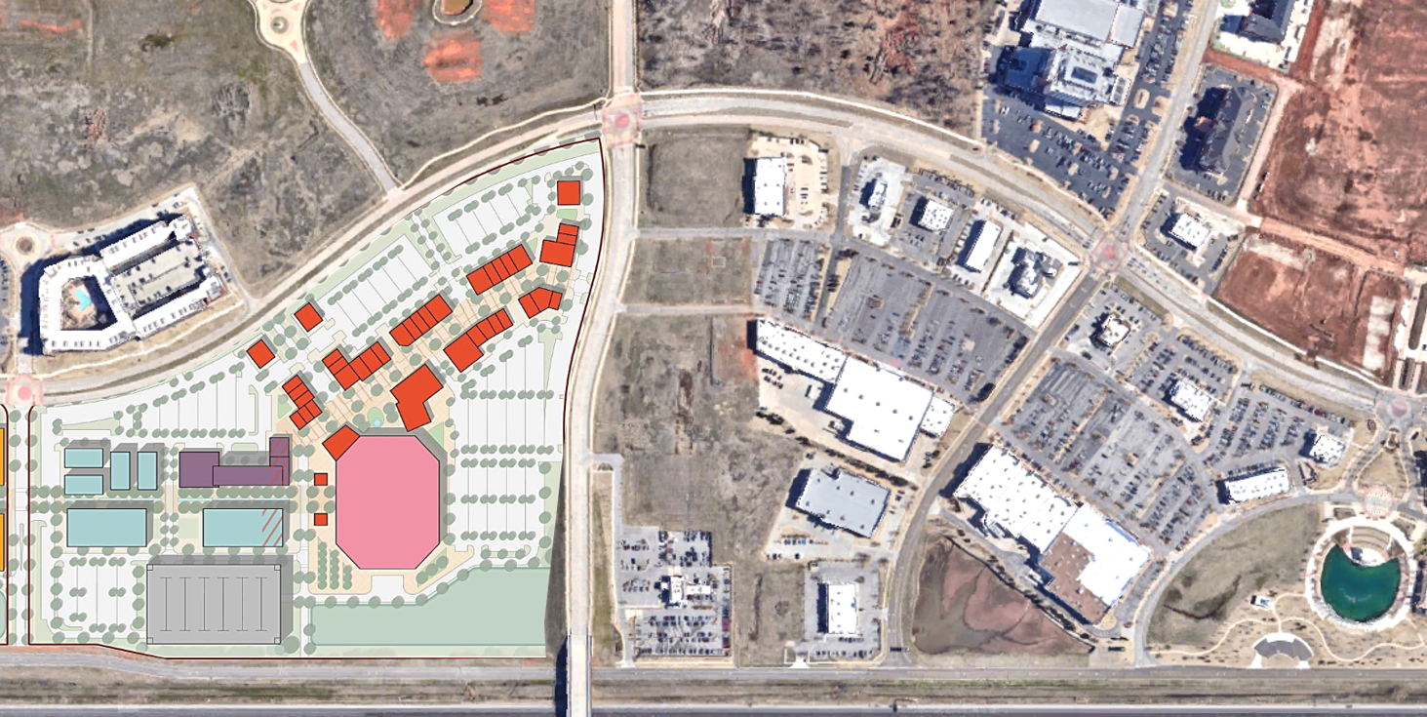
Parking
1,206 surface parking
retail/restaurant area
2,061 surface parking
retail/restaurant area
24th Ave NW
Rock Creek Rd
1,250

Slide 25
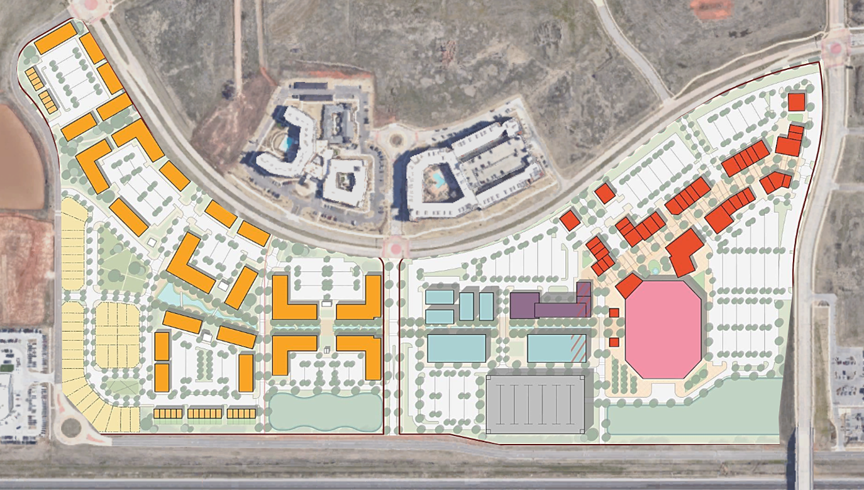
Walkability
24th Ave NW
Rock Creek Rd
0.6 Miles

Slide 26
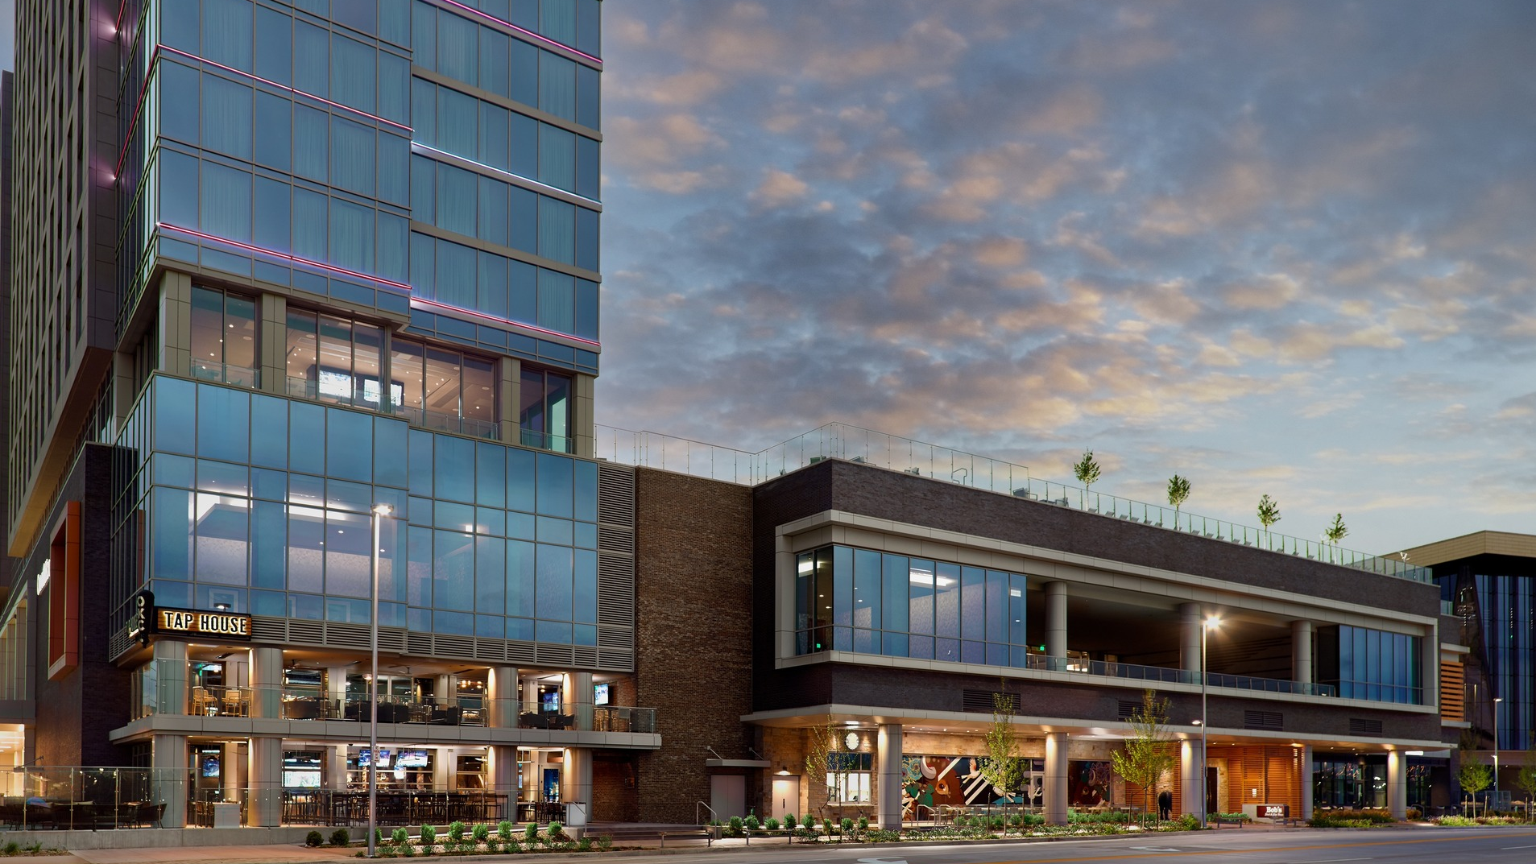
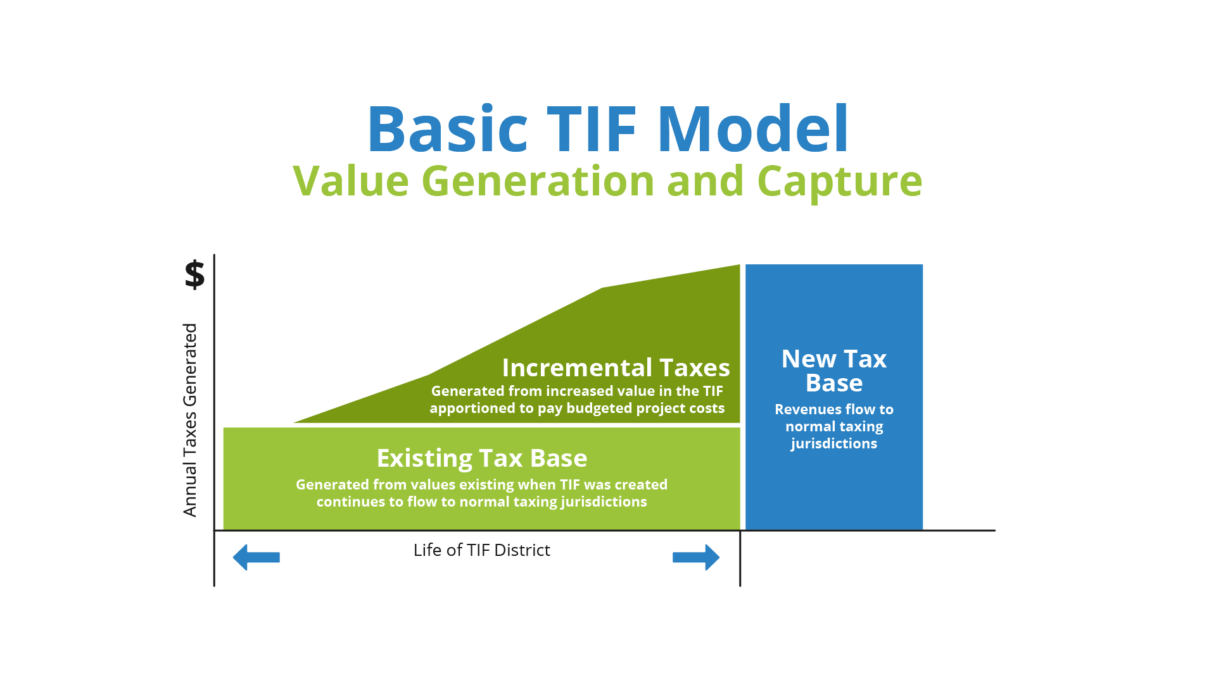

TAX INCREMENT FINANCE

Slide 27
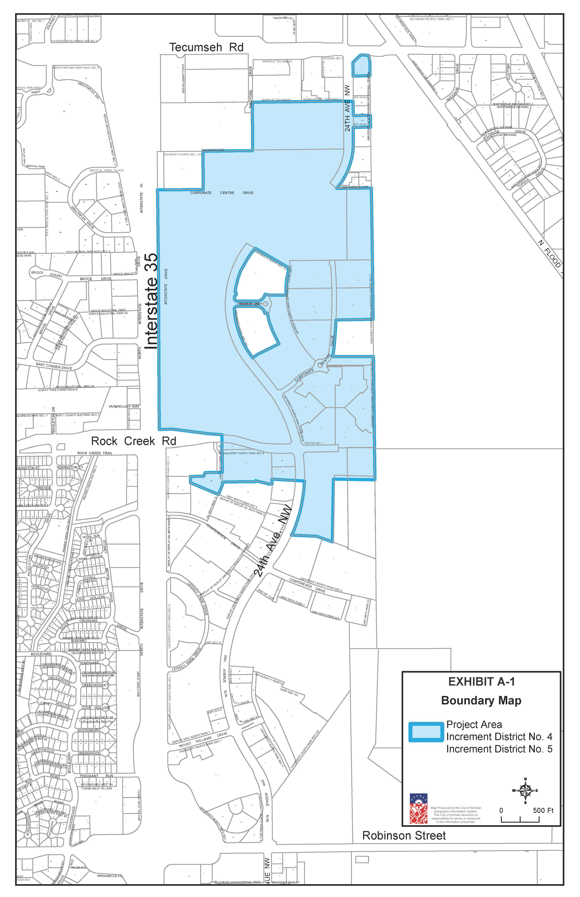
Proposed Rock Creek Entertainment District Project Plan

Slide 28
Authorized under Local Development Act and Oklahoma Constitution Art 10, Sec. 6C
Up to 25 years
Taxing jurisdictions are part of the process
Proposed Rock Creek Entertainment District Project Plan
Mixed-use Project previously discussed this evening:
  $1+ billion investment including residential, retail, office, commercial, arena, parking garage, and hotel, along with festival plaza and related public improvements
Proposed 2 TIF Districts for up to 25 fiscal years:
  Increment District 4: Sales Tax TIF district, collecting non-dedicated and capital improvements sales taxes (3%) generated by the Project starting 5/1/25
  Increment District 5: Property Tax TIF district, collecting 100% of ad valorem taxes generated by the Project starting 12/31/26
Authorized Project Costs up to $600 million, primarily assistance in development financing
Estimated total incremental tax revenues of $540 million, not including potential Leverage Act matching payments

Slide 29
Authorized under Local Development Act and Oklahoma Constitution Art 10, Sec. 6C
Up to 25 years
Taxing jurisdictions are part of the process
Proposed Rock Creek Entertainment District Project Plan
Objectives :
Retain or expand employment, attract major investment in the area, and reverse stagnation
Preserve and enhance the tax base
Stimulate private commitments to invest and reinvest in the area

Slide 30
Proposed Rock Creek Entertainment District Project Plan
What are the identified Project Costs?
Assistance in Development Financing—
  100% of incremental taxes generated annually in TIF 4 and TIF 5, less administrative costs, up to the lesser of (i) the amount necessary to finance $230 million in private development and public infrastructure costs or (ii) $600 million
  Leverage Act payments would contribute to the cap
  Would be provided through separate development agreement between developers, City, and Norman Tax Increment Finance Authority (“NTIFA”), obligating the Project’s development (anticipated to be considered concurrently with Project Plan)
  Intended to partially reimburse Project developers for costs incurred in construction of arena and parking garage components of the Project
  Developers would be responsible for all upfront costs and anything not reimbursed through TIF; neither the City nor NTIFA would issue any debt or make any revenue/collateral pledge to any Project financier
Administrative and Implementation—
  2% of TIF 5 increment, limited to $200,000 annually and $5 million total

Slide 31
Authorized under Local Development Act and Oklahoma Constitution Art 10, Sec. 6C
Up to 25 years
Taxing jurisdictions are part of the process
Proposed Rock Creek Entertainment District Project Plan
What are the projected TIF revenues?
Estimated $151 million in aggregate Sales Tax TIF revenues (TIF 4)
Estimated $389 million in aggregate Property Tax TIF revenues (TIF 5)
[Though not TIF revenues, Leverage Act payments of up to $151 million]

Slide 32
Authorized under Local Development Act and Oklahoma Constitution Art 10, Sec. 6C
Up to 25 years
Taxing jurisdictions are part of the process
Proposed Rock Creek Entertainment District Project Plan
Oversight of TIF Revenues
City will apportion TIF revenues pursuant to the Project Plan
  City Manager listed as person in charge of implementation
  City and/or NTIFA will approve public agreements with developer, as appropriate
Assistance in Development Financing for Developer
  Pursuant to an economic development agreement approved by City and/or NTIFA

Slide 33
Proposed Rock Creek Entertainment District Project Plan
Expected Impacts of Project:
(see Oklahoma Commerce Department and Hunden Partners Reports)
Impacts on Taxing Entities
  Increase in population/students and associated needs (capital infrastructure and service demands)
New office/commercial development will increase employment opportunities
Destination experiences will attract increased visitors to and recaptured spending within the City
Ancillary development outside of TIF districts may generate additional revenue and local Gross Domestic Product

Slide 34
Authorized under Local Development Act and Oklahoma Constitution Art 10, Sec. 6C
Up to 25 years
Taxing jurisdictions are part of the process
Proposed Rock Creek Entertainment District Project Plan
UNP TIF Citizen’s Oversight Committee Action:
Determine whether the proposed “material modification to the University North Park Master Plan” should be recommended to the City Council for approval;
Provide general recommendations to City Council regarding the proposed Rock Creek Entertainment District TIF Project Plan (see 10/2023 Letter)
OR Take No Action

