Slide 1
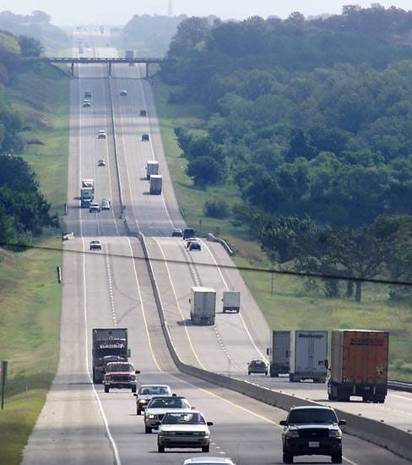
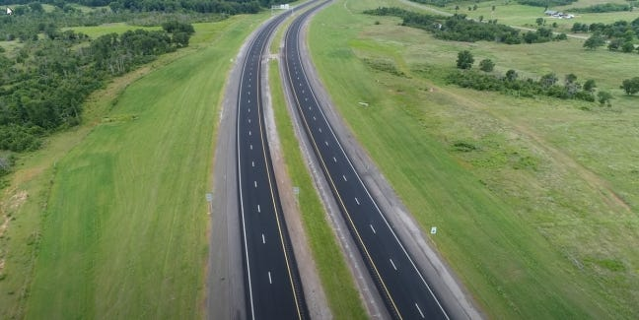
City of Norman OTA Resolution
City Council Study Session
July 30, 2024

Slide 2
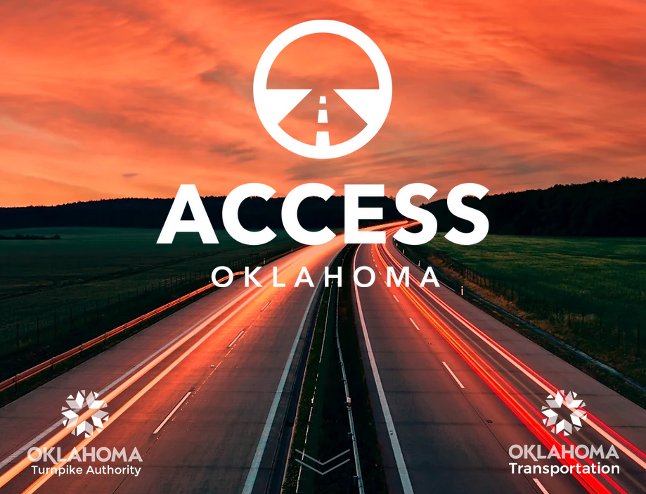
History of OTA
December 7, 2021 – OTA announces $5 Billion Access Oklahoma long range plan
Included alignment of turnpikes across north and east Norman
March 22, 2022 – Norman passes resolution opposing the turnpikes in Norman
June 9, 2022 – OTA resolution to authorize bonds for Access Oklahoma
August 9, 2022 - Council of Bond Oversight (COBO) gives conditional bond approval resolution pending court actions
September 6, 2022 – Norman files brief protesting legislative authorization of south extension
October 10, 2022 - Oklahoma Supreme Court assumed jurisdiction of OTA bond issuance application
August 1, 2023 - Oklahoma Supreme Court rules the OTA has statutory authority to build new turnpikes included in Access Oklahoma
All lawsuits have been concluded and the OTA is moving forward with Access Oklahoma

Slide 3
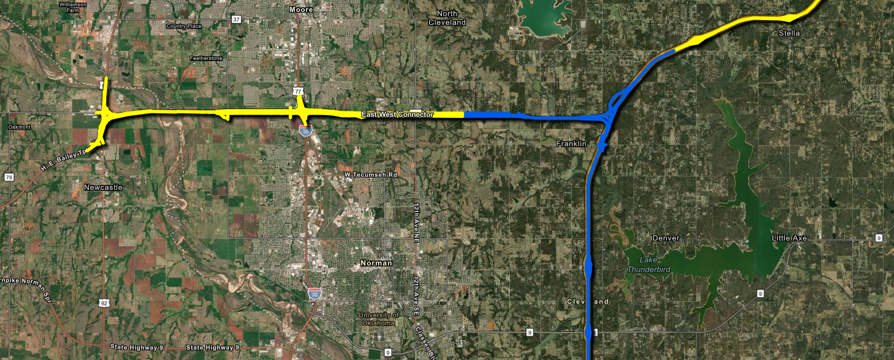
OTA Meeting with Staff
OTA requested a meeting with staff to discuss the Access Oklahoma in Norman
July 15, 2024 - Darrel Pyle, Shannon Stevenson and Scott Sturtz attended the meeting at OTA
Discussions included;
Current design for East West Connector (EWC)
Norman’s plans for roadways in the corridor
Norman’s requests to be incorporated into the turnpike design
Project status and timeline
Yellow is under design
Blue is future design

Slide 4
East-West Connector
Current Project
Design under way for 60% plans from I-44 to 24th Avenue NW
Drawings generated from www.Accessoklahoma.com
Norman City Limits
7000 foot bridge over the Canadian River and floodplain

Slide 5
East-West Connector – Phase 1
First Phase
Access points at
60th Avenue NW
36th Avenue NW
Norman is requesting
One-way frontage roads from 60th Avenue NW to end of project (ultimately built out to 48th Avenue NE)
10 foot multimodal trail on south side
36th Avenue NW constructed to current Norman design
Green infrastructure to protect water quality

Slide 6
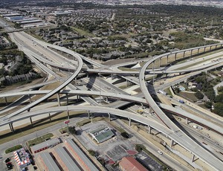
East-West Connector – Phase 1
5 levels at full build out
Will be completed in phases as traffic volume and construction phases dictate
Bridge east will extend to include train tracks and floodplain
George W. Bush Turnpike – Dallas, Texas

Slide 7
East-West Connector – Future Phases
Under design
Access points at
12th Avenue NW
12th Avenue NE
48th Avenue NE
Norman is requesting
One-way frontage roads from 24th Avenue NW to end of project (ultimately built out to 48th Avenue NE)
10 foot multimodal trail on south side
Green infrastructure to protect water quality

Slide 8
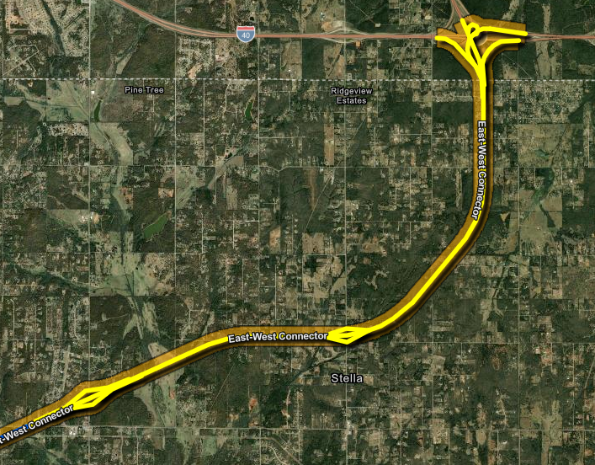
East-West Connector – Future Phases
Under design
Access points at
120th Avenue NE
156th Avenue NE
No frontage roads
Norman is requesting
Green infrastructure to protect water quality
Norman City Limits

Slide 9
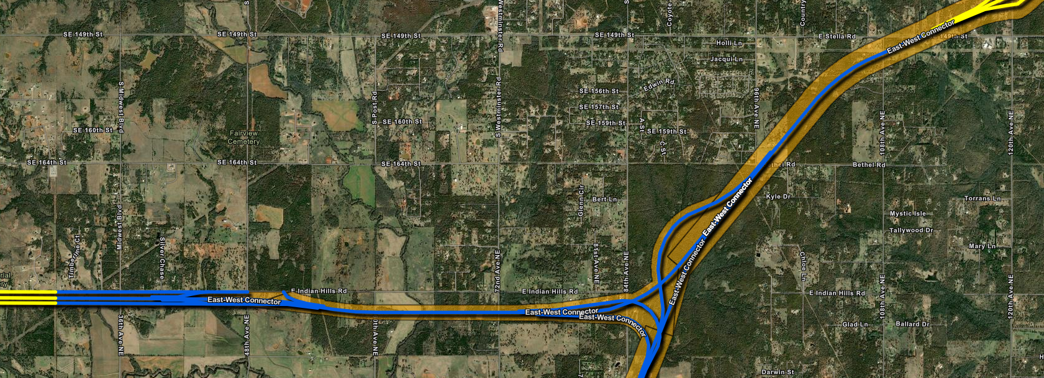
East-West Connector – Future Phases
Design to resume once alignment for South Extension Turnpike (SET) is determined
Norman City Limits

Slide 10
Current Timelines
Phase 1
Environmental studies underway for
Water bodies
Wetlands
Threatened and endangered species
Cultural resources (Historic and archaeological)
Fall 2024 - 60% Plans to be completed
Mid 2025 - Final plans
Late 2025 – Begin Construction
End of 2027 – Mainline open to traffic
No permits are required from Norman because this is all on State property
Future phases
Environmental studies start once design is underway for
Water bodies
Wetlands
Threatened and endangered species
Cultural resources (Historic and archaeological)
Early 2025 - 60% Plans to be completed
Early 2026 - Final plans
2025 - 2027 – Begin construction
End of 2030 – Mainline open to traffic to I-40
Begin SET once alignment is determined

Slide 11
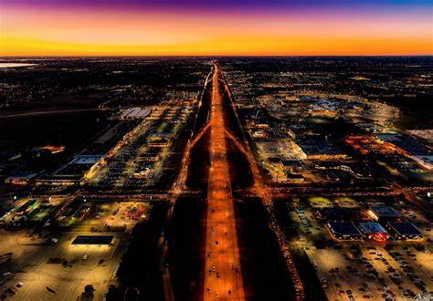
Norman Resolution
The OTA has requested a resolution be provided from the City of Norman
Indicates cooperation in process
Includes
Statement regarding water quality and coordination with COMCD
Green infrastructure to protect water quality
Locations of future interchanges on EWC
Addition of two-lane, one-way frontage roads from 60th Avenue NW to 48th Avenue NE
Requests assistance in construction of 36th Avenue NW
10 foot multimodal trail on south side of the turnpike
Affirms Norman’s partnership and cooperation in the development of the turnpikes
Adds language that the future SET will be coordinated between OTA and Norman
Kilpatrick Turnpike at night
Should Council not approve the resolution OTA funding for all of the items listed above may be jeopardized

Slide 12
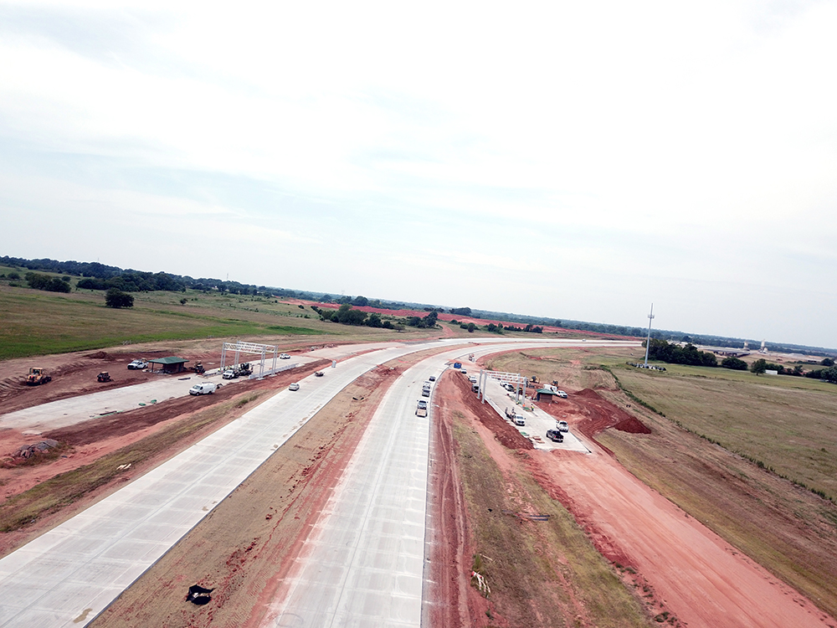
Council Next Steps
OTA is requesting the resolution by September 2, 2024, so that items can be incorporated into the plans
Staff can bring the resolution to Council on August 13, 2024 for consideration
Kilpatrick Turnpike under construction

Slide 13
Council Direction and Questions

