Slide 1
Gray Street Two-Way Project Update
August 1, 2024

Slide 2
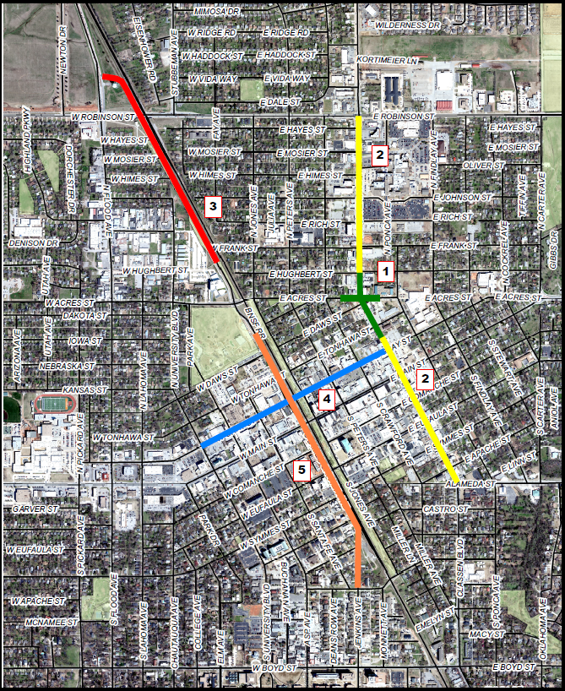
Downtown Projects
Porter Avenue and Acres Street Intersection (2019 Transportation Bond) (Complete)
Porter Avenue Streetscape (2019 Transportation Bond) (Completion August 2024)
James Garner Phase 2 (ODOT Bid Oct. 2022, Complete August 2024)
Gray Street Two-way (2019 Transportation Bond) (Begin Construction August 2024, Complete August 2024)
James Garner Phase 3 (2019 Transportation Bond)
Total City Investment - $21,900,000

Slide 3
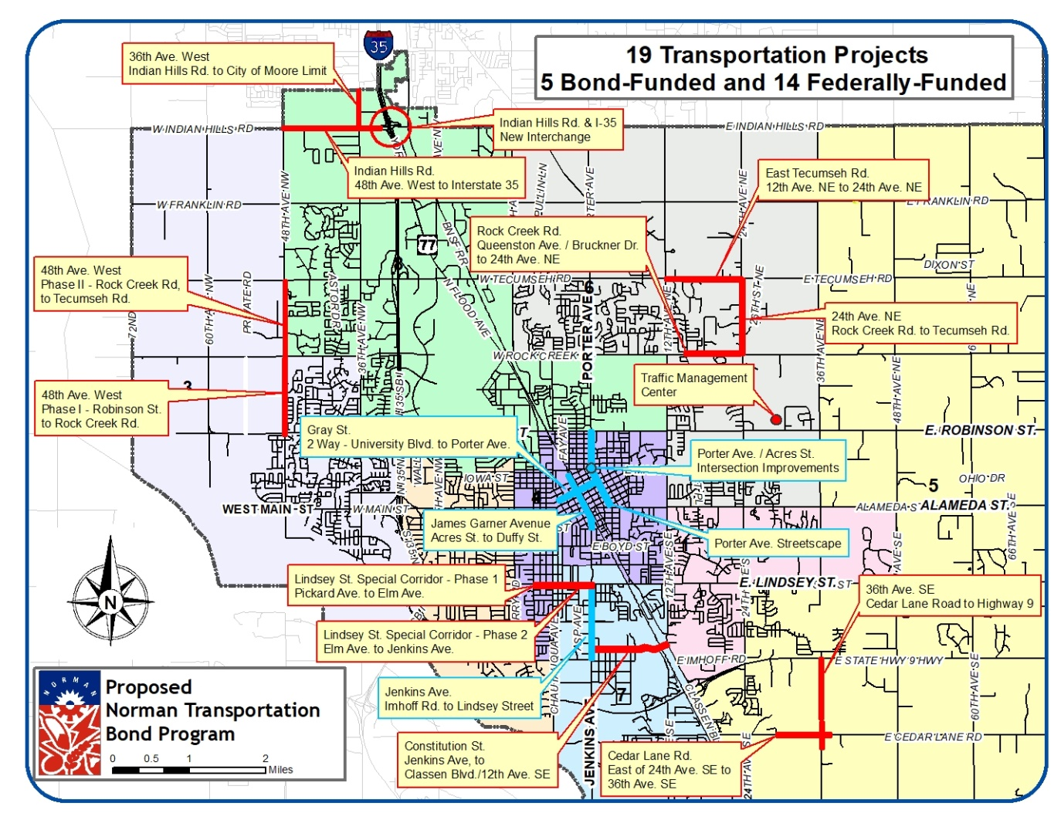
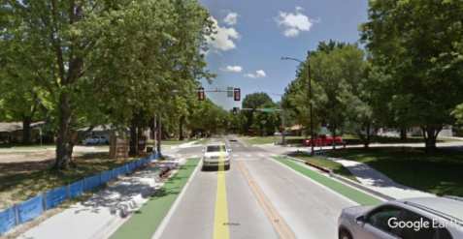
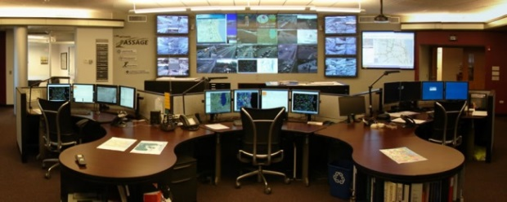
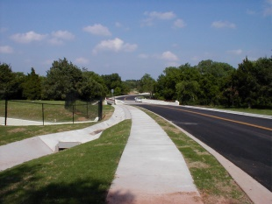
Projects Map

Slide 4
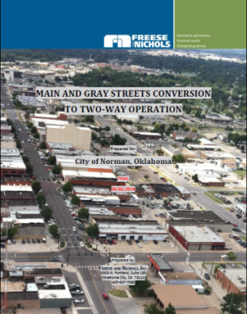
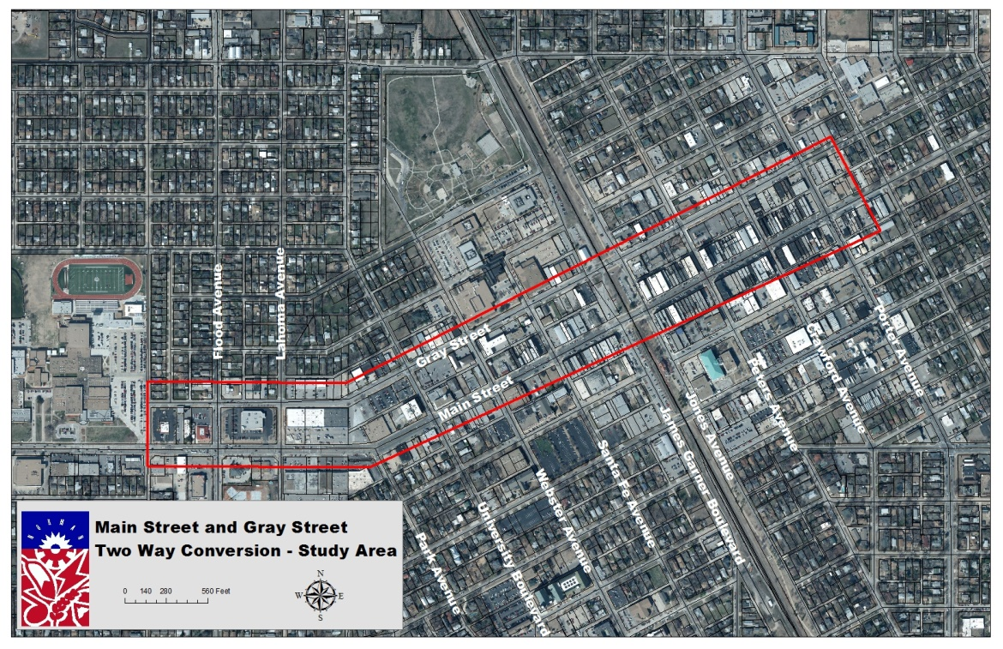
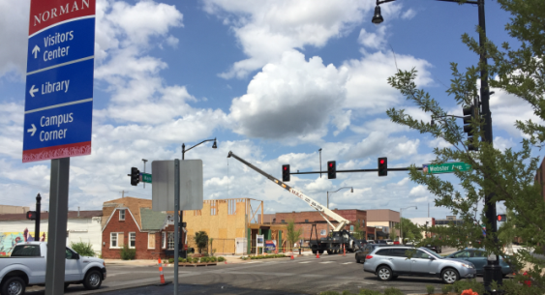
Project Details
Gray Street Two-Way Conversion
Scope
Traffic Signal Modifications
Intersection Widening
Four-Quadrant Gate Systems at Railroad Crossing
Restriping
Signage
Construction Cost (Federal Share) | Total Cost | Bond Cost
$0 | $5,300,000 | $5,300,000
Key Issues:
Preservation of Railroad Quiet Zone and traffic impact of James Garner Avenue connection to Flood Avenue
Key Stakeholder

Slide 5
Current
Gray Street Two-Way Conversion
Project Cost: $5,100,000
(Local: $2,834,147, Federal $2,265,853)
Scope
Traffic Signal Modifications
Intersection Widening
Railroad Crossing Improvement
Restriping
Signage
Reverse Angle Parking
Landscaped Islands
Begin Construction 2023
Complete Construction 2024
Key Issues:
Preservation of Railroad Quiet Zone and traffic impact of James Garner Avenue connection to Flood Avenue
Key Stakeholder

Slide 6
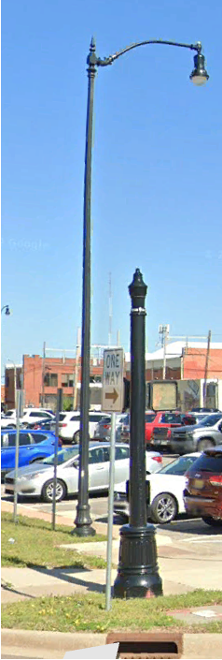
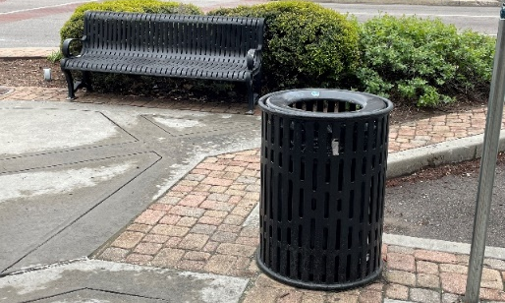
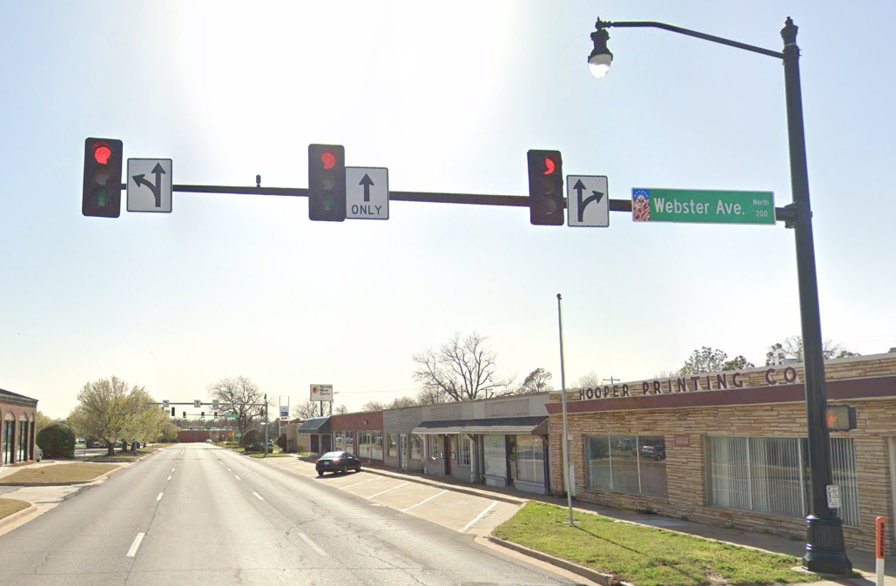
Gray Street Two-Way Conversion
During project design additional streetscape enhancements were added where budget and space allowed
Bulb outs at intersections where appropriate
Decorative intersections
Street trees
Landscaped intersections
Landscaped islands at the railroad crossing
Traffic access management
Eliminated several drives
Lighting
10 lights to remain on the decorative traffic signals (LED)
11 old lights to be removed
27 new LED light fixtures to be installed
Lighting power lines underground
Street furniture at selected locations
Benches
Trash cans

Slide 7
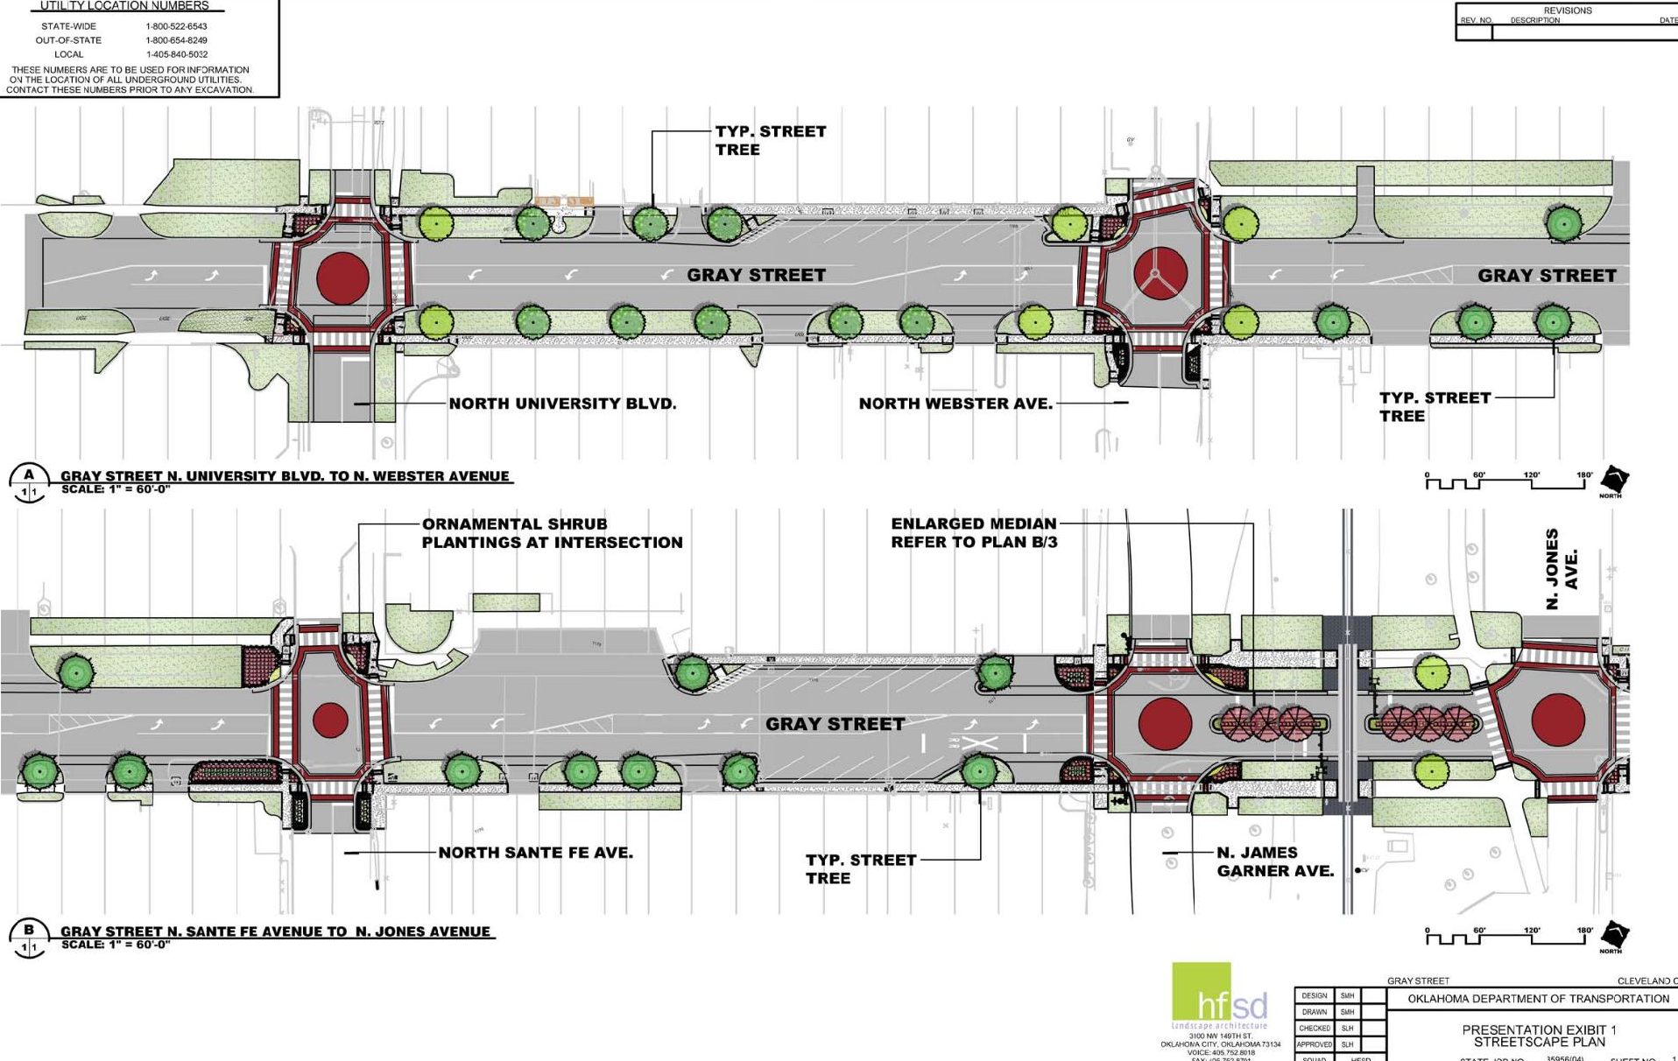
Gray Street Two-Way Conversion

Slide 8
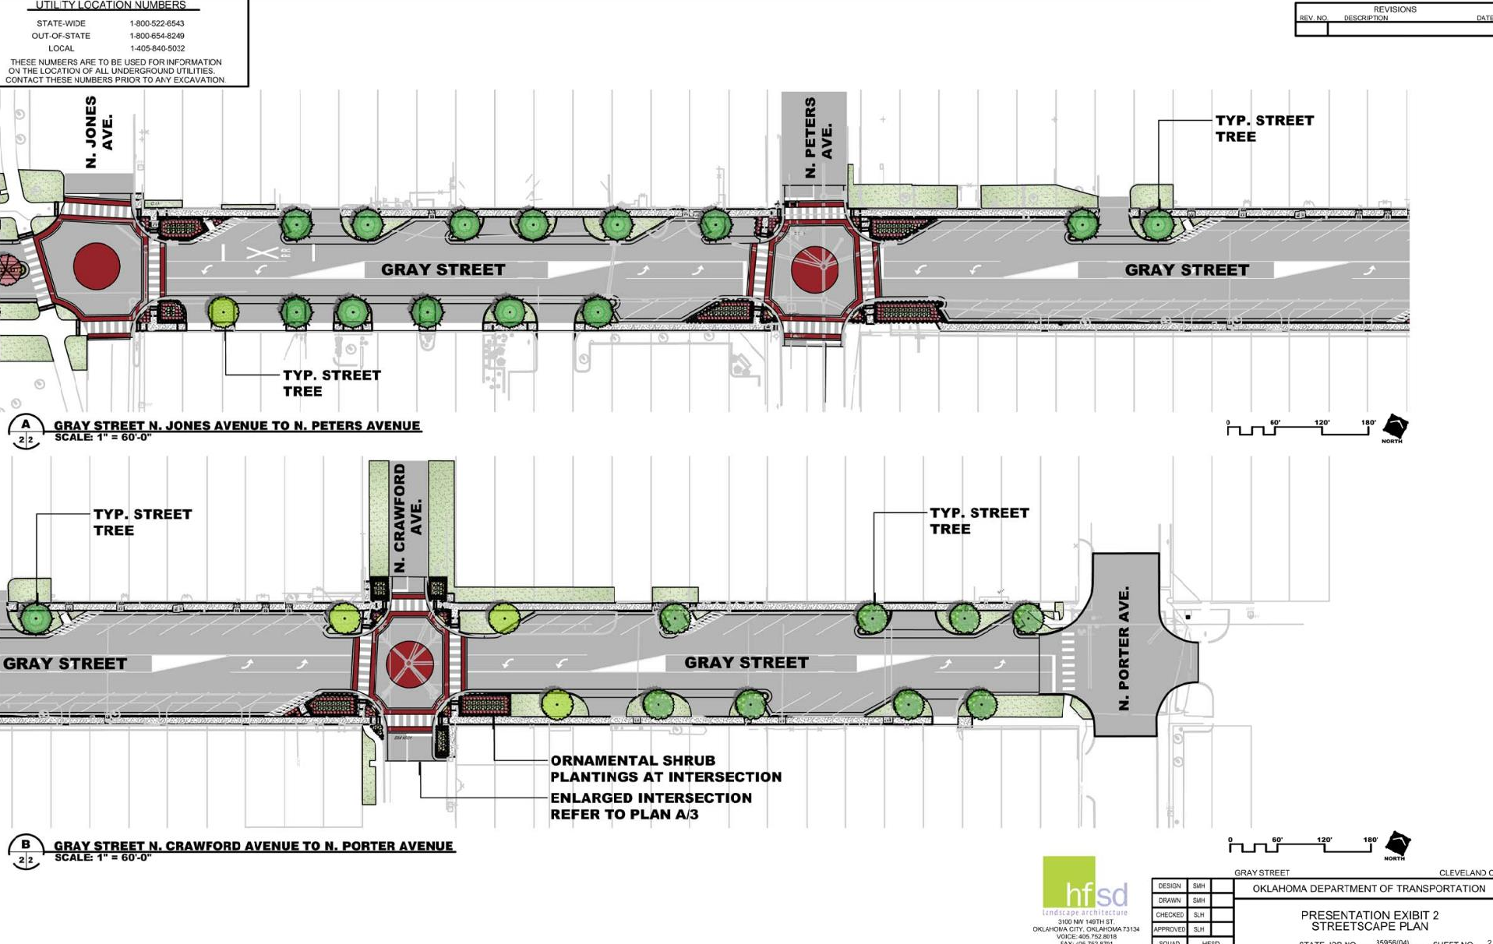
Gray Street Two-Way Conversion

Slide 9
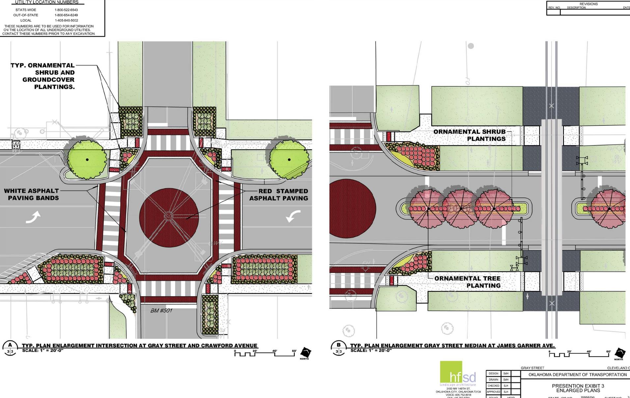
Gray Street Two-Way Conversion

Slide 10
Gray Street Two-Way Conversion
Community Coordination
Project plans near the Standard have been coordinated with owner (Cameron Brewer)
Project plans shared with multiple property owners (Adair, Worster, etc.)
Notifications sent to 33 property owners
Met with several to discuss scope of project
Staff presentations to Norman Downtowners
Information posted on “Normanstreets.com”
No negative comments received

Slide 11
Gray Street Two-Way Conversion
Project Schedule
August 5, 2024 - Start construction
August 2025 - Project completion

Slide 12
Questions?

